Slide 1
GW170817/GRB 170817A
Koutarou Kyutoku
High Energy Accelerator Research Organization (KEK), Institute of Particle and Nuclear Studies

Slide 2
GW170817/GRB 170817A/AT 2017gfo electromagnetic counterparts to binary neutron star mergers
Koutarou Kyutoku
High Energy Accelerator Research Organization (KEK), Institute of Particle and Nuclear Studies

Slide 3
GW170817/GRB 170817A/AT 2017gfo electromagnetic counterparts to binary neutron star mergers: where the short GRB has gone?
Koutarou Kyutoku
High Energy Accelerator Research Organization (KEK), Institute of Particle and Nuclear Studies

Slide 4
Contents
Introduction
Short gamma-ray burst (GRB 170817A)
r-process and kilonova/macronova (AT 2017gfo)
Some on neutron-star properties
Future prospect and Summary

Slide 5
1. Introduction

Slide 6
Neutron star binary coalescence
Gravitational waves
- test of the theory of gravitation in a non-vacuum
- high-density matter signature: equation of state
Formation of a hot massive remnant (star/disk)
- central engine of short gamma-ray bursts
Mass ejection of neutron-rich material
- r-process nucleosynthesis
- radioactively-driven “kilonova/macronova”

Slide 7
Electromagnetic counterpart
EM radiation will accompany neutron star mergers
localization
- host identification
- cosmological redshift
ejecta properties
- ejection mechanism
- r-process element
Berger (2014)

Slide 8
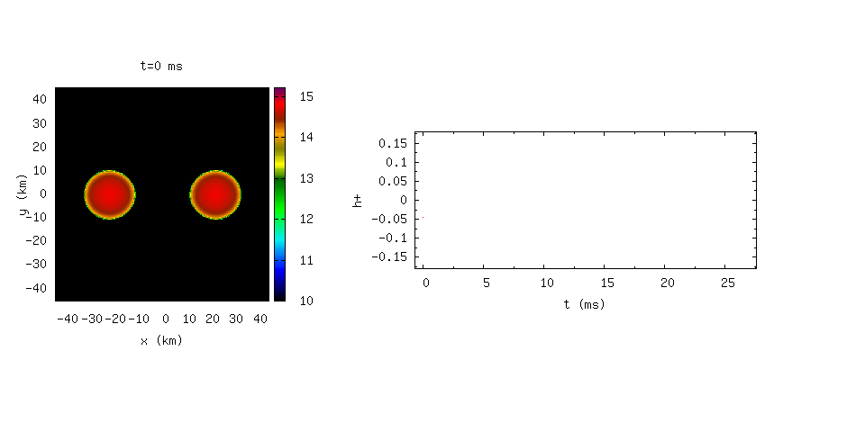

Example of the binary merger
A massive rotating star can be left after merger, and emit gravitational waves to collapse to a black hole
$\log{ρ}$ (g/cc)
(old) Movies by Kenta Hotokezaka
Based on Hotokezaka, KK+ (2011)

Slide 9
Merger dynamics of NS-NS
$$M_{\text{total}}<M_{\text{max}}$$
$$M_{\text{total}}<M_{\text{crit}}$$
Massive, hot NS
Stable NS
$M_{\text{total}}>M_{\text{crit}}$:
prompt collapse
(unlikely)
Hypermassive:
~100ms
Supramassive:
$M_{\text{total}}<M_{\text{rot}\text{,}\text{max}}$
~spin-down time
Small-mass disk
Large-mass disk
Small-mass disk?
[See e.g., Hotokezaka+KK+ (2013)]

Slide 10
2. Short gamma-ray burst (GRB 170817A)

Slide 11
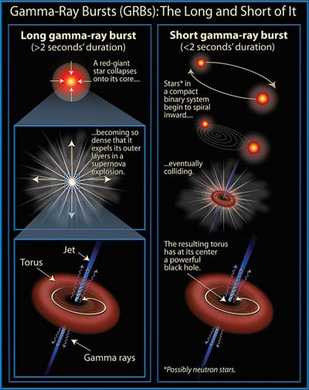

Short gamma-ray burst
About ${10}^{51}\text{erg}\text{/}\text{s}$ explosions
- the sun is $\sim 4×{10}^{33}\text{erg}\text{/}\text{s}$
Long-soft GRB: $≥2\text{s}$
deaths of massive stars
Short-hard: $≤2\text{s}$
neutron star binary merger?
rigorous confirmation needs
gravitational waves
http://www.daviddarling.info/images/gamma-ray_bursts.jpg

Slide 12
Time coincidence
LIGO,Virgo, Fermi
INTEGRAL (2017)
Fermi and INTEGRAL
agree each other
though relatively weak
The 1.7s delay from GWs
- jet launch
- jet propagation in
the ejected material
- onset of transparency

Slide 13
Scenario confirmation
Apparently, short gamma-ray burst (but not hard)
-> Binary neutron stars drive some short GRBs!
Goldstein+ (2017)
Hard spectrum
Duration of emission
Soft spectrum

Slide 14
Other high-energy emission
Mostly upper limit for >MeV gamma and neutrinos, and Fermi/LAT put an upper limit only at late times
Abdalla+ (2017)

Slide 15
South Atlantic Anomaly
Sensitivity is not good, LAT was not available
Fermi-LAT (2017)

Slide 16

Two component prompt emission
Goldstein+
(2017)
Main peak: $E_{p}≈185 \text{keV}$
Soft tail: $k_{B}T≈10 \text{keV}$
not necessarily “compact”
$Γ>2−3$ is sufficient
10-300keV
Main peak:
power law + exp. cutoff
Soft tail:
blackbody

Slide 17
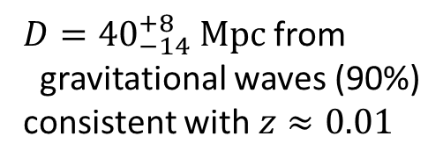
The closest short gamma-ray burst
Among the short GRBs with measured redshifts
Fong+ (2017)
$D={40}_{−14}^{+8} \text{Mpc}$ from
gravitational waves (90%)
consistent with $z≈0.01$

Slide 18

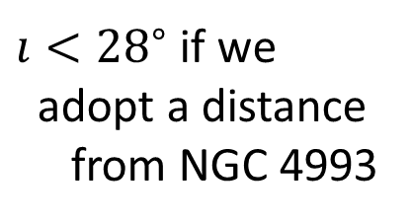

Distance-inclination degeneracy
$Δı<5^{∘}$ is possible with Virgo or KAGRA (Arun+ 2014)
LVC+ (2017)
see also Mandel (2017)
PDF from LVC: $ı<{55}^{∘}$
$ı<{28}^{∘}$ if we
adopt a distance
from NGC 4993
: proxy of the inverse distance here

Slide 19
Underluminous…
(isotropic-equivalent) luminosity of gamma-ray emission
Detection threshold vs redshift
Because this event was quite nearby,
the normal apparent luminosity
means the intrinsically low luminosity
LVC, Fermi, INTEGRAL (2017)

Slide 20
Off-axis? early X/radio afterglow
As of Oct 16, on-axis short GRBs were disfavored and an off-axis jet offered a natural interpretation
previous SGRB
likely on-axis
Troja+ (2017)
GRB 170817A
Multiband
explanation
Murguia-Berthier+ (2017)

Slide 21
But … 100-day radio observation
An ultra-relativistic top-hat jet seems to be rejected (though this “ruled out” may be a bit too strong)
Mooley+ (2017)

Slide 22
Cocoon with a chocked jet?
When a jet interact w/ ejecta (macronova/kilonova), the energy is dissipated and hot material breaks out
Prompt
emission
Mooley+ (2017)
Gottlieb+ (2017)
Main peak
Soft tail

Slide 23
Seemingly satisfactory
Blue kilonova/macronova may also be explained
If so, GRB 170817A was not a typical short GRB
Kasliwal+ (2017)
UV/optical/IR
Mooley+ (2017)

Slide 24
X-ray at 100days
Fully consistent with radio, i.e., no signature of a jet
Ruan+ (2017)
Optical observations are also ongoing

Slide 25
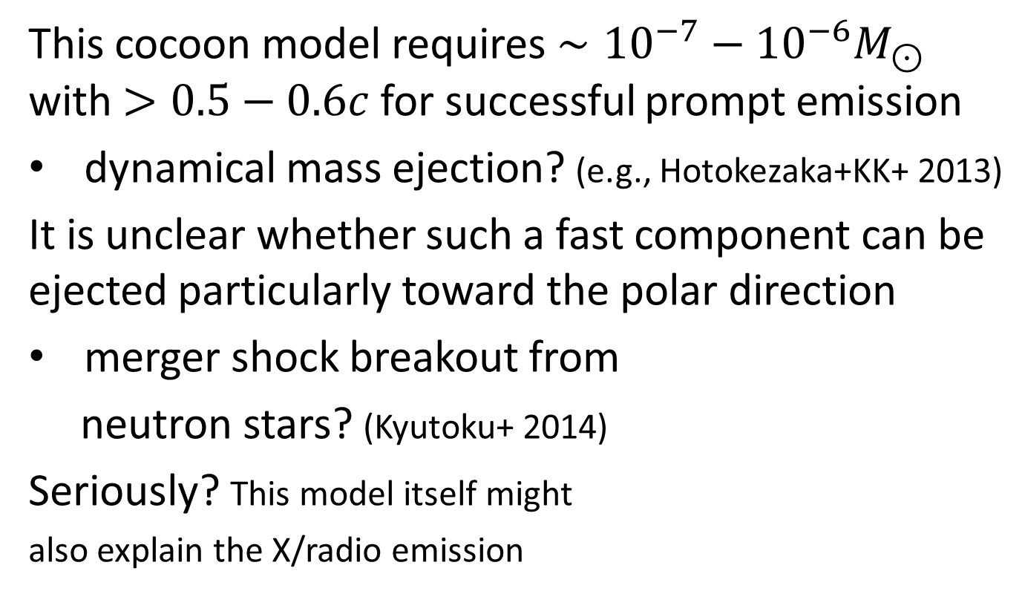
Prerequisite: very fast ejecta
This cocoon model requires $∼{10}^{−7}−{10}^{−6}M_{⊙}$ with $>0.5−0.6c$ for successful prompt emission
dynamical mass ejection? (e.g., Hotokezaka+KK+ 2013)
It is unclear whether such a fast component can be ejected particularly toward the polar direction
merger shock breakout from
neutron stars? (Kyutoku+ 2014)
Seriously? This model itself might
also explain the X/radio emission

Slide 26
Structured jet?
An ultra-relativistic jet is not necessarily ruled out (though a cocoon-like component is required)
Lazzati+ (2017)

Slide 27
Where is the short gamma-ray burst?
The gamma-ray emission of GRB 170817A may not be a subclass of ultra-relativistic short-hard GRBs
- simply an ultra-relativistic and structured jet?
- missing the jet due to a large observing angle?
- dependence of success on binary characteristics?
- black hole-neutron star binaries are true origins?
The whole picture requires much more statistics …
- long-term observations of this event is also useful

Slide 28
GeV-TeV gamma ray emission?
A central engine or late-time GRB activity may give us a chance of detecting ~100GeV gamma rays
Magnetar model on-axis SGRB
thick: 1GeV, thin: 100GeV
100GeV
Murase+ (2017)

Slide 29
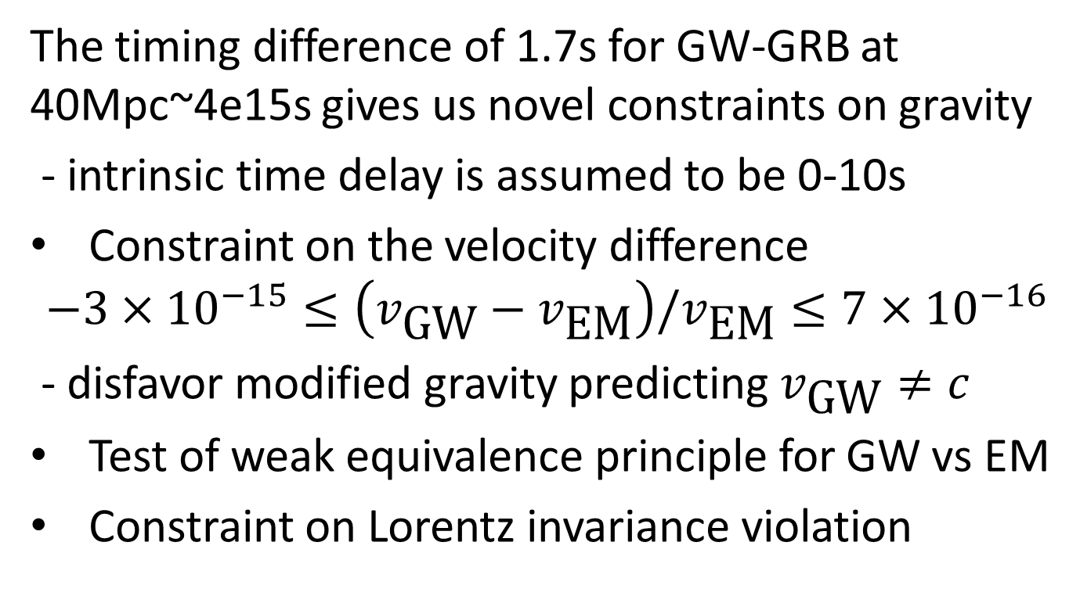
Implication to fundamental physics
The timing difference of 1.7s for GW-GRB at 40Mpc~4e15s gives us novel constraints on gravity
- intrinsic time delay is assumed to be 0-10s
Constraint on the velocity difference
$$−3×{10}^{−15}≤\left(v_{\text{GW}}−v_{\text{EM}}\right)/v_{\text{EM}}≤7×{10}^{−16}$$
- disfavor modified gravity predicting $v_{\text{GW}}≠c$
Test of weak equivalence principle for GW vs EM
Constraint on Lorentz invariance violation

Slide 30
3. r-process and kilonova/macronova (AT 2017gfo)

Slide 31
r-process nucleosynthesis
Synthesize heavy, neutron-rich elements (Au, Pt…)
r = rapid: neutron capture faster than beta decay
need very dense and
neutron-rich matter
supernova explosions
now seem to fail to
achieve r-process
Sneden+ (2008)

Slide 32
Mass ejection from binary mergers
Successful at least for some binary models
how can we confirm this idea?
Sekiguchi+KK+ (2015)
Wanajo+KK+ (2014)

Slide 33
Kilonova/macronova
Ejected material contain
radioactive r-elements
Their decay heat the ejecta
Thermal photons try to
diffuse from the ejecta
But r-elements efficiently
traps the photon inside
Characteristic “kilonova”!
Kisaka+ (2015)

Slide 34
AT 2017gfo
In general agreement with theoretical models
particularly in NIR
Compared to SNe
- small mass
- high velocity
- high opacity
- no time scale
of the heating
Tanaka+ (2017)
many other obs.

Slide 35
Uniqueness as an optical transient
Consistent (only) w/ kilo/macronova
featureless red spectrum
rapid dimming and reddening
Black (SSS17a=AT 2017gfo): this event
Colored: other known transients
red
bright
blue
dim
blue
red
Siebert+ (2017)

Slide 36
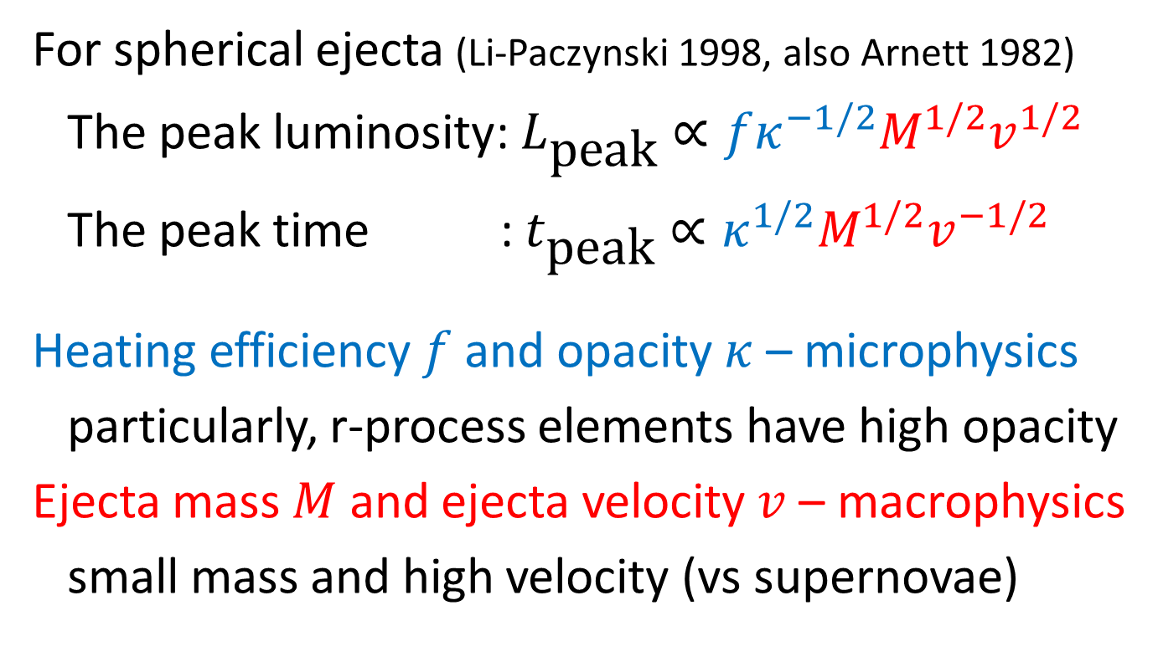
Kilonova/macronova characteristics
For spherical ejecta (Li-Paczynski 1998, also Arnett 1982)
The peak luminosity: $L_{\text{peak}}∝fκ^{−1/2}M^{1/2}v^{1/2}$
The peak time : $t_{\text{peak}}∝κ^{1/2}M^{1/2}v^{−1/2}$
Heating efficiency $f$ and opacity $κ$ – microphysics
particularly, r-process elements have high opacity
Ejecta mass $M$ and ejecta velocity $v$ – macrophysics
small mass and high velocity (vs supernovae)

Slide 37
Too many lines of lanthanides
A bunch of energy levels -> complex line structures
-> very frequent interaction -> very high opacity
Especially, lanthanides are very opaque to photons
Kasen+ (2013)

Slide 38
Two component?
lanthanide-free
intermediate
lanthanide-rich
Too bright at earlier epochs
Early lanthanide-free +
late lanthanide is very likely
Tanaka+ (2017)
Tanaka+ (2017)
lanthanide
actinide

Slide 39
Theoretical modeling
Likely fast light r-elements + slow heavy r-elements
- the latter may be dynamical ejecta or disk wind
- how the former is generated? under debate
Kasen+ (2017)
Shibata+KK+ (2017)

Slide 40
How to distinguish models?
Two-component? Dynamical or postmerger?
One (e.g., Waxman+ 2017)? Three (e.g., Villar et al. 2017)?
Spatial resolution by radio observations
Determine the postmerger remnant: BH vs NS
- GeV-TeV gamma rays could do (Murase+ 217)
More detections seems necessary anyway
Angular dependence of emission
Polarization (ND for this event: Covino+ 2017)

Slide 41
4. Some on neutron-star properties

Slide 42
Neutron star
Remnant of massive stars
(mass range is uncertain)
Mostly consists of neutrons
1.4 solar mass, ~10km
The density is higher than
nuclear saturation values
“a huge nucleus”
Arena for nuclear physics
Lattimer (2014)

Slide 43

Neutron-star matter
Cold, high-density, highly neutron-rich matter
also could be magnetized up to ~${10}^{17}\text{G} \left({10}^{13}\text{T}\right)$
Fukushima-Hatsuda (2011)
~density

Slide 44
Neutron star equation of state
Note: not need to observe the radius, and other quantities may be fine
We want to know the realistic equation of state, that uniquely determines the mass-radius relation
Equation of state: Nuclear physics
Mass-Radius relation: Astrophysics
Özel-Freire
(2016)
Özel-Freire (2016)

Slide 45
Maximum mass of neutron stars
Put a robust constraint on equation-of-state models
Generally,
emergence of
exotic particles
tend to reduce the
maximum mass
… not so preferred
observed maximum
Demorest+ (2010), see also Antoniadis+ (2013)

Slide 46
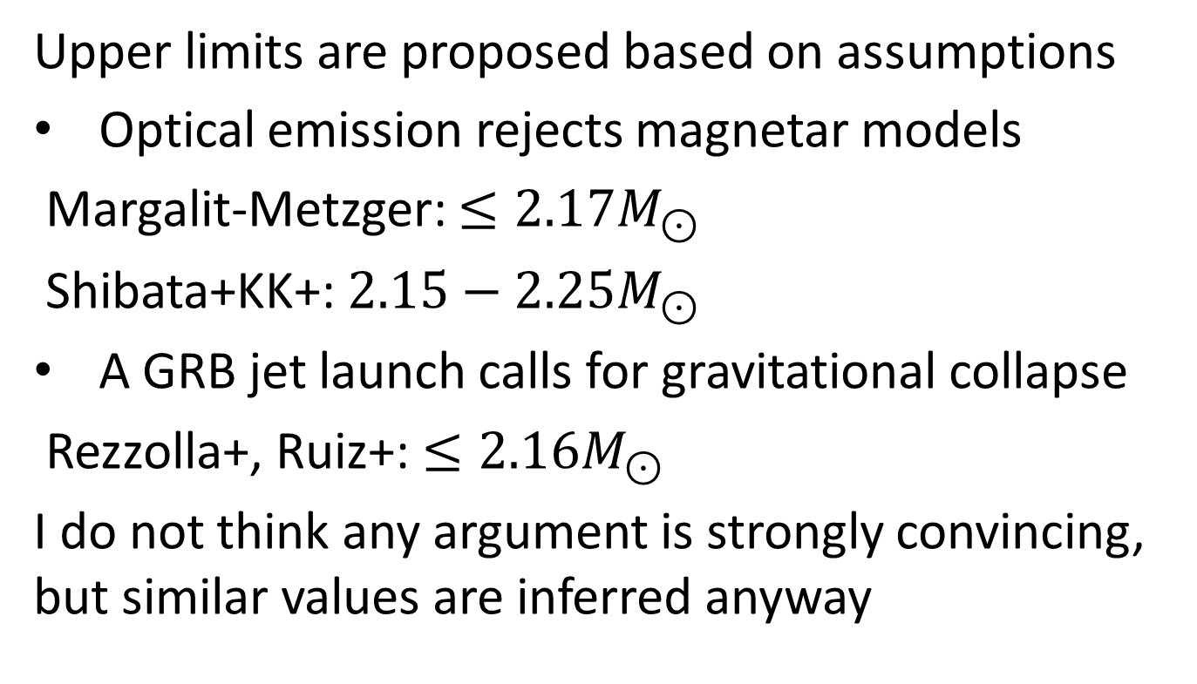
Maximum mass from GW170817
Upper limits are proposed based on assumptions
Optical emission rejects magnetar models
Margalit-Metzger: $≤2.17M_{⊙}$
Shibata+KK+: $2.15−2.25M_{⊙}$
A GRB jet launch calls for gravitational collapse
Rezzolla+, Ruiz+: $≤2.16M_{⊙}$
I do not think any argument is strongly convincing, but similar values are inferred anyway

Slide 47
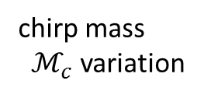
Constraints on parameters
The NS radius may be smaller than ~13-14km
- this can be made tighter with better waveforms
Blue: astro. realistic
Red: conservative
Mass ratio
variation
chirp mass
$ℳ_{c}$ variation
mass
tidal
deformability
BH-BH
LIGO&Virgo (2017)

Slide 48
Quadrupolar tidal deformability
Leading-order finite-size effect on orbital evolution (strongly correlated with the neutron-star radius)
$$Λ=Gλ{\left(\frac{c^{2}}{GM}\right)}^{5}=\frac{2}{3}k{\left(\frac{c^{2}R}{GM}\right)}^{5}∝R^{5}$$
$k\sim 0.1$: (second/electric) tidal Love number
External field
deformed
$$𝒬_{ij}=−λℰ_{ij}$$
$$𝒬_{ij}≡\int{ρ\left(x_{i}x_{j}−\frac{1}{3}x^{2}δ_{ij}\right)d^{3}x}$$
$$ℰ_{ij}≡\frac{∂^{2}Φ_{ext}}{∂x^{i}∂x^{j}}$$

Slide 49
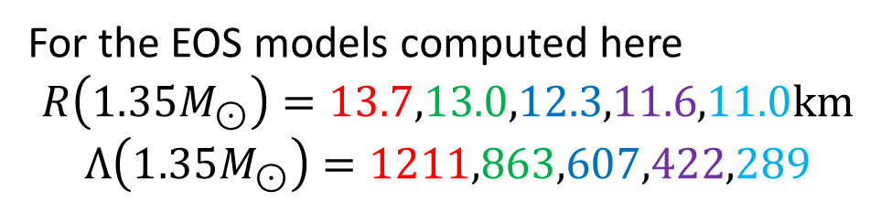
Representative example
Different EOSs predict different tidal deformabilities
For the EOS models computed here
$$R\left(1.35M_{⊙}\right)=13.7,13.0,12.3,11.6,11.0\text{km}$$
$$Λ\left(1.35M_{⊙}\right)=1211,863,607,422,289$$

Slide 50

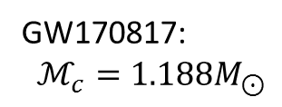

Tight correlation of $\tilde{Λ}−ℳ_{c}$
GW-measured $\tilde{Λ}$ is
tightly correlated
w/ the chirp mass
$Λ\left({M=2^{1/5}ℳ}_{c}\right)$ is
effectively constrained
>13km is not favored
Mass ratio
variation
GW170817:
$ℳ_{c}=1.188M_{⊙}$

Slide 51
5. Future prospect and summary

Slide 52
High-energy neutrino upper limit
No neutrino event with
time/space coincidence
No model is rejected
(except for on-axis ones)
Analyses by SK/KamLAND
are both ongoing
Albert+ (2017)

Slide 53
Why don’t you observe neutrinos?
I know it is a reckless attempt, but arXiv:1710.05922

Slide 54
Dark age of binary neutron star merger
What is ongoing in
the 1.7s delay between
gravitational waves
and gamma rays?
- black hole formation?
- magnetar?
Only neutrinos could be
possible messengers

Slide 55
Summary
A short GRB 170817A is detected simultaneously with GW170817, and binary neutron stars are confirmed to drive some short gamma-ray bursts.
GRB 170817A cannot be an off-axis top-hat jet, while both the cocoon and structured jet models seem to be consistent with observations.
The kilonova/macronova is generally consistent with theoretical models, but early blue emission requires explanations.

Slide 57
Appendix

Slide 58
Encoded physics
Remnant massive NS:
extreme temperature/density
Early inspiral: mass, spins…
Late inspiral and merger:
tidal deformation, NS EOS
(H/S)MNS
Ringdown: GR
Hotokezaka, KK+ (2011)

Slide 59


Gravitational-wave cosmology
Hubble’s constant is determined in a novel manner
CMB
Supernova
$$cz=v=H_{0}D$$
z: redshift from the host galaxy
D: distance from gravitational waves
$$H_{0}={70}_{−8}^{+12} \text{km} {\text{s}}^{−1} \text{Mp}{\text{c}}^{−1}$$
See also
Seto-Kyutoku (2017)
arXiv:1710.06424
LIGO&Virgo+ (2017)

Slide 60
Hubble tension?
GW-EM can examine this 3.4sigma~9% discrepancy
Freedman (2017) adapted from
Beaton+ (2016)

Slide 61
Localization
LIGO-Virgo three detectors did a good job this time
Interplanetary network
by Fermi and INTEGRAL
LIGO-Virgo skymap
Earth
Fermi/GBM
(n1,n2,n5 detectors)
Goldstein+ (2017)

Slide 62




Late rise due to relativistic beaming
Emission from relativistically moving material is concentrated (beamed) within an angle of $θ∼1/Γ$
Jet w/ $Γ$
Usual GRB observer
Observable throughout
Emission mechanism:
nonthermal synchrotron
$$θ∼1/Γ$$
Off-axis observer
Observable only after
the jet is decelerated to
$Γ<1/θ_{\text{obs}}$

Slide 63
Case of a magnetized jet
Similar emission may be expected even if the central engine was a massive remnant neutron star
Bromberg+ (2017)

Slide 64
Future prospect for the inclination
A distance measurement (3D localized) improves the localization accuracy by a factor of 2-3
L: LIGO Livingston, H: LIGO Hanford, V: Virgo
K: KAGRA, I: LIGO India BH-NS (NS-NS)@200Mpc
Arun+ (2014)

Slide 65
Rapid reddening of the spectrum
features are consistent w/
r-process element models
McCully+ (2017)
Chornock+ (2017)

Slide 66
Why two components?
The early spectrum is blue and featureless
The late spectrum is red and has a broad peak
Kasen+ (2017)

Slide 67
Theoretical understanding
Likely fast light r-elements + slow heavy r-elements
- “light” + “slow heavy” seems necessary to me
- but their “squeezed dynamical” seems to much…
Kasen+ (2017)

Slide 68
Kyoto numerical-relativity group
A moderately large maximum-mass of neutron stars
-> long-lived remnant massive neutron stars
-> strong neutrino irradiation
-> light r-elements
-> blue kilonova!
Remnant’s lifetime
our model: >1s
Kasen’s model: <10ms
Shibata+KK+ (2017)

Slide 69
Heavy-element lines?
If true, this is a genuine proof of ongoing r-process
Smartt+ (2017)

Slide 70
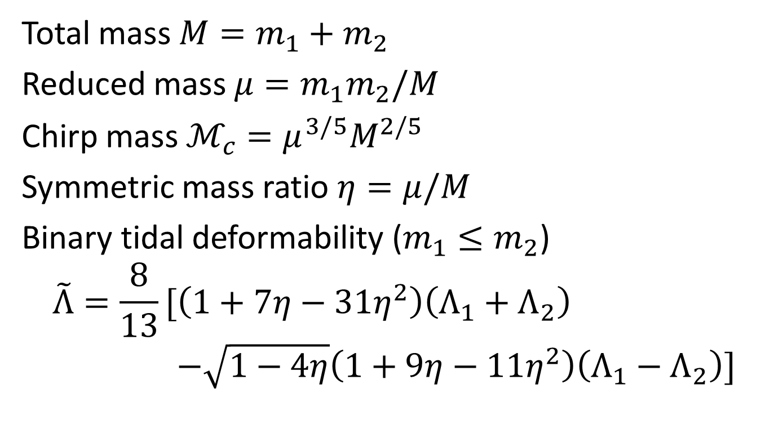
Definition of parameters
Total mass $M=m_{1}+m_{2}$
Reduced mass $μ=m_{1}m_{2}/M$
Chirp mass $ℳ_{c}=μ^{3/5}M^{2/5}$
Symmetric mass ratio $η=μ/M$
Binary tidal deformability ($m_{1}≤m_{2}$)
$$\tilde{Λ}=\frac{8}{13}[\left(1+7η−31η^{2}\right)\left(Λ_{1}+Λ_{2}\right)$$
$$−\sqrt{1−4η}\left(1+9η−11η^{2}\right)\left(Λ_{1}−Λ_{2}\right)]$$

