Slide 1
High Energy Neutrinos and Gamma Rays from the Galactic Center
Haoning He(RIKEN)
Collaborators：Herman Lee, Nagataki Shigehiro, Alexander Kusenko
2016.12

Slide 2
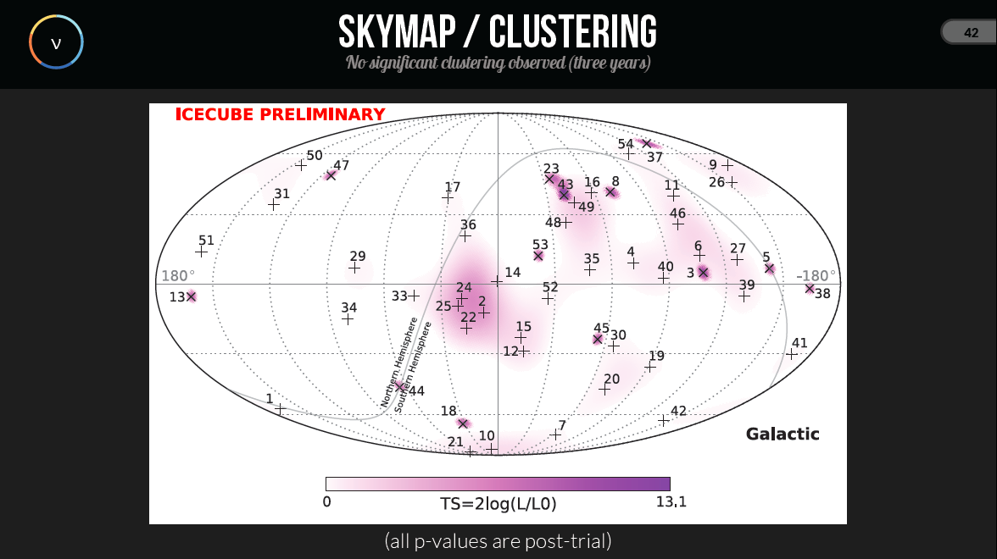

Slide 3
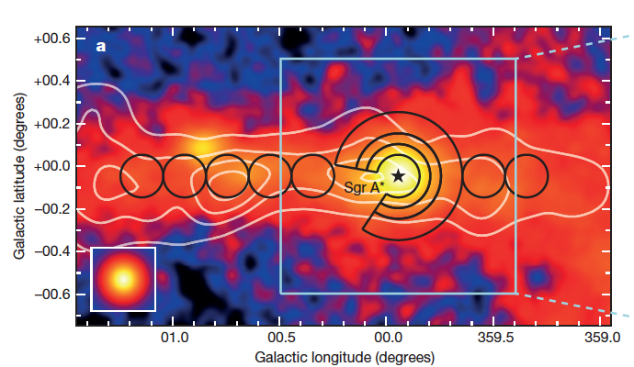
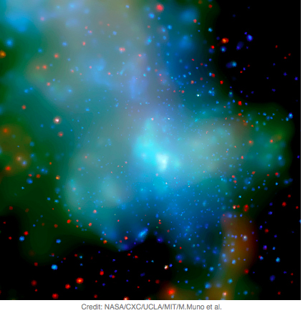
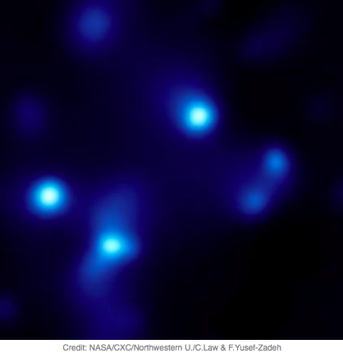
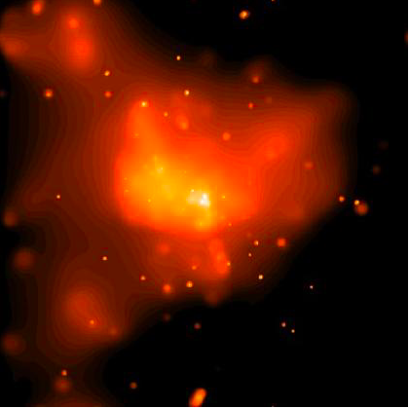
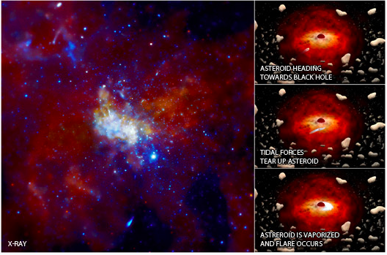
Galactic Center Objects
Dense Gas
TeV Galactic Ridge
Stellar Clusters
Sgr A East SNR
Supermassive black hole
Sagittarius A*

Slide 4
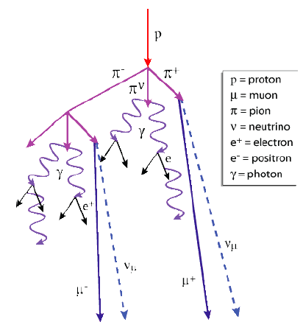
Two conditions to produce Neutrinos
in the Galactic Center (pp collision)
Accelerators:
Supernova/Hypernova Remnant
Supermassive black hole
Tidal disruption event
…
2. Dense environment
Notes:
The possible sources I studied are astrophysics sources. Theoritically, there are two general ways to produce very high energy neutrinos for astrophysics sources.
One way is the ,the other way is
Both of these two procedures producing high energy neutrinos, require the very high energy protons/nuclei.

Slide 5
Hypernova Rate in the Galactic Center
Dense environment in the GC
High star-formation rate
0.05 per century in the region of radius ~250 pc and height ~50 pc
High supernova rate
1%
S. Schanne et al.2006
High hypernova rate
1 per 200,000 years
Cappelaro et al. 1999
Guetta& Della Valle, 2007

Slide 6
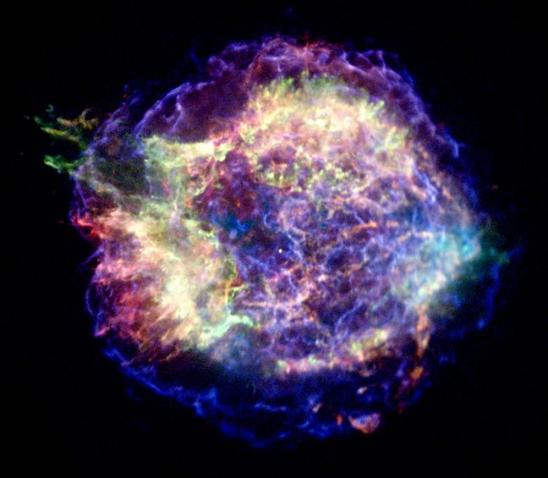

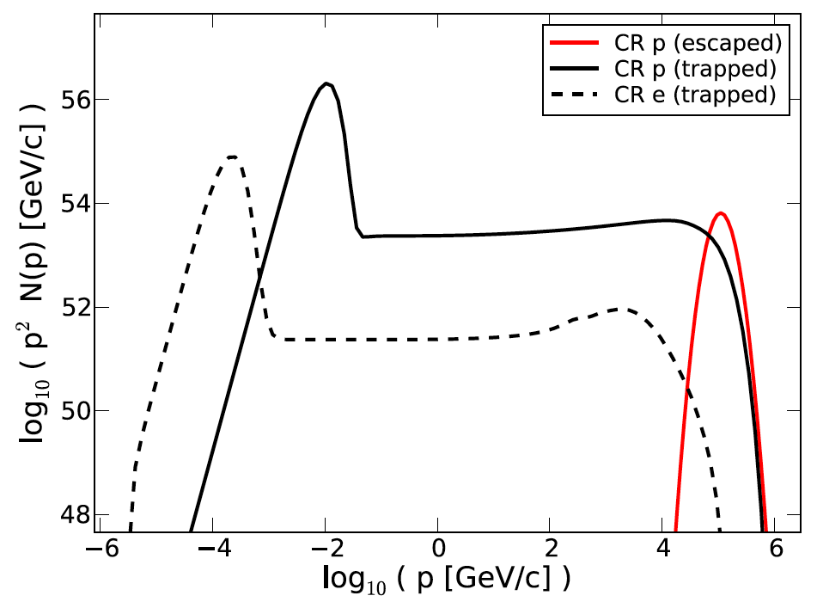
Non-linear Diffusive Shock Acceleration in SNR/HNR
S.H. Lee
(RIKEN→ JAXA)
Lee, Ellison & Nagataki (2012)
Accelerated but trapped protons
Escaped
protons
p
e-
pmax
10 TeV-1PeV

Slide 7
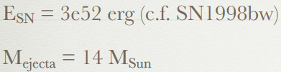
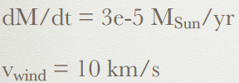
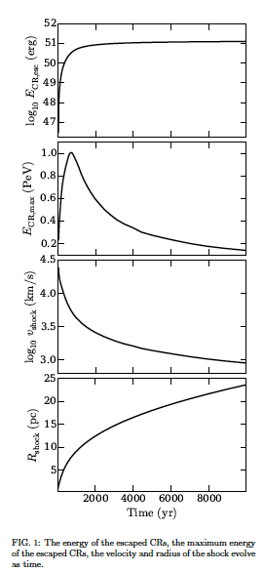
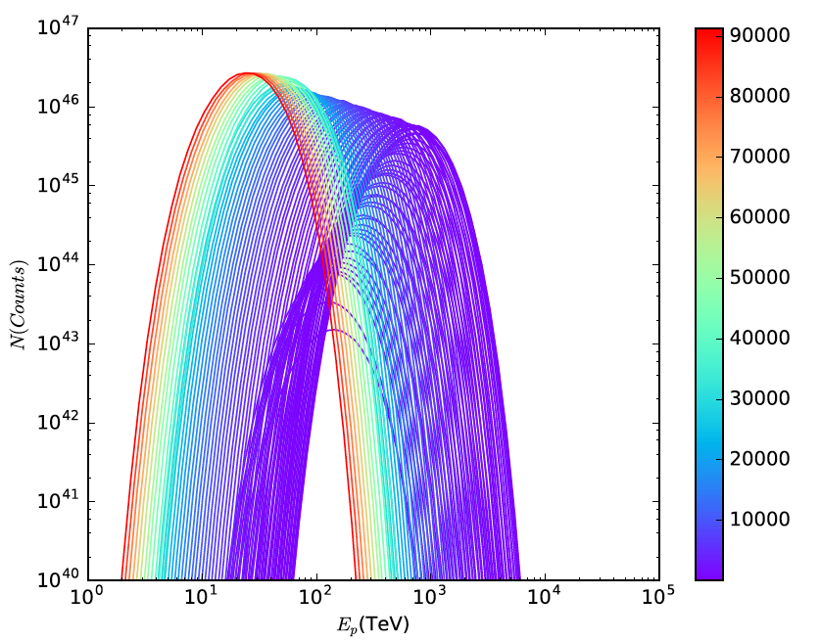
Continuous Escaping protons from a HNR of ~1e5 years old
Escaping proton spectra for each time bin
10TeV(100kyr)
PeV(1000yr)
Escaping time
(Year)

Slide 8


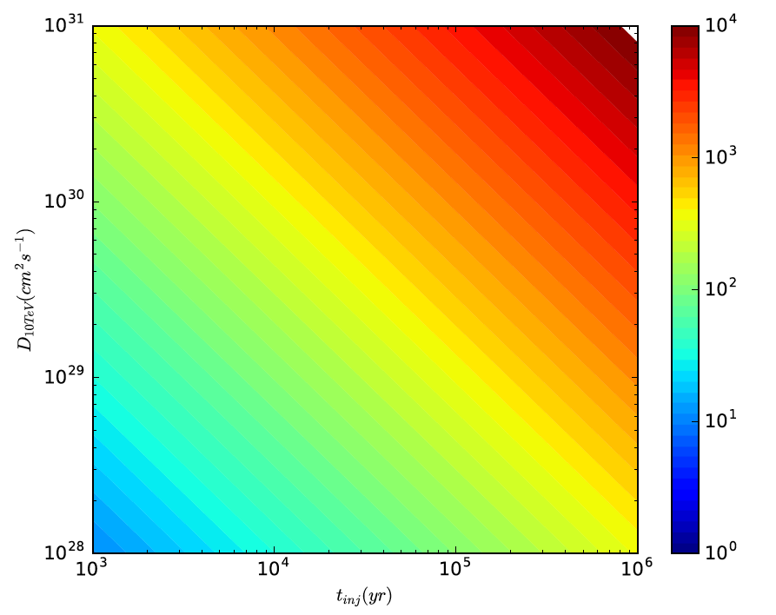
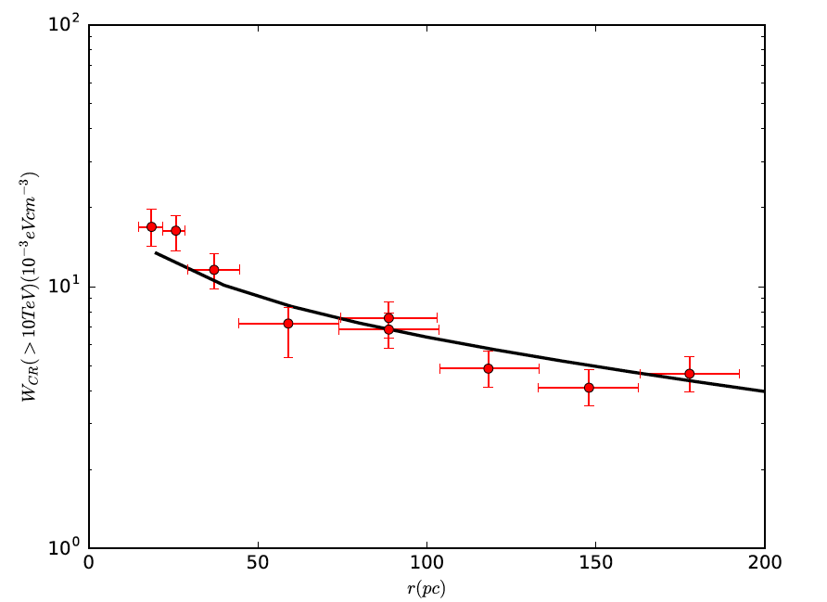
Protons propagating around the Galactic Center
Propagation radius
The distribution of
Cosmic Rays from HNR of 2e5yeas old
after propgation
CRs distribution indicated
by HESS’s model
Diffusion coefficient(10TeV)
R_dif~100pc
T_prop~1e4yr
R_dif~600pc
T_prop~2e5yr
Diffusion coefficient
D(10TeV)=1.5e29 cm^2/s
T_prop(yr)
R_dif (pc)

Slide 9
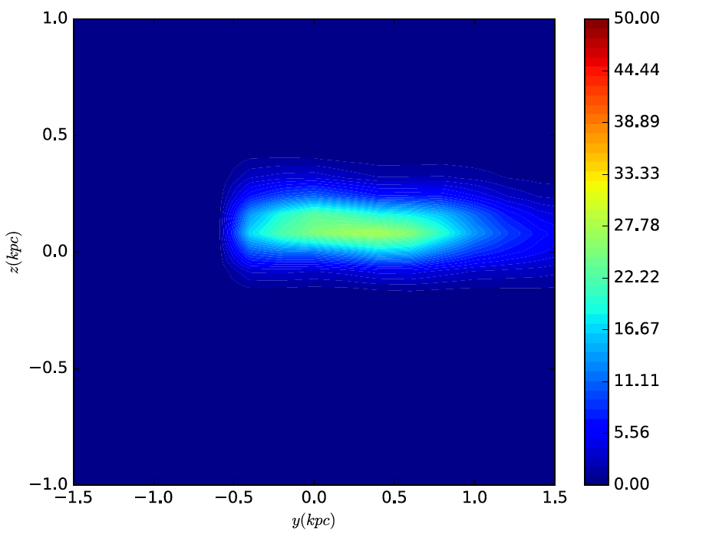
The total gas density
X=0
Components:
Neutral atomic hydrogen:HI
Ionized atomic hydrogen:HII
Molecular hydrogen:H2
Nakanishi et al. 2006

Slide 10
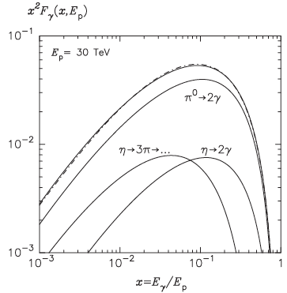
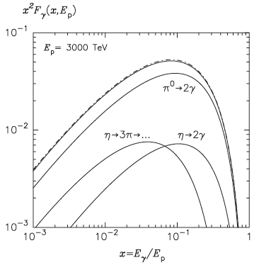
Photons spectrum produced in pp collision of protons with energy Ep
The produced photon spectrum peak at 0.1Ep.
Kelner et al. 2006, Kafexhiu et al. 2014

Slide 11
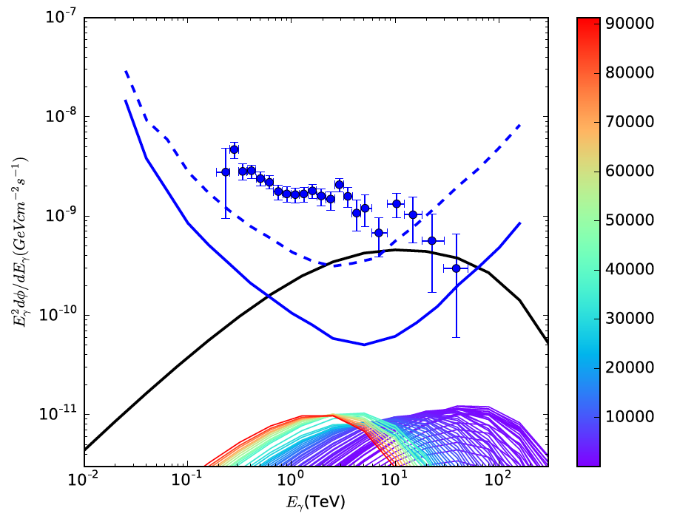
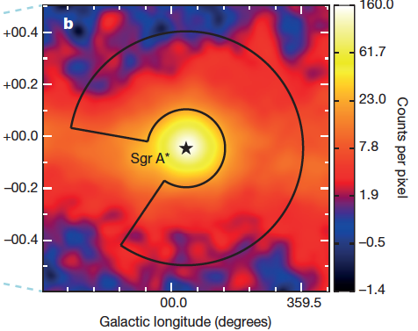
Gamma-Ray spectrum
HNR: Total Energy of escaping proton: ~2e51erg , 2e5 years old
Calculated Gamma-Ray spectrum integrated over
the annulus with inner and outer radii of 0.15deg and 0.45deg centered at the GC
Escaping time
(Year)
preliminary
Proton index~-2.4
HESS data
0.15deg 22pc
0.45deg 66 pc
CTA south 5 h
CTA south 50 h
Total Gamma-Ray emission
Gamma-Ray emission from each time bin
Low energy cutoff
At 1 TeV
High energy cutoff
At 100 TeV

Slide 12
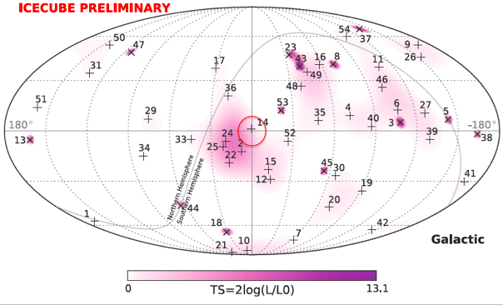
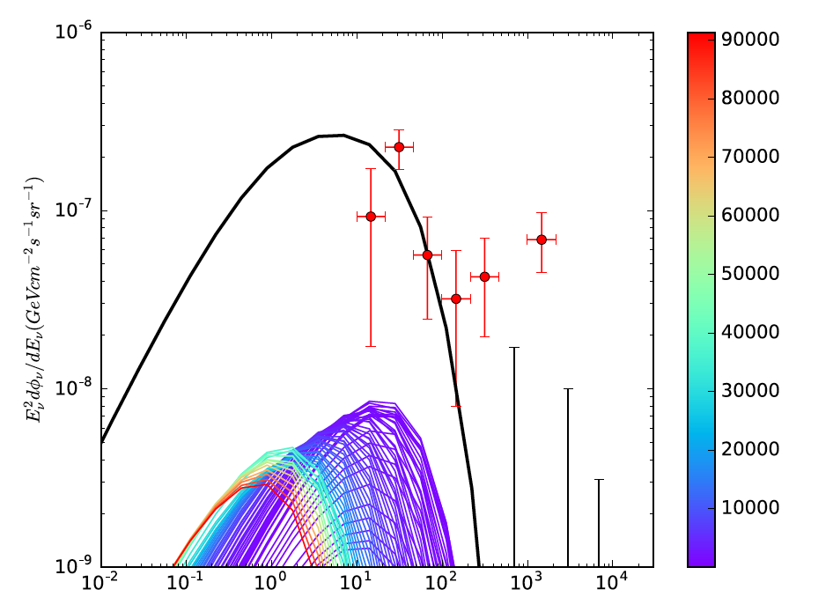
Neutrino spectrum
HNR: Total Energy of escaping proton: ~2e51erg, 2e5 years old
Calculated Neutrino spectrum averaged over
the circle with radii of 10 degree(1.5kpc) centered at the GC
Compatible
No clustering
Significant
clustering?
IceCube observed average neutrino flux
over the whole sky
Total Neutrino emission
preliminary
Neutrino emission from each time bin
Escaping time
(Year)

Slide 13
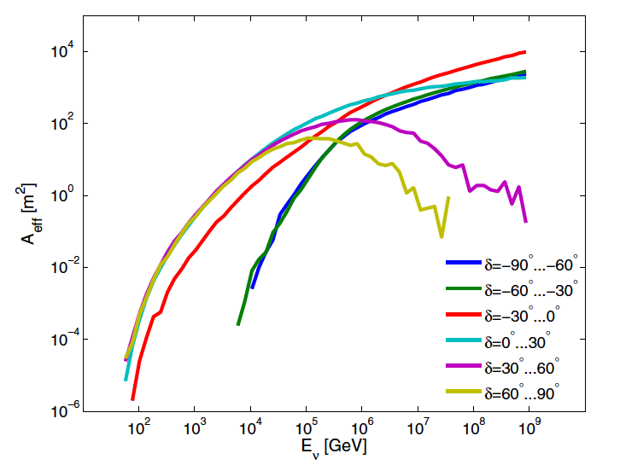
Predicted 10TeV IceCube neutrino events
Effective area of IC86
Total Energy of
escaping proton:
~2e51erg
Integrated over 5 years:
8 neutrino events
with energy of ~1-100 TeV

Slide 14
Summary
Motivation: Study the contribution of a HNR to protons, gamma-rays and neutrinos in the galactic center
Our metiod of calculation:
Acceleration + Escaping + Propagation + Interaction + Observation
C. Current results:
A young hypernova of ~1,000 years old can accelerate protons to PeV, indicating a cutoff of the gamma ray spectrum at about 100 TeV.
The hypernova of ~2e5 years old in the Galactic Center indicate a cutoff of the gamma ray spectrum at the energy of ~100 TeV, and produce 8 neutrino events around the Galactic Center with energy of ~1-100 TeV that can be observed by IC86 for 5 year operation.
D. To do list:
1. Study the contributions from SNRs with smaller energy and older age.
Can multi SNRs+A HNR explain the HESS observation?
2. Calculate the significance of <10 TeV neutrinos excess in the Galactic Center
Prospect: The hypernova or supernova with different age leads to different cutoff energy of neutrinos and gamma-rays. The age of the hypernova can be constrained by the future observations of CTA and IceCube.
Thank you!

