Slide 1
Excl simul of primary CR interactions in atmosphere
Progress report: 2 October 2014
CTA-Japan Meeting
Tune Kamae (Univ. of Tokyo and SLAC/KIPAC)
Yasushi Nara (Akita International Univ)
Technical Goals
Simulate, exclusively, CR-atmosphere interaction for primary p, alpha, CNO, Si, Fe
The above requires simulation of (pion, e, μ, γ, p, n, alpha) + (N, O) interaction
Data used or to be used
Legacy data compiled in LB and other archives: KE of proton < 50GeV
Fermilab Fixed Target, ISR, SPS, Tevatron, LHC
FermiGST-Earth Rim, Accelerator neutrino beams,
Air shower experiments (muons)
Acknowledgements: Konstantin Goulianos and Robert Ciesielski of Rockefellar Univ

Slide 2
JAM and Pythia8 MBR
Below KE < 100GeV: Resonance productions based on Quantum Molecular Dynamics (QMD) models (RQMD and UrQMD variants)
Nuclear part is simulated in a sequence of collisions with “shadowing” effects
KE > 50-100GeV:
  Choice 1: HIJING model (perturbative QCD extended to pA and AA) has been tried but abandoned because the codes are not maintained anymore. Also the model is known to violate, often, the energy-momentum conservation.
    X. N. Wang and M. Gyulassy; Phys. Rev. D44 (1991) 3501
    X. N. Wang; Physics Report 280 (1997) 287
  Choice 2: Pythia 8 Minimum Bias Rockefeller reproduces the minimum-bias events in a widest energy range from Ecm=10GeV to LHC energies. However it has been developed only for single particle collisions and need to be extended to include light-to-medium nuclei.
    Pythia: T. Sjostrand; Comp. Phys. Comm. 82 (1994) 74
    Pythia 8: T. Sjostrand; Pythia8.1 Tutorial (Nov-Dec 2007)
    R. Ciesielski and K. Goulianos; arXiv 1205.1446 (Aug 2012) “MBR Monte Carlo Simulation”
    Pythia 8 MBR: R. Ciesielski; Revent developments on diffraction in Pythia8 (Dec 2012 CERN)

Slide 3
pp >Inelastic: Resonance region

Slide 4
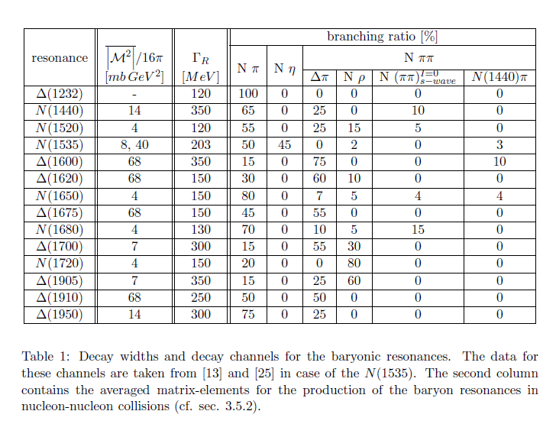
OBE Resonance Excitation Models

Slide 5

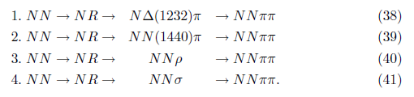
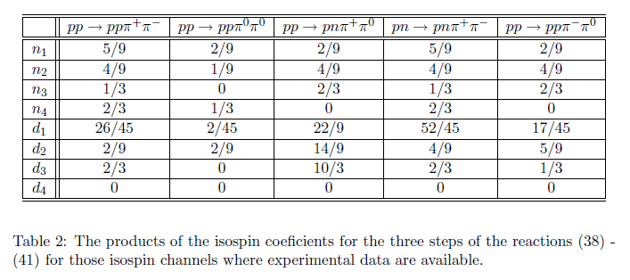
pp>NN2π by Teis et al

Slide 6
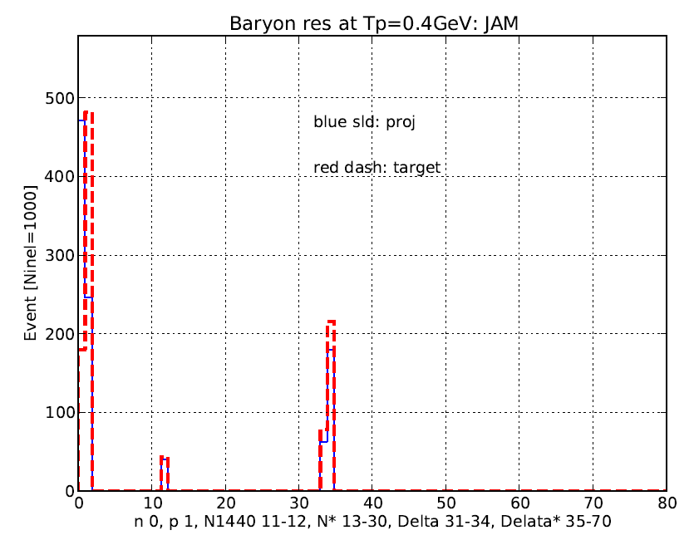
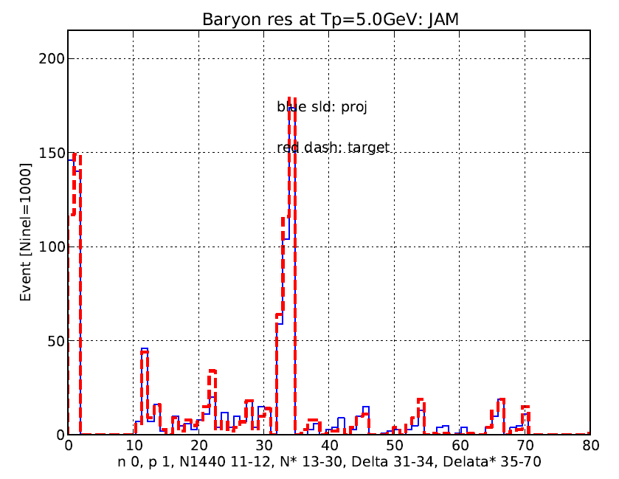
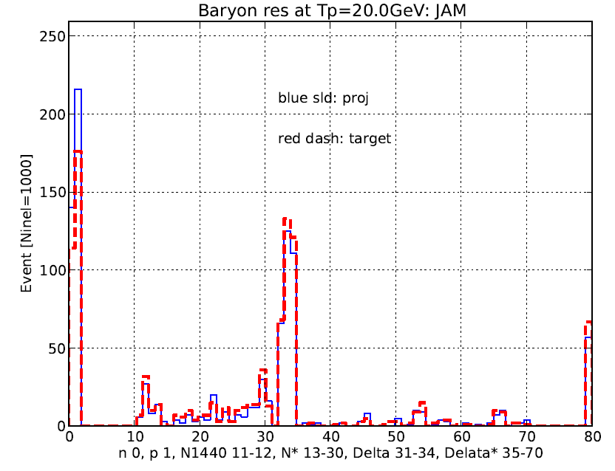
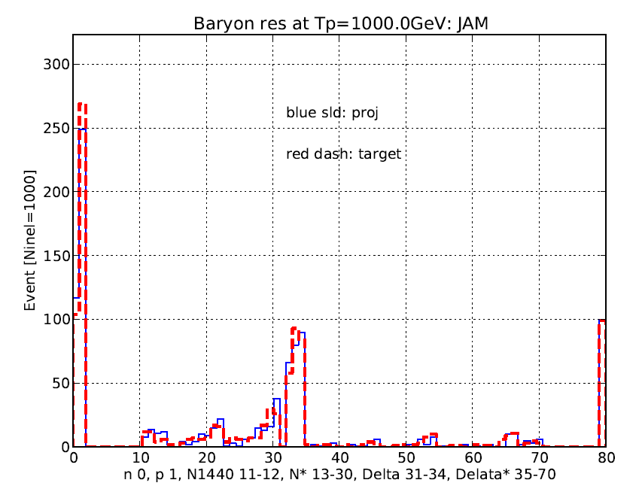
Baryon Resonance Excitation: pp (JAM)
KE=0.4GeV
sld: proj
Dsh: tgt
D(1232)
KE=5.0GeV
sld: proj
Dsh: tgt
D(1232)
N* res
Higher D
N(1440)
KE=20GeV
sld: proj
Dsh: tgt
KE=1TeV
sld: proj
Dsh: tgt
D(1232)
D(1232)
N* res
Higher D
N* res
Higher D

Slide 7
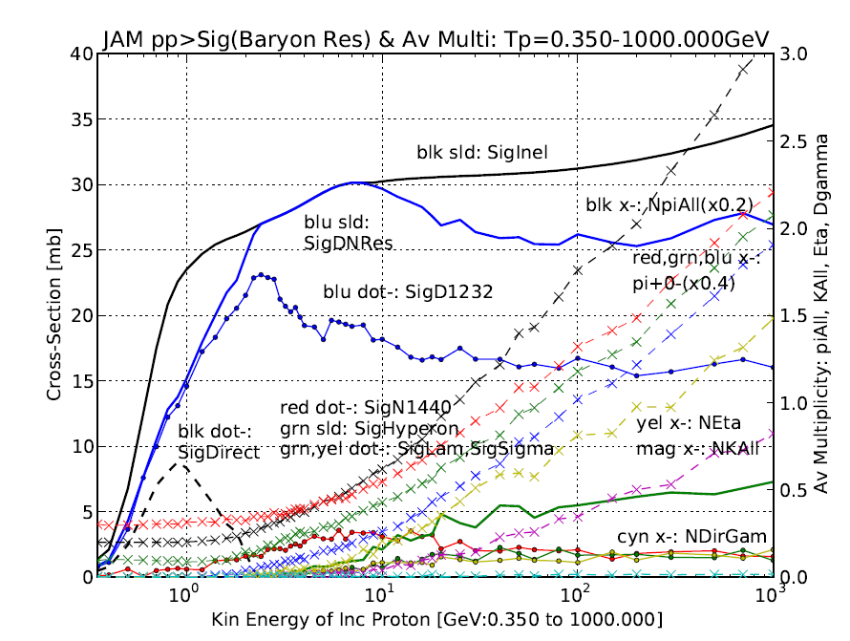
Baryon res & N_{av}(π,K,η) : JAM pp

Slide 8
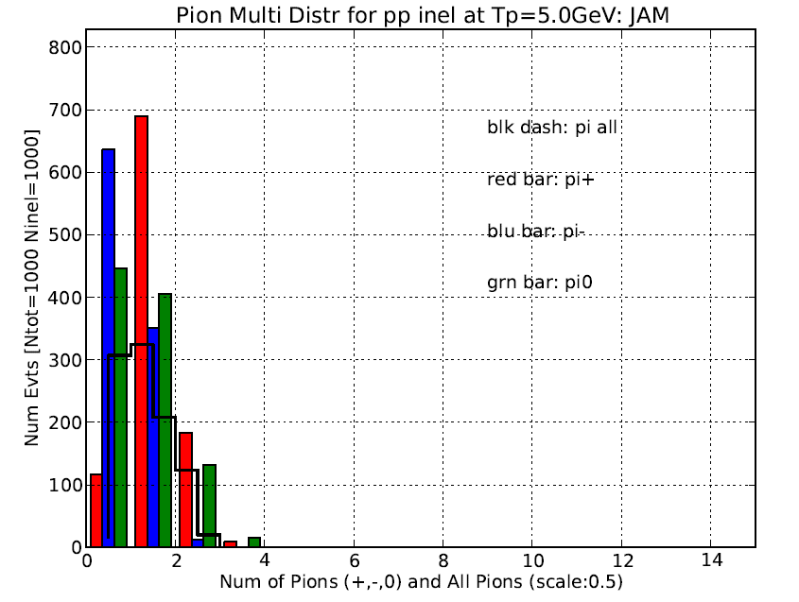
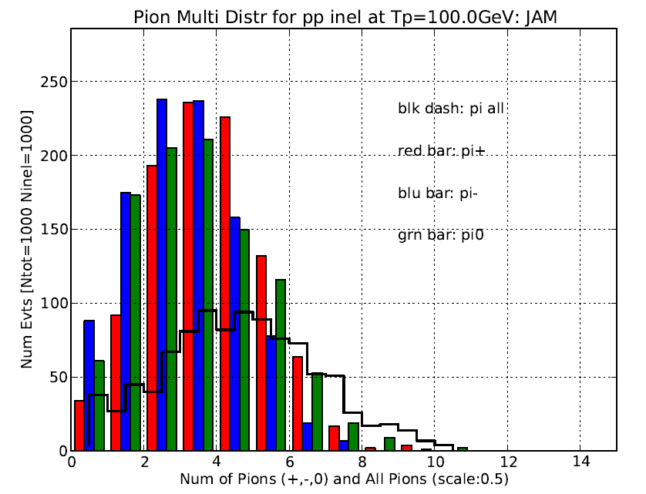
pp> pion multiplicity: JAM

Slide 9
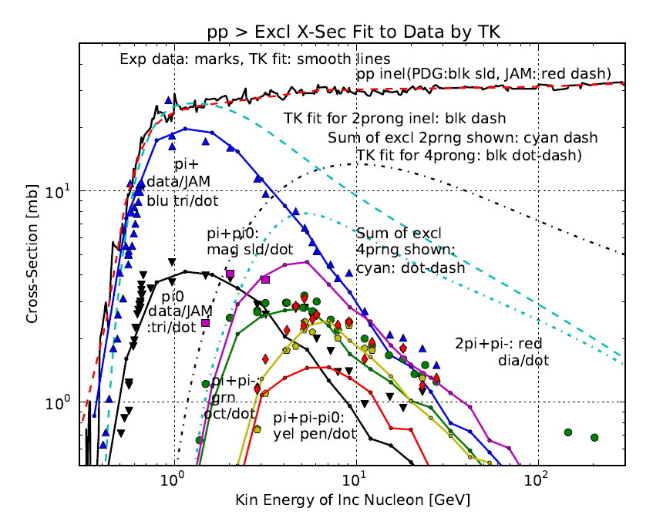
pp > pions: Exp data vs. JAM
Data and JAM

Slide 10
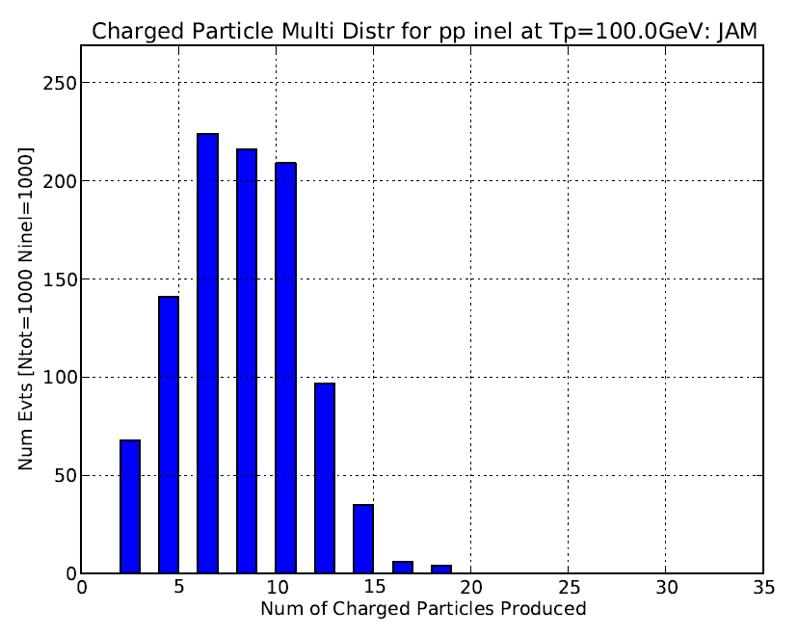
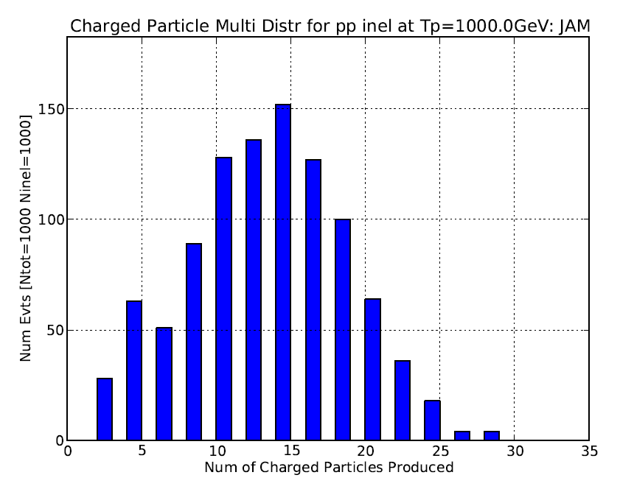
pp > Charged Multiplicity (JAM)
KE=100GeV
KE=1TeV

Slide 11
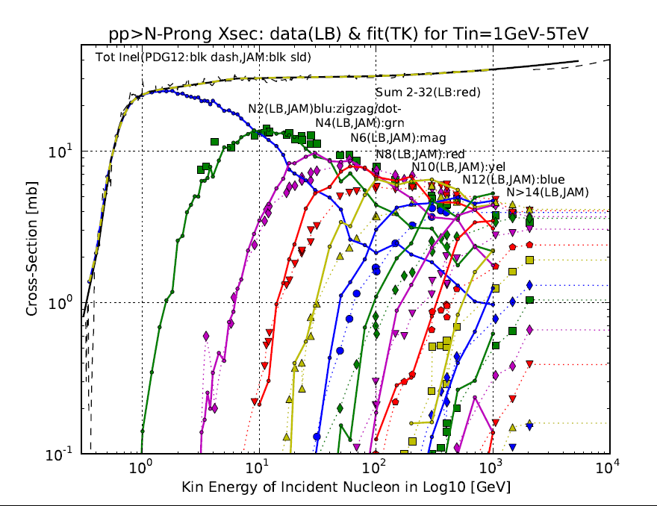
pp> N charged prong: Exp dat vs JAM
JAM

Slide 12
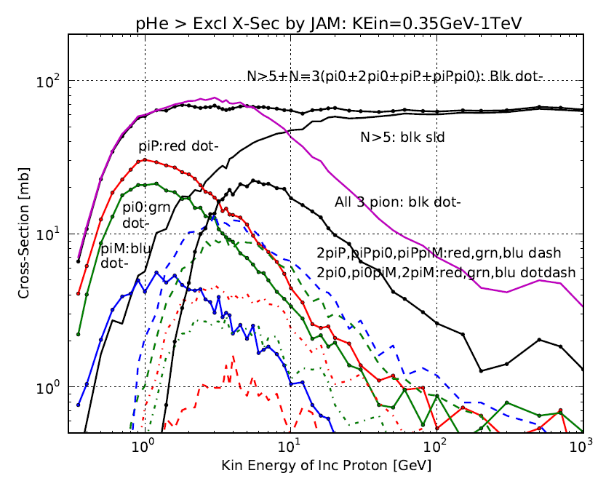
pHe > pions (JAM)

Slide 13
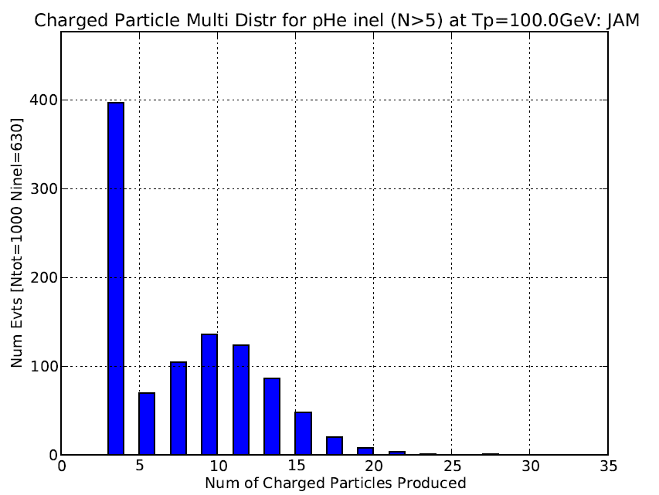
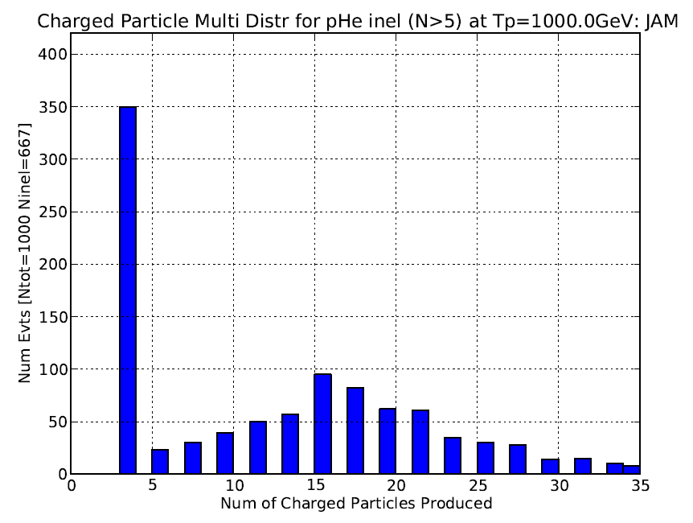
pHe > Charged Multiplicity (JAM)
KE=100GeV
KE=1TeV

Slide 14
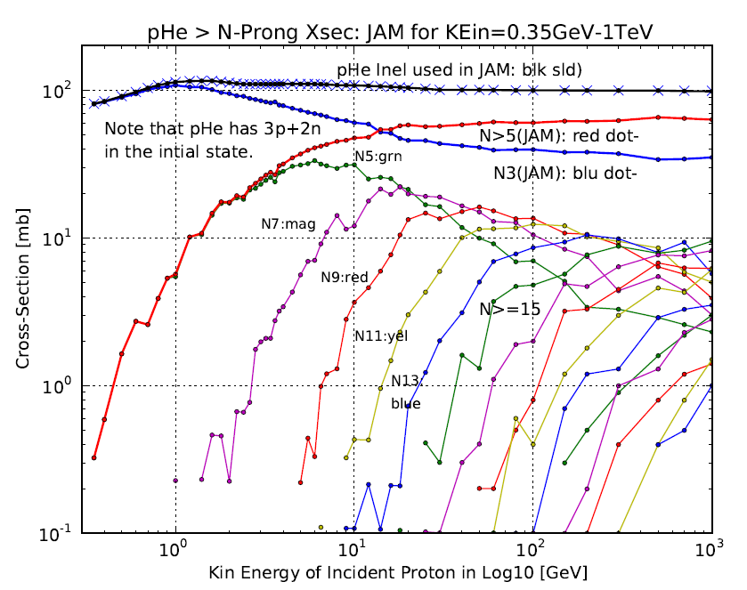
pHe > N charge prongs (JAM)

Slide 15
No major issues but many minor issues

Slide 16
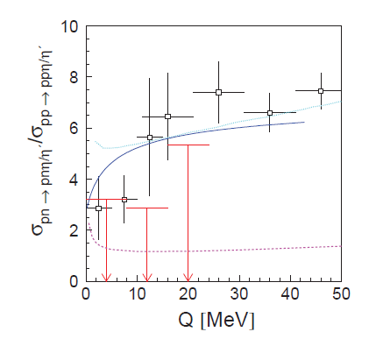
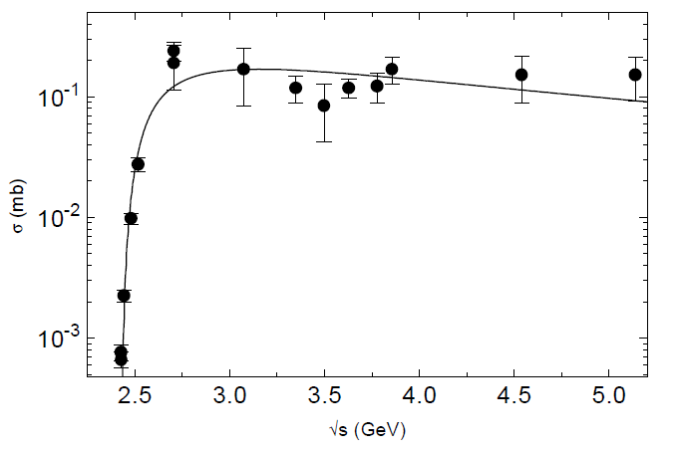
Eta prod higher in pn near thres
Teis et al; Z. Physik 1997
Klaja et al; arXiv:1003.4378 (2010)

Slide 17
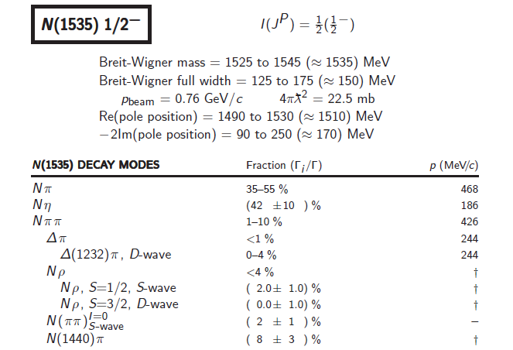
More η in pn: some other mechanism?

Slide 18
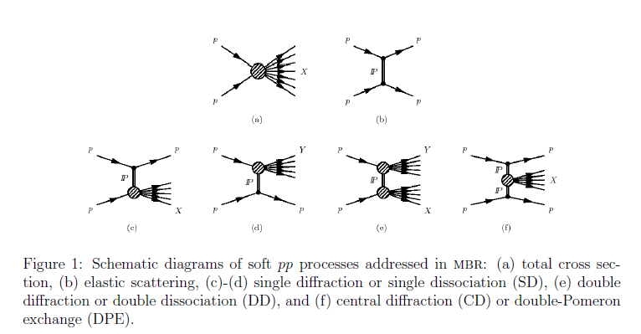
Pythia8 Mini Bias Rockefellar

Slide 19
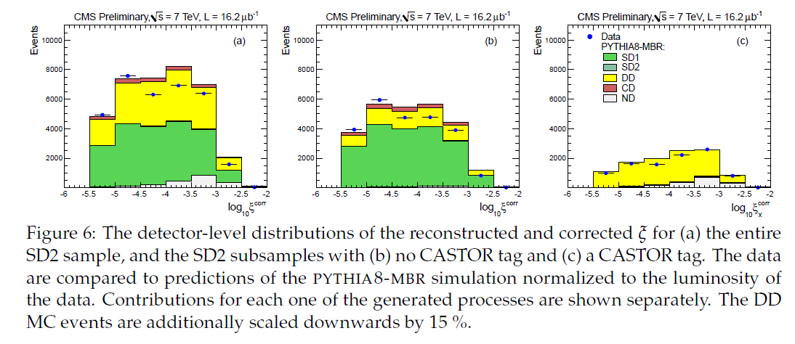
CMS data and Pythia8MBR
CMS SD2 sample reproduced well by Pythia8MBR
SD2 all
Remove non-diff
Tag double-diff

Slide 20
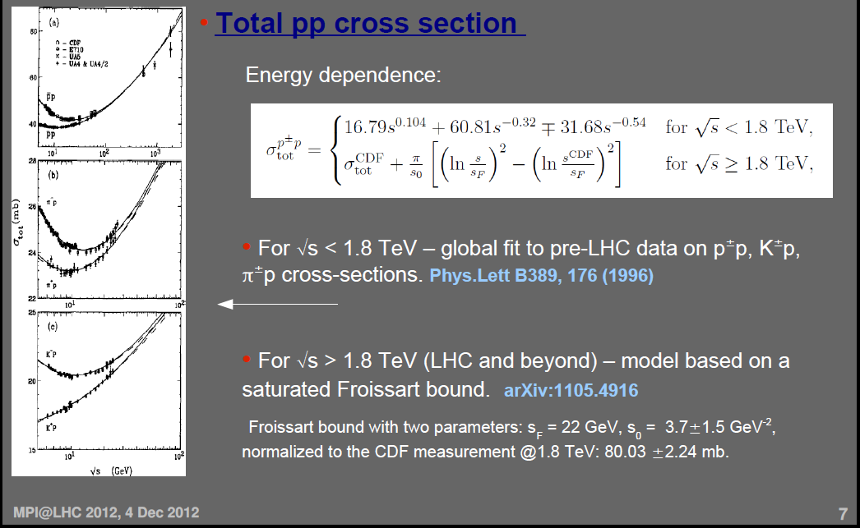
Pythia8 MBR tot cross-sec: p/p-bar, pi+/Pi-,K+/K-

Slide 21
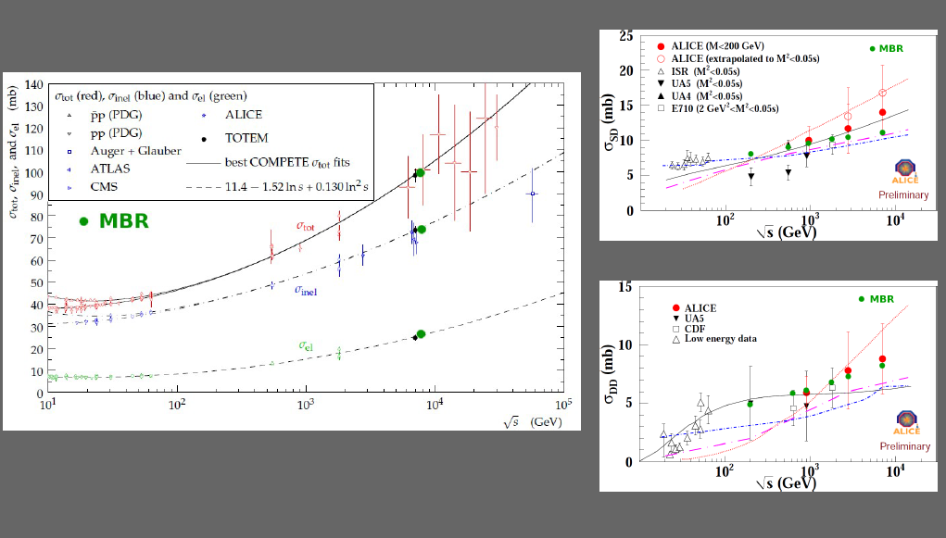
Pythia8 MBR vs LHC

Slide 22
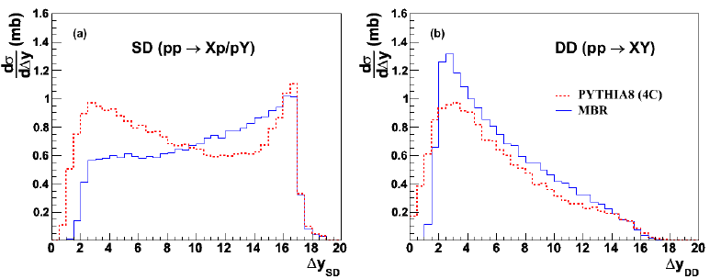
Pythia MBR vs Pythia8 4C (default)

Slide 23
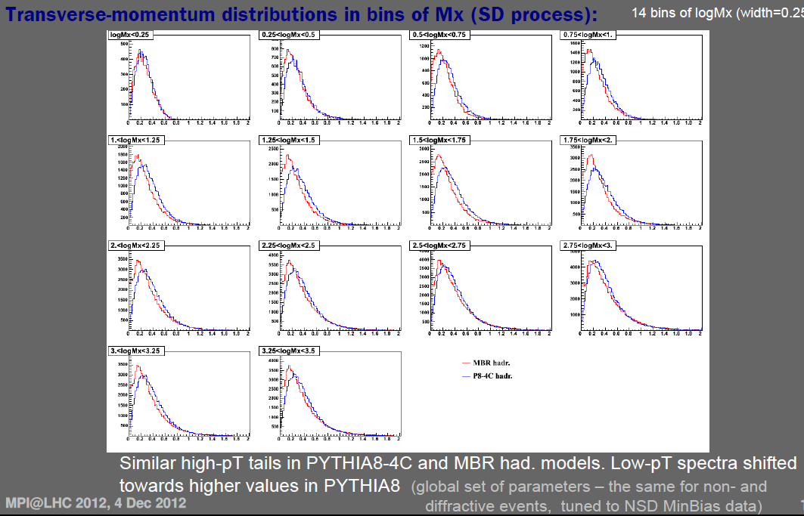
Pythia MBR vs Pythia8 4C (default)

Slide 24
Merit of Pythia8 MBR
Pythia8 MBR reproduces experimental data better at LHC energies
and
reproduces experimental data at Tevatron

Slide 25
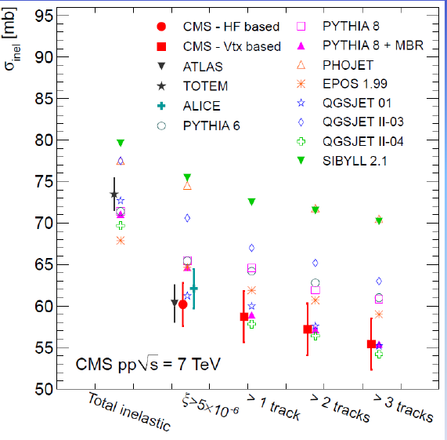
Pythia8 MBR vs other simulators (CMS data)
Note:
Most simulators are not firmaly based on QCD and include several arbitrary parameters.

Slide 26
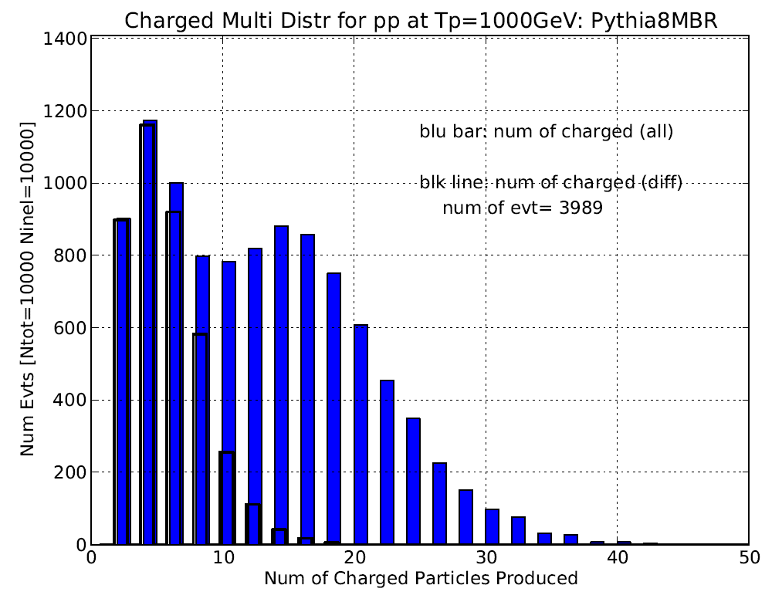
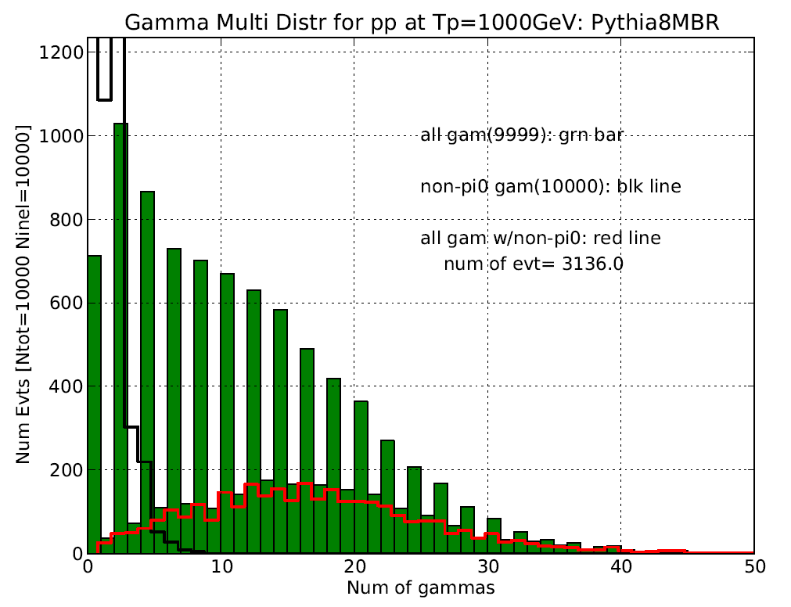
Current Status of Pythia8 MBR Sim
31% of events includes γ come from non-pi0 at KE=1TeV
Nearly 40% of events are diff events and their charged multiplicity is low.

Slide 27
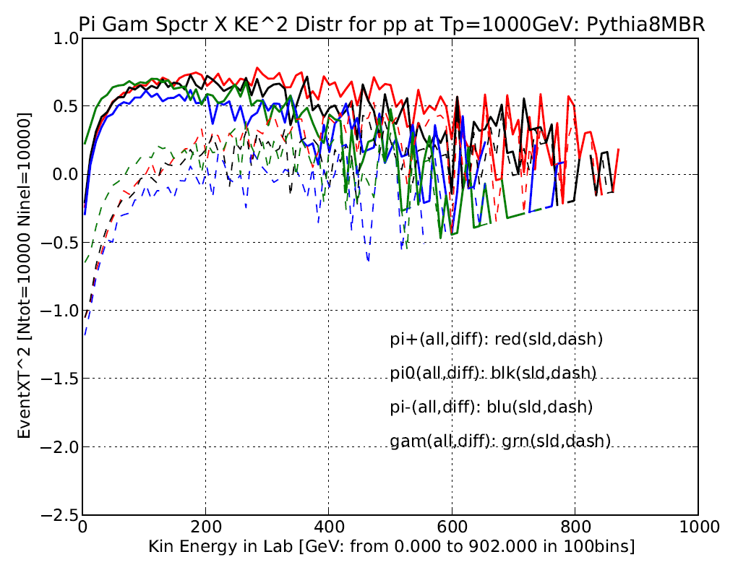
Current Status of Pythia8 MBR Sim
Energetic γ’s are from single diff and accompany few or no pi+/pi-

Slide 28
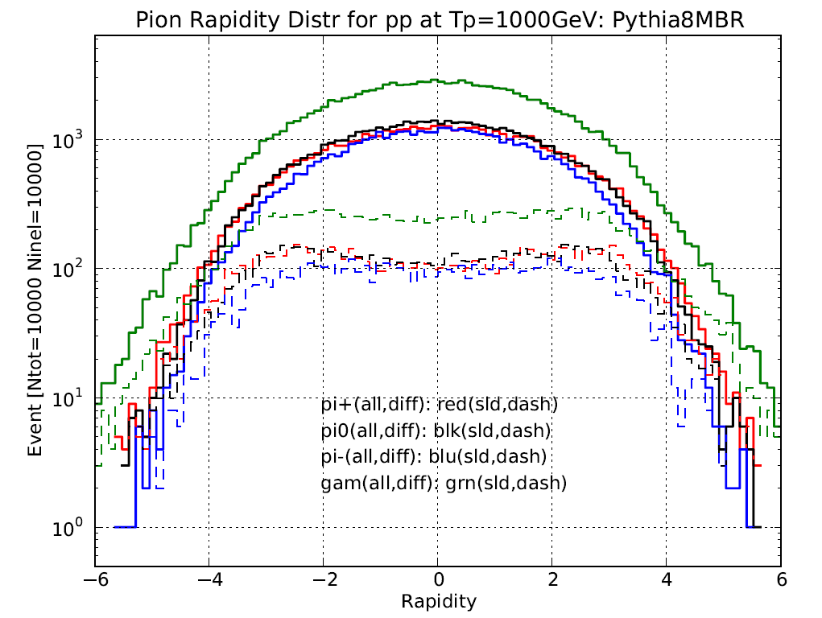
Current Status of Pythia8 MBR Sim
Energetic γ’s are from single diff and may no accompany pi+/pi-

Slide 29
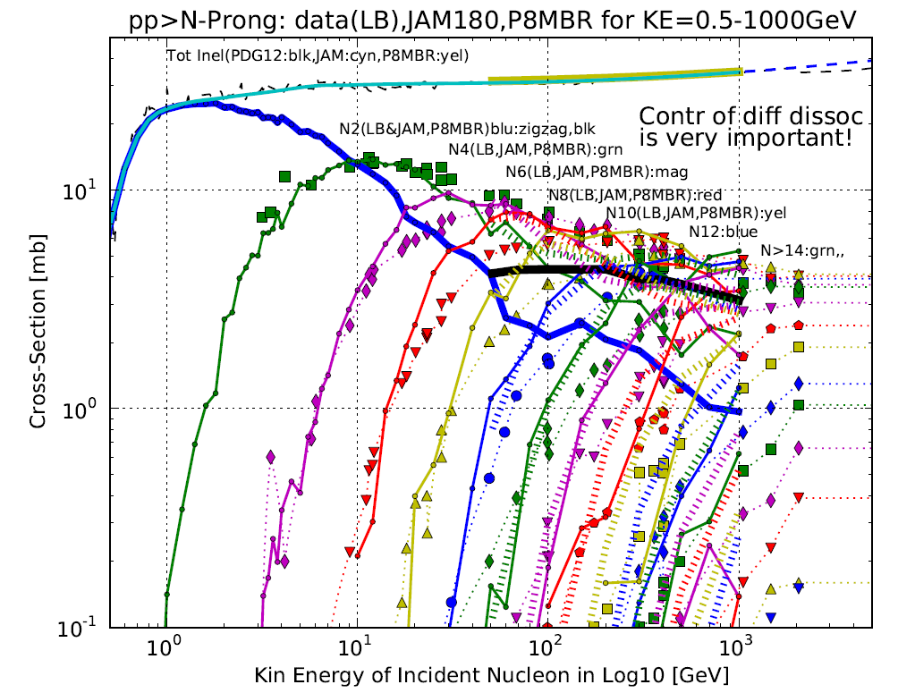
Combining JAM and Pythia8MBR
Pythia8MBR
predicts
3-4mb for
2 prong evnts.

Slide 30
Work to be done
Extension of Pythia8 MBR to (pion, e, μ, γ, p, n, alpha) + (N, O)
Test against FermiGST-Earth Rim γ-rays
  Angular distribution
  Rigidity cut-off dependence
Test against accelerator neutrino beams (pAl)
This work will open up a new venue to study primary CR
  Neutrino detectors (muon bundles)
  CTA including background studies
  Air shower arrays (HAWC, Tibet, TA, Auger)

