Slide 1
The Fermi Bubbles as a Scaled-up Version of Supernova Remnants and Predictions in the TeV Band
Yutaka Fujita (Osaka)
Ryo Yamazaki (Aoyama)
Yutaka Ohira (Aoyama)
ApJL in press (arXiv:1308.5228)

Slide 2
Introduction

Slide 3
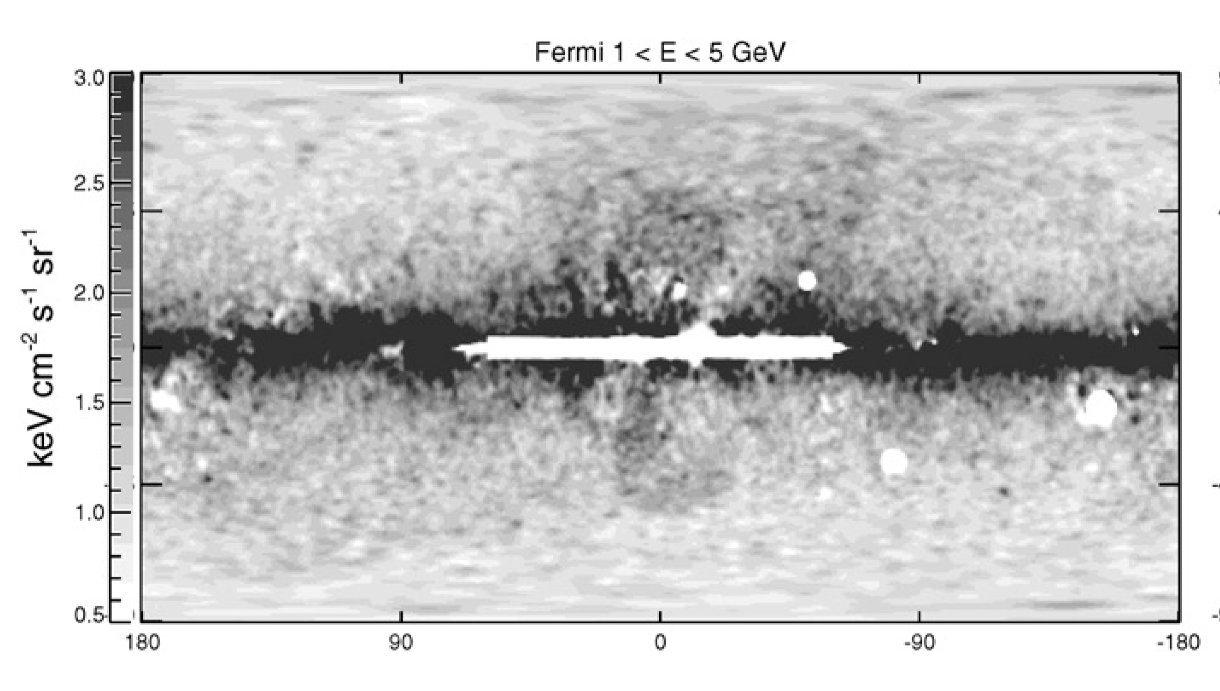
Fermi Bubbles
Huge gamma-ray bubbles discovered with Fermi Satellite
  Apparent size is ~50°
  If they are at the Galactic center (GC), the size is ~10 kpc
Su et al. (2010)

Slide 4
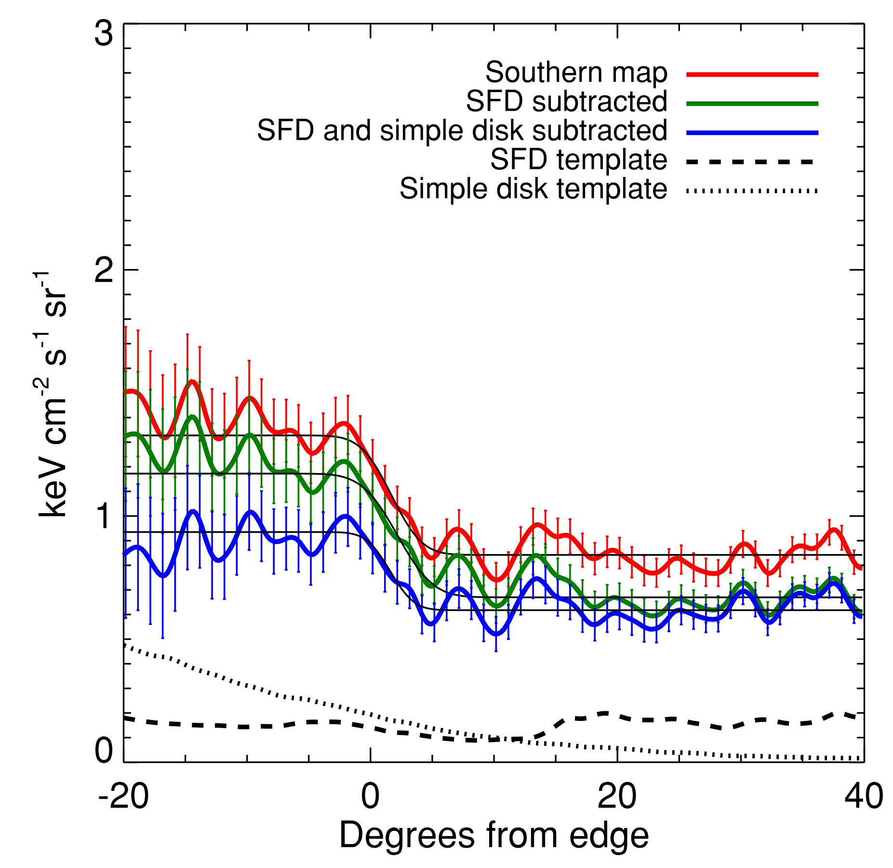
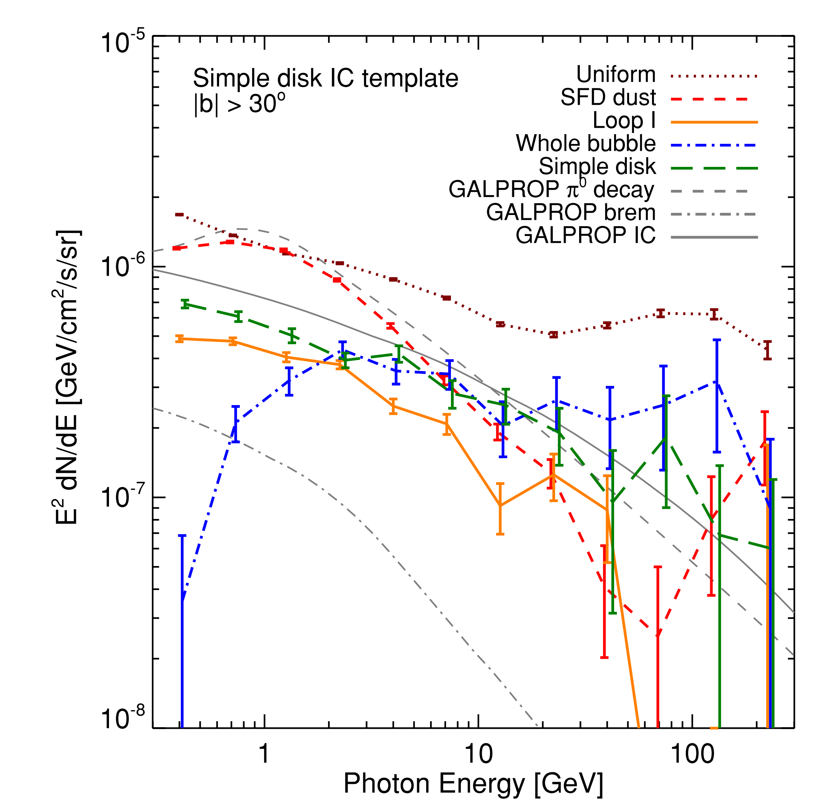
Interesting Features
Flat distribution
Sharp edges
Hard spectrum
Surface brightness Spectrum
Su et al. (2010)

Slide 5
Interesting Features
Flat distribution
  Cosmic-rays (CRs) are distributed neither uniformly nor at the shells
Sharp edges
  CRs do not much diffuse out of the bubbles
Hard spectrum (∝E ⁻²)
  Short electron cooling time (t_{cool, e} ~10⁶ yr) compared with the age of the bubbles (t_{age} ~10⁷ yr)
    Ongoing acceleration? hadronic?
  Standard diffusion (higher energy CRs escape faster)
    Even if the spectrum is hard when CRs are accelerated, it becomes softer as time goes by

Slide 6
Proposed Models
Hadronic + starburst (Aharonian & Crocker 2011)
Leptonic + acceleration inside the bubbles (Cheng et al. 2011, Mertsch & Sarkar 2011)
CR protons
pion decay
Inverse Compton
CR electrons

Slide 7
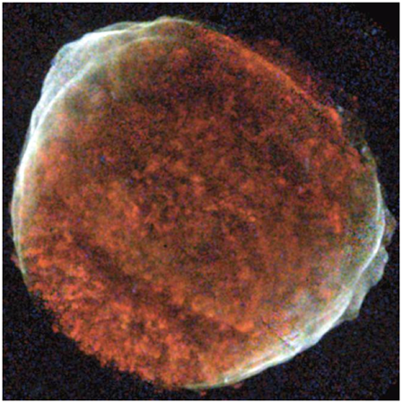
Our Model
CRs are accelerated at the forward shock like a SNR
  Activities of central BH or starburst at the GC
Gamma-rays come from protons (hadronic)
  CR proton - gas proton interaction
Fermi bubbles (Su et at. 2010)
?

SN 1006
(Chandra)

Slide 8
Models

Slide 9
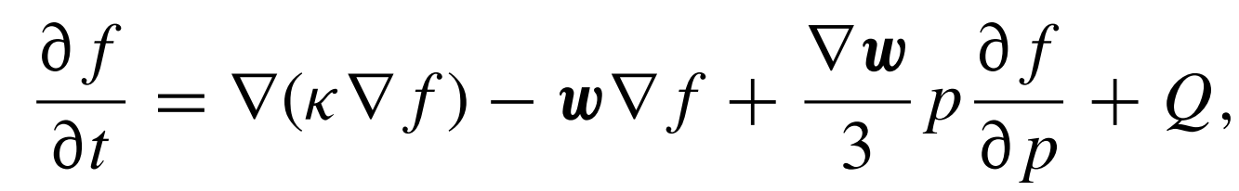
Equations
CRs
  Diffusion-advection equation (spherically symmetric)
    f : distribution function, κ : diffusion coefficient
    w : gas velocity, Q : CR source (at the shock surface)
  CRs escape from the shock surface (r =R_{sh})
    p_{max} ∝(eB/c ²)V_{sh}² t
    Q (r, p, t ) ∝ p ^{-q}δ (r - R_{sh}) for p < p_{max}
      B : Magnetic field
      V_{sh}: Shock velocity
Q
p^{-q}
p_{max}

Slide 10
Equations
Diffusion coefficient
  CRs are scattered by magnetic fluctuations (Alfvén waves)
  Wave growth rate
    ∂ψ/∂t ∝ |∇f | (streaming instability; Skilling 1975)
      ψ : wave energy density
  Diffusion coefficient
    κ ∝ 1/ψ
Gas
  Sedov solution
  Back reaction from CRs is ignored
Resonance
CR
Wave

Slide 11
Parameters (Fiducial Model)
Energy
  Injection from Galactic Center (GC)
    E_{tot} = 2.5×10⁵⁷ erg
    Injected at 0 < t  t₀ = 1×10⁶ yr (instantaneous)
  CR energy
    E_{cr,tot} = 0.2 E_{tot}
    CRs are accelerated for t₀ < t < t_{stop} = 3×10⁶ yr
    CR acceleration stops because of low Mach number of the shock (M ~ 4)
  Accelerated CR spectrum at the shock ∝ p ^{-4.1}
  Current time is t_{obs}=1×10⁷ yr
Halo gas
  Initial halo gas profile is ∝ r ^{-1.5}
  Temperature: T =2.4×10⁶ K

Slide 12
Results

Slide 13
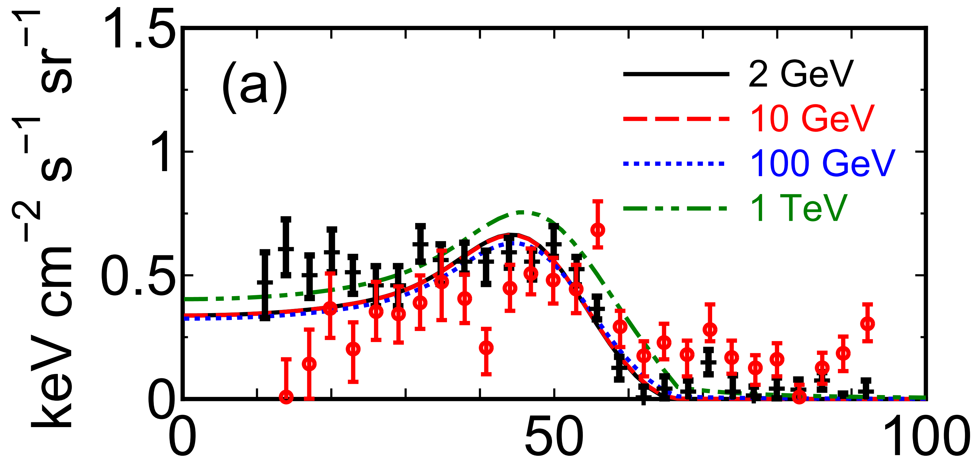
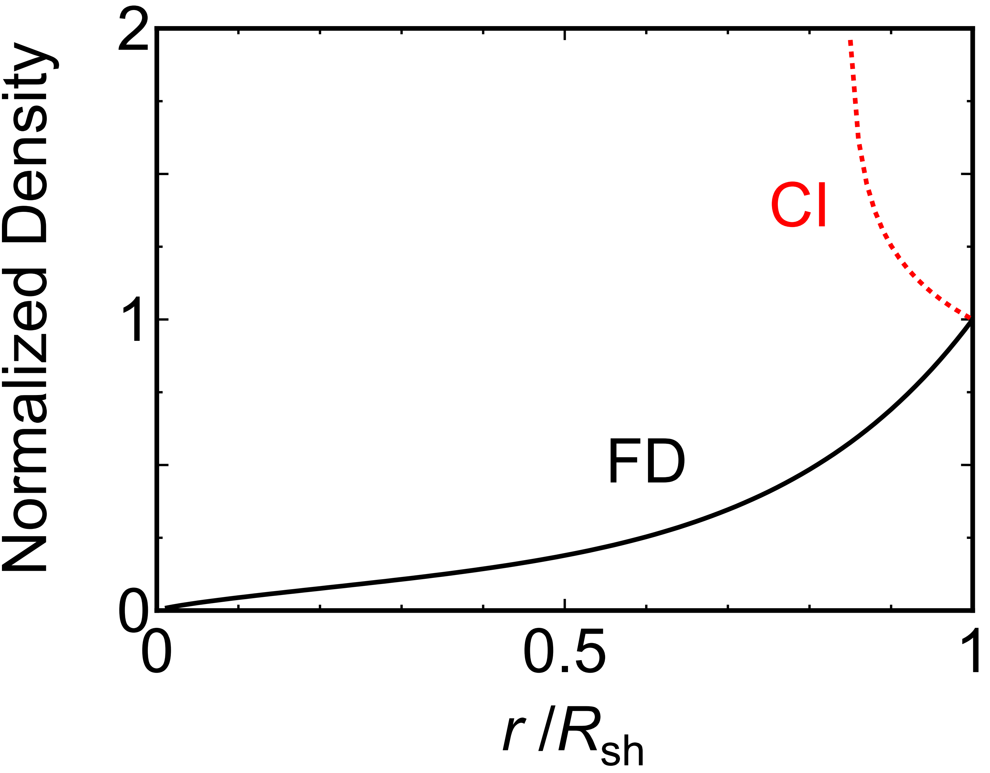
Surface Brightness
γ -ray surface brightness profile
  Fairly flat
    Halo gas remains inside the bubble
      Interact with CR protons
  Sharp edge
    Gas density is high at the shock
    Decrease of diffusion coefficient just outside the shock (CRs amplify waves)
      CRs cannot much diffuse out of the shock
Surface brightness
ρ_{gas}
R_{sh}

Slide 14
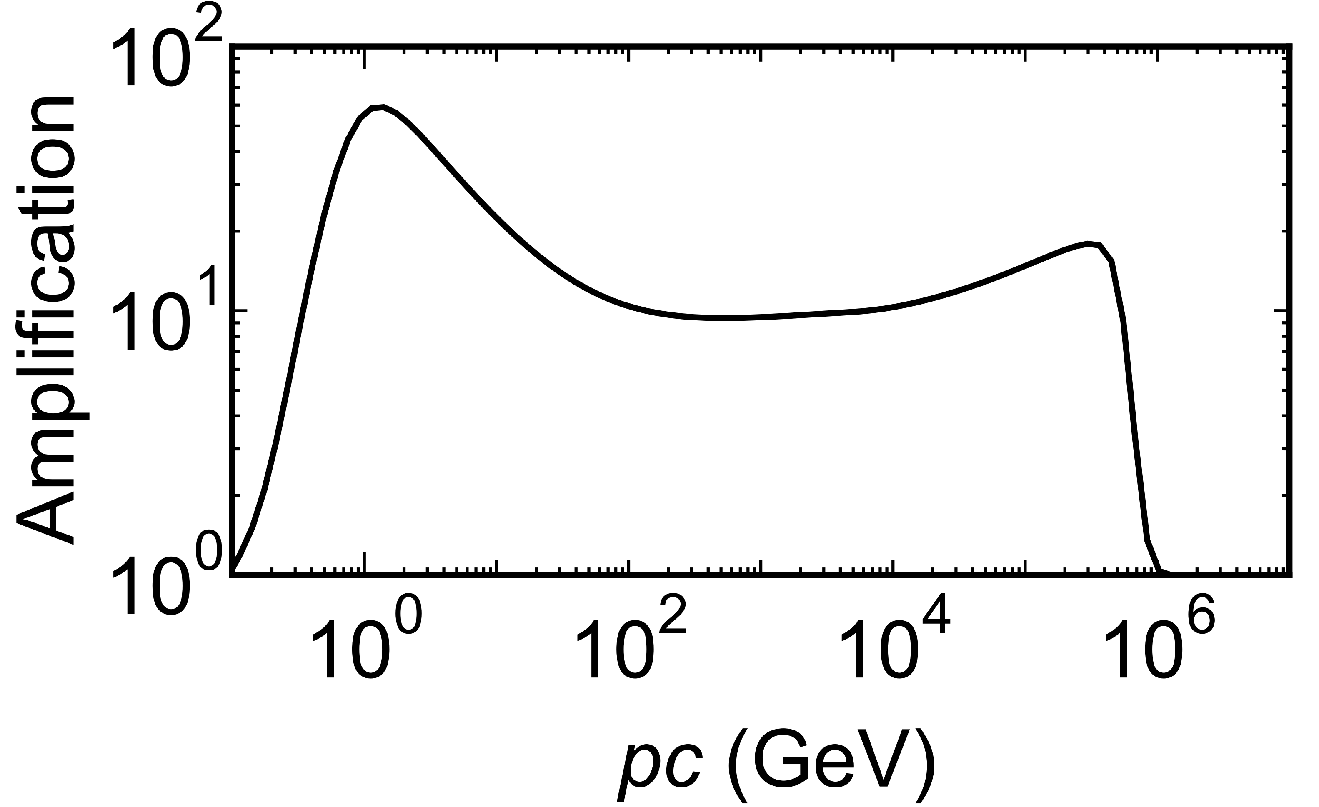
Amplification of Magnetic Fluctuations
Because of CR streaming, magnetic fluctuations increase
  CRs are more scattered
  Diffusion coefficient decreases
Most CRs cannot escape from the bubble
  Since t_{stop} < t_{obs}, Most CRs are left far behind the shock front at t = t_{obs}
At t = t_{obs}, r = R_{sh+}
Shock
CRs

Slide 15
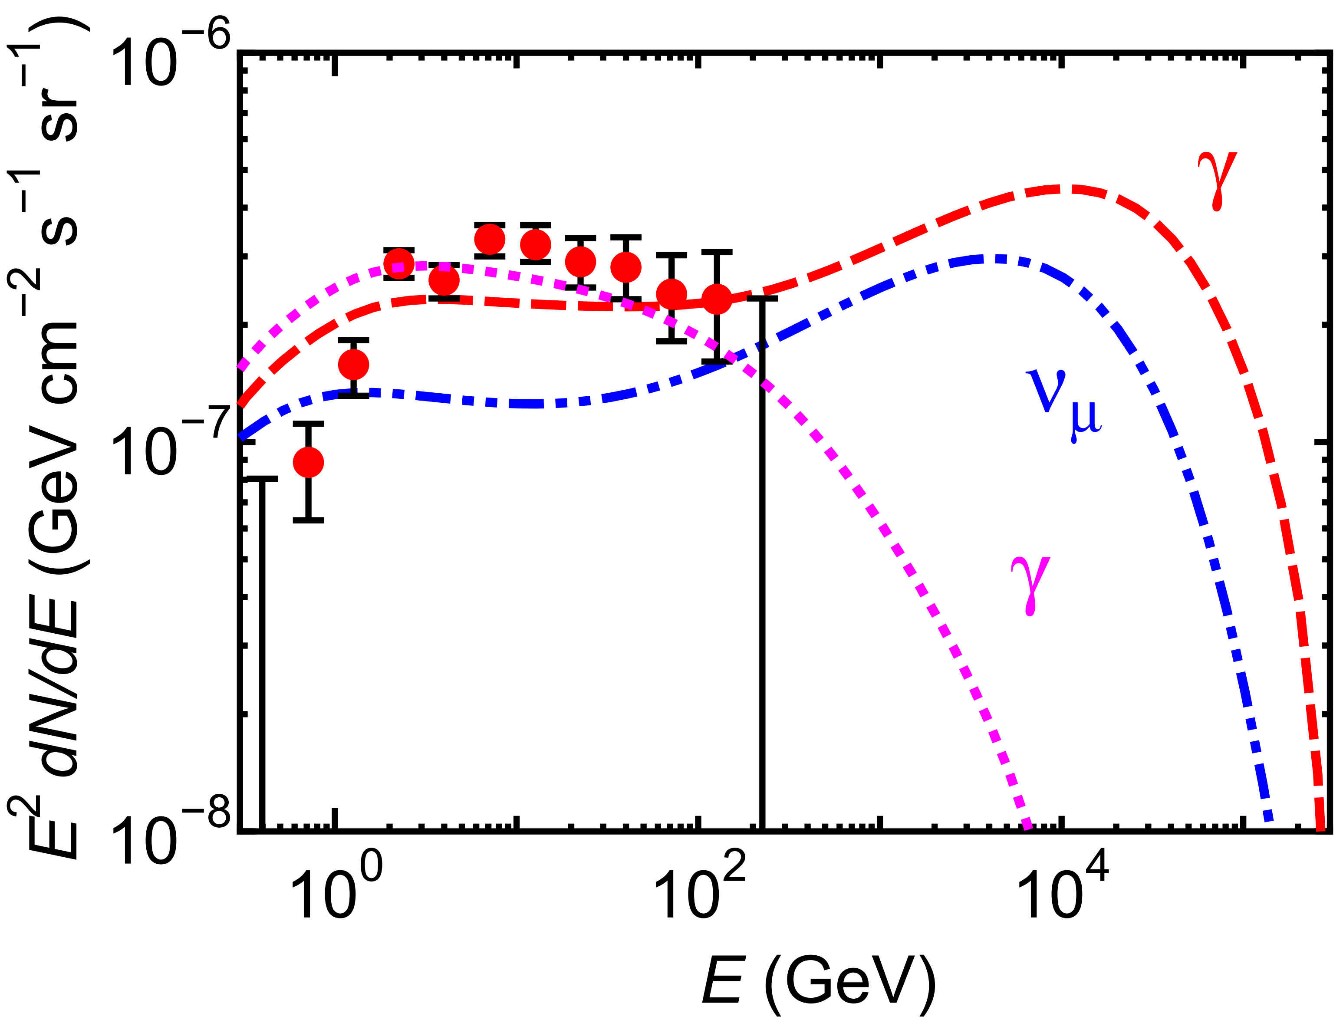
Spectrum
Bohm diff.
(large p_{max})
Gamma-ray spectrum
  Hard spectrum
  CR energy spectrum is not much deferent from the original one (∝E ⁻²)
    Decrease of diffusion coefficient just outside the shock
    consistent with observations
  TeV flux depends on p_{max}
    For Bohm diffusion, p_{max} ~10¹⁵ eV
Neutrino spectrum is also calculated
Small p_{max}

Slide 16
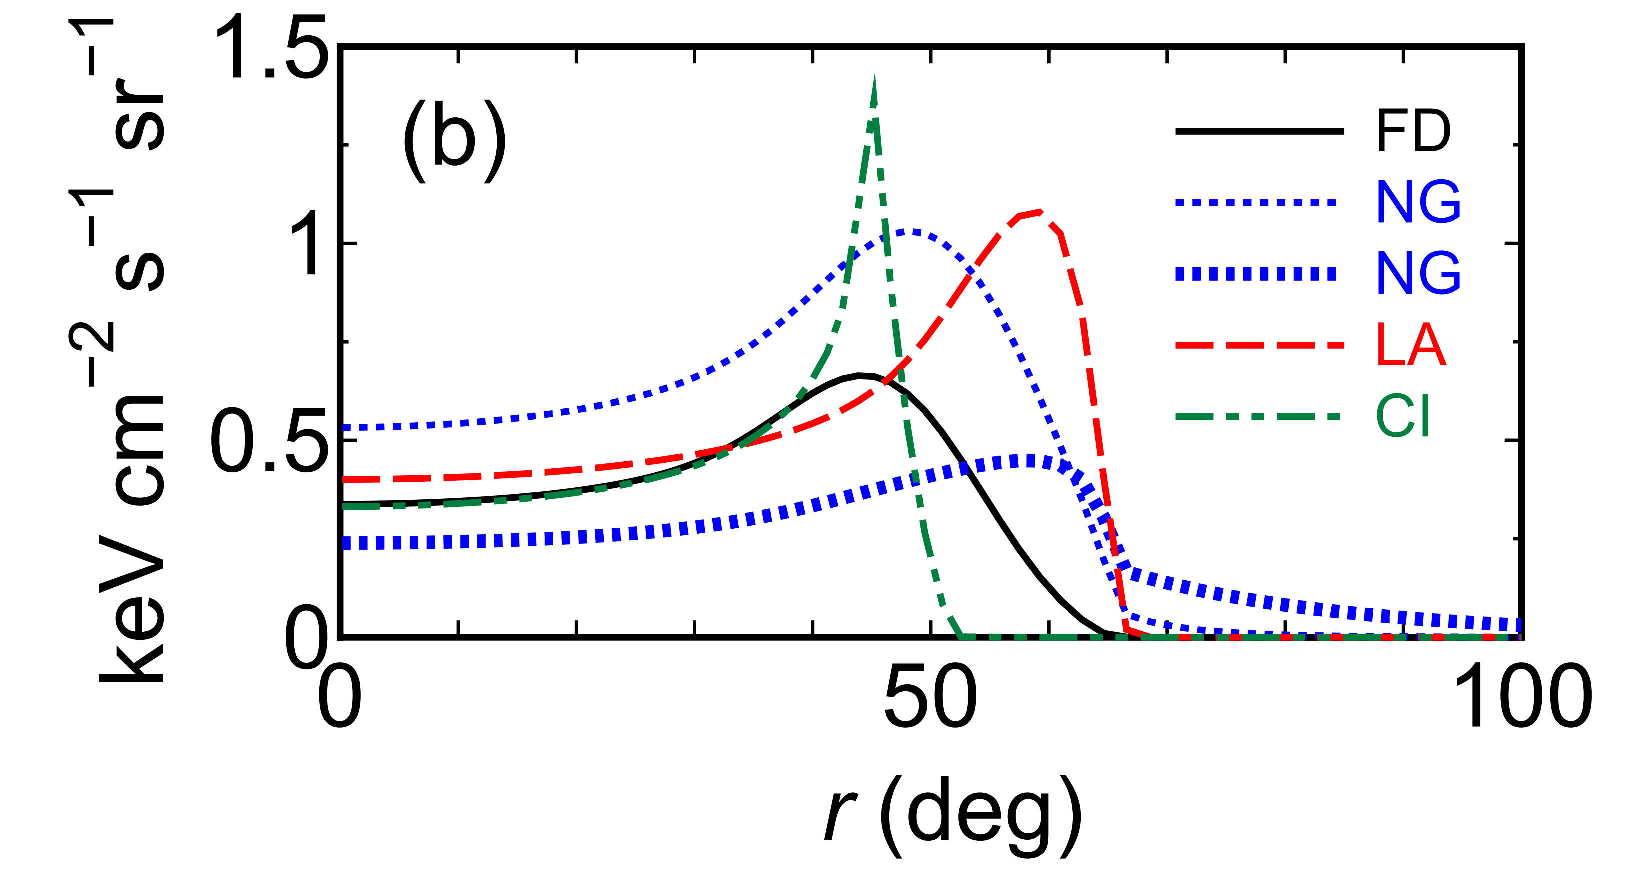
Other parameters
No wave growth (NG)
  Larger diffusion coefficient
  Brighter at 2 GeV
    Low energy CRs reach high gas density region just behind the shock
  Dimmer at 1 TeV
    High energy CRs escape from the bubble
    γ-ray spectrum does not follow observed spectrum (∝ E ⁻²)
Surface brightness profile
2 GeV
Fiducial
Shock
1 TeV
CRs
Shock
CRs

Slide 17
Other Parameters
Late acceleration (LA)
  CRs are accelerated at 4×10⁶ yr < t < 10⁷ yr = t_{obs}
    Later than fiducial (FD) model (10⁶ yr < t < 3×10⁶ yr)
Bubble limb becomes brighter
  CRs have not diffused much
    CRs must be accelerated at the early stage of bubble evolution
Surface brightness profile

Slide 18
Other Parameters
Continuous energy injection (CI) from GC
  Enegy is injected for 0< t < t_{obs}
    Longer than fiducial (FD) model (0  t  1×10⁶ yr)
Bubble limb becomes sharp
  Gas is concentrated around the shock
    Energy injection from GC must be instantaneous
Surface brightness profile

Slide 19
Summary
We treated the Fermi bubbles as a scaled-up version of a supernova remnant
  CRs are accelerated at the forward shock of the bubble
We solved a diffusion-advection equation
  We considered the amplification of Alfvén waves
Comparison with observations
  Wave growth is required
  CRs are accelerated at the early stage of bubble evolution
  Energy injection from GC must be instantatious

