Slide 1
AMS-02 data and open questions
T. Shibata
Aoyama-Gakuin University, Japan
CTA研究会(03/Sep./2013)

Slide 2
observables in AMS-02:
1) proton: 1GV-1.8TV
for two years exposure
2) helium: 2GV-3.2TV
only 10% of total exp. !
3) B/C ratio: 0.5-670 GeV/n
4) electron: 0.5-500 GeV
5) positron: 0.5-350 GeV
6) e⁺, e⁻ : 0.1GeV-1TeV ?
in the near future ?
7) p/p ratio: ~ 1TeV ?
8) C- Fe: 1GeV/n-1TeV/n ?
9) B/C, subFe/Fe, : 0.5GeV/n-1TeV/n ?
10) ¹⁰Be/⁹Be, ²⁶Al/²⁷Al, . . : 10-20GeV/n ?
11) high energy γ: 0.1-1TeV ?

Slide 3
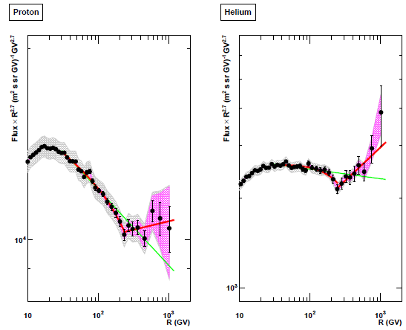
spectrum index について
PAMELA (Adriani et al. 2011)

Slide 4

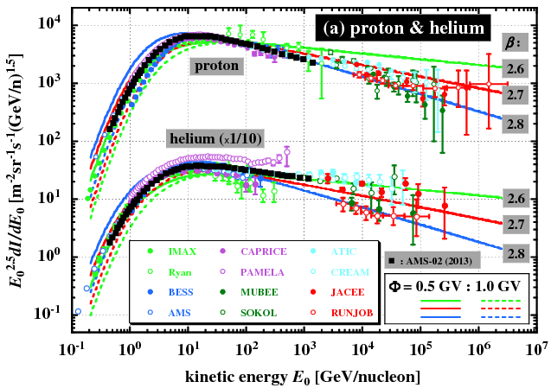

0.1~ 0.2
γ :
2.27
2.37
2.47
2.27
2.37
2.47
source

Slide 5
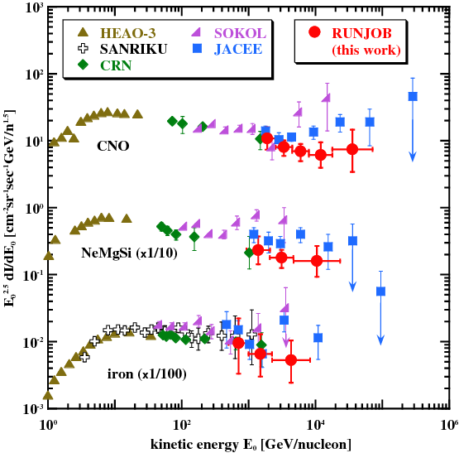
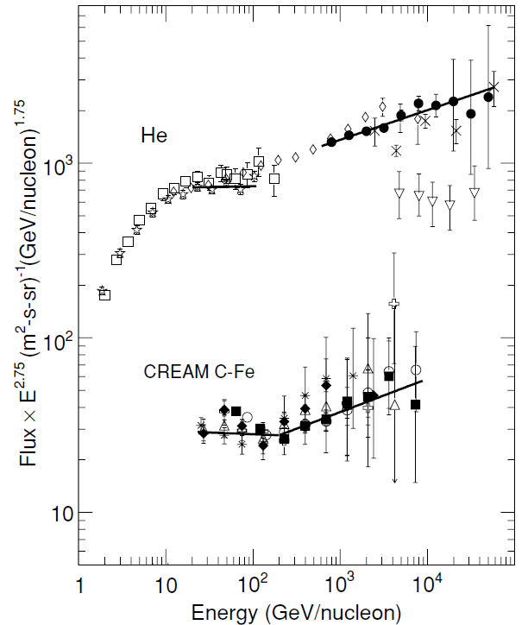
heavy components
Ahn et al. ApJL, 2010, 714, L89
(Derbina et al. 2005)

Slide 6
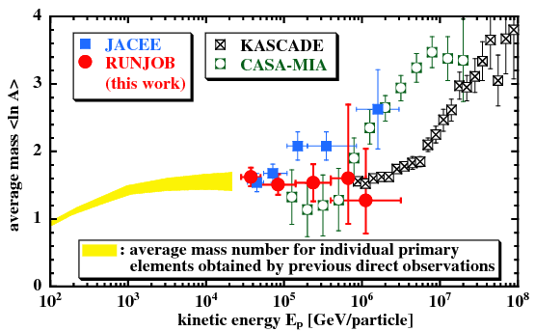
average mass composition
He ~ Li
(Derbina et al. 2005)

Slide 7
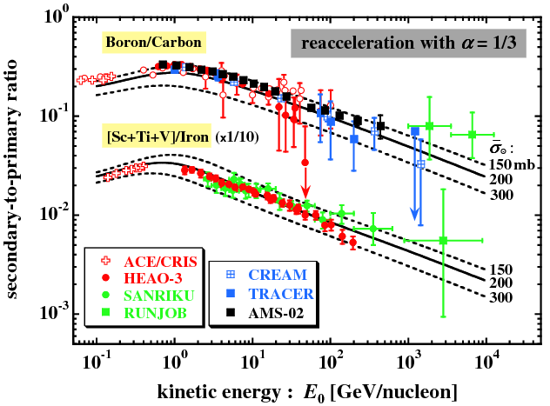
2ry-to-1ry ratio について
α = 1/2
?
anisotropy

Slide 8
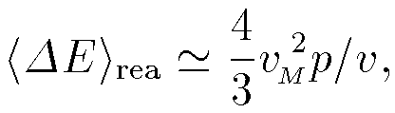
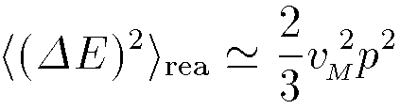
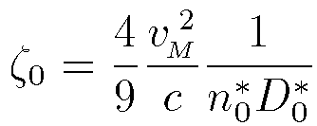


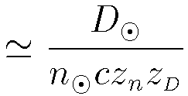






reacceleration & escape length
(Simon & Heinrich 1986)
●
efficiency:
(Shibata et al. 2006)
for
●
escape σ :
(Berezinsky et al. 1990;
Shibata et al. 2006)
for
or in g/cm²
11.5 g/cm²
;

Slide 9
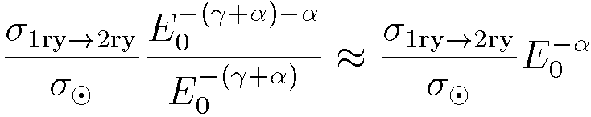






2ry-to-1ry ratio in HE and LE limits

Slide 10
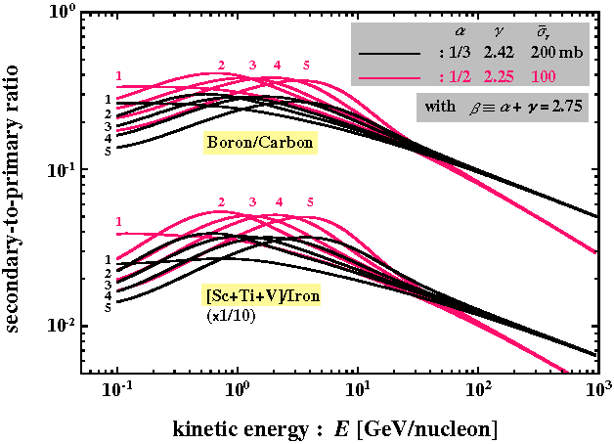
ζ₀
(mb)
1 0
2 20
3 50
4 100
5 200
(Shibata et al. 2006)

Slide 11
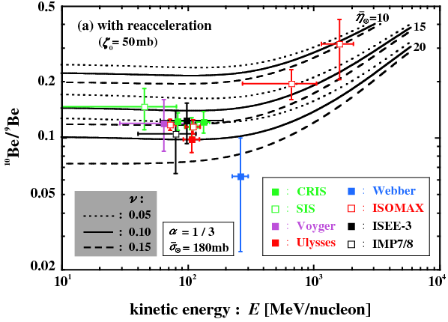
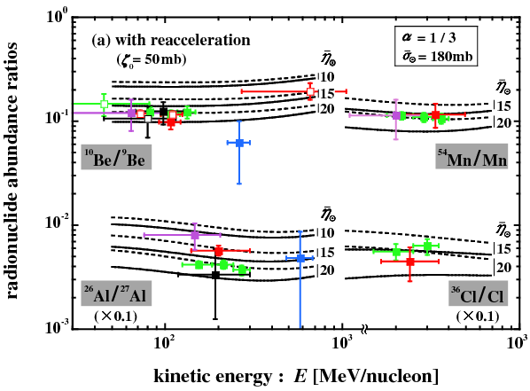
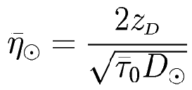




radio-nuclide abundance ratios
◎ , normalized to
: halo thickness
: isotope spread
Galactic plane

Slide 12



陽電子問題
: quite hard to obtain experimentally
in the high energy region
: rather easy to obtain experimentally
even in the high energy region
production cross-sections for and
: observable in machine with
E₀ = 1GeV – 20PeV !
(empirical cross-section)
: not observable in machine
how to check ?

Slide 13
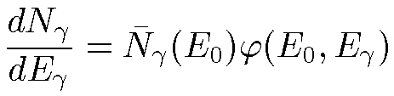
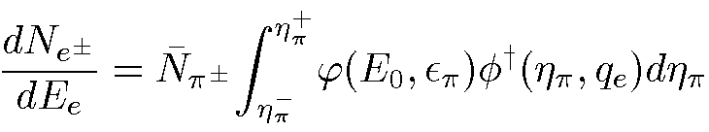
kinematically equivalent
(through μ-e decay kinematics => model independent)
(Commins 1973; Orth & Buffington 1976; Dermer 1986)
observable
(Shibata et al. arXiv:1304.0879v1 [astro-ph] 3 Apr 2013)

Slide 14
E₀ = 23.1 GeV
(Fidecaro et al. 1962)

Slide 15
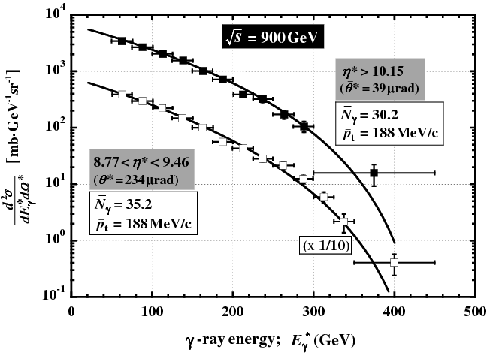
E₀ = 396 TeV
(Adriani et al. 2012)

Slide 16
multiplicity and prod. cross-section for γ-rays
γ-rays

Slide 17
multiplicity and prod. cross-section for charged mesons
π⁺, K⁺

Slide 18
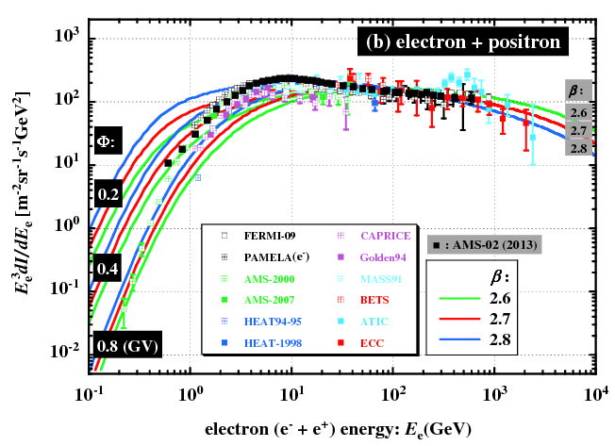
all electrons (e⁺ + e⁻)
β_{e}
3.2
3.3
3.4

Slide 19
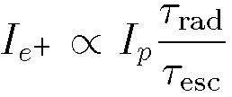
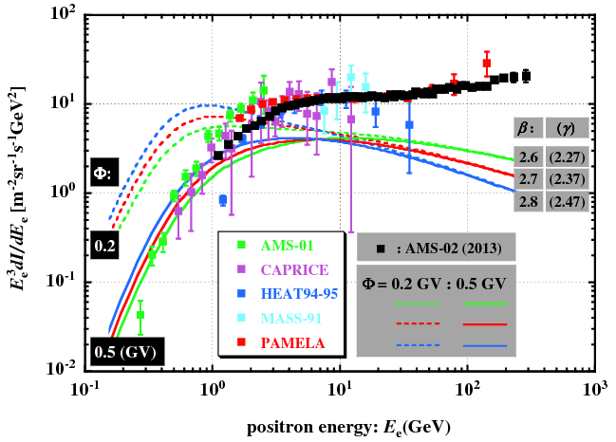
positrons

Slide 20
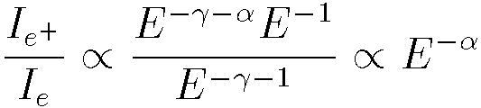
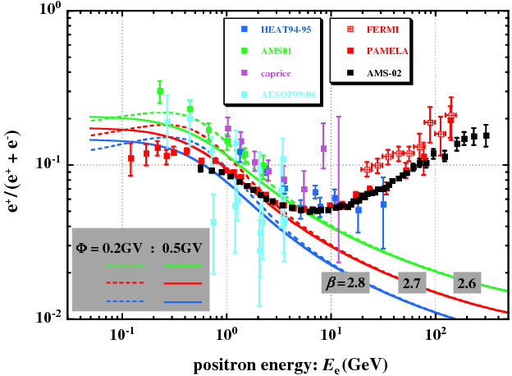
positron fraction

Slide 21
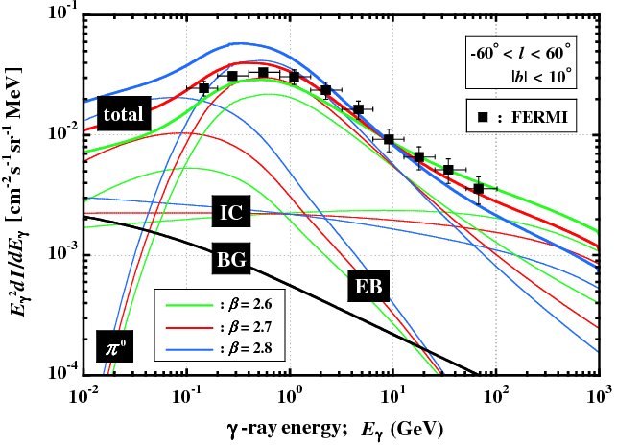
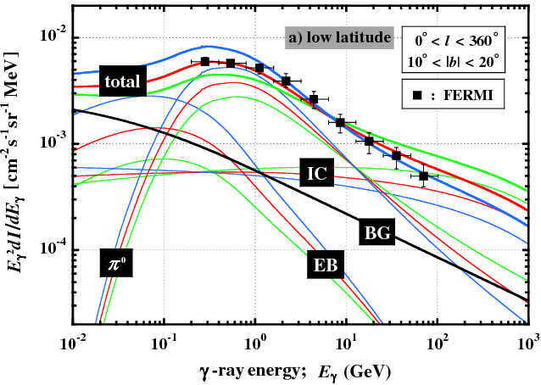
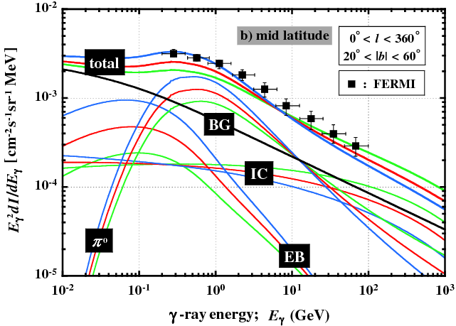
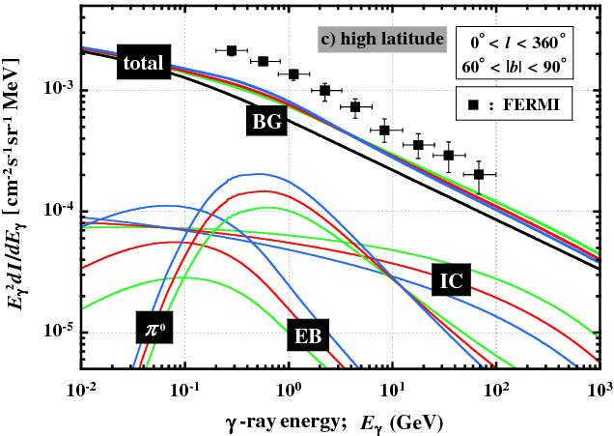
diffused γ-rays

Slide 22
summary
the positron excess is experimentally established
Kolmogorov-type turbulence in ISM preferable
what is an origin of excess ?
cosmological origin
(DM-annihilation/decay) ?
astronomical origin
nearby pulsars ?
reacceleration in source ? (Blasi 2009)
dense gas cloud ? (Fujita et al. 2009)
. . . . .
absolute intensities in e⁺, p⁺, A; B/C; ¹⁰Be/⁹Be; . . .
_
_
diffused-γ spectrum from galactic pole ?

Slide 23
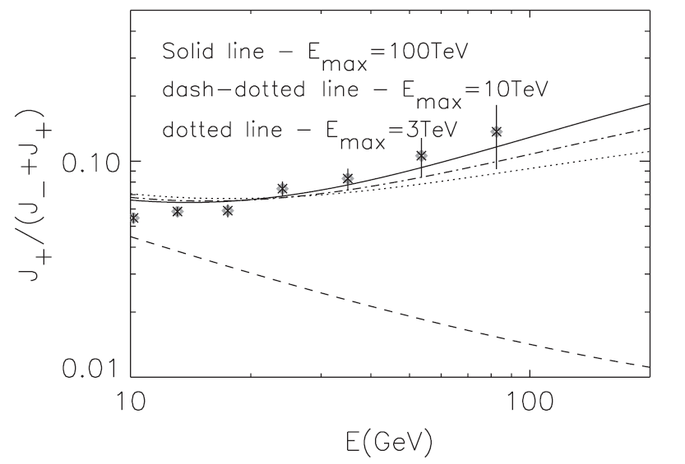
positron fraction
Blasi (2009, Jul.)

Slide 24
E_{p}^{-1/3}
Shibata et al. 2008

Slide 25
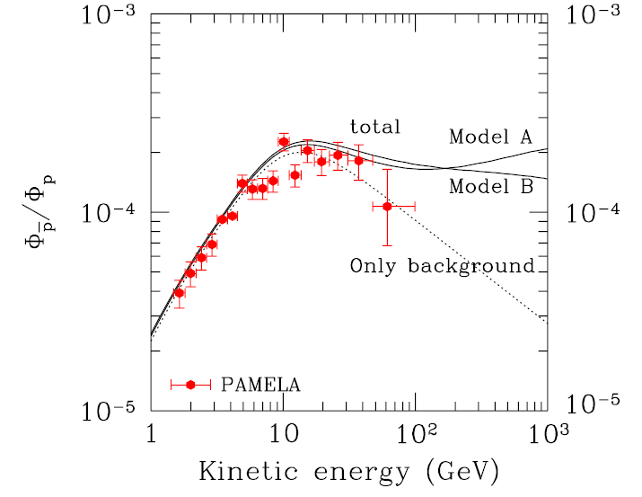
E_{p}^{-1/2}
Fujita et al. 2009

