Slide 1



Upper Limit on the Cosmological γ-Ray Background
Yoshiyuki Inoue (Stanford)
Kunihito Ioka (KEK)

Slide 2
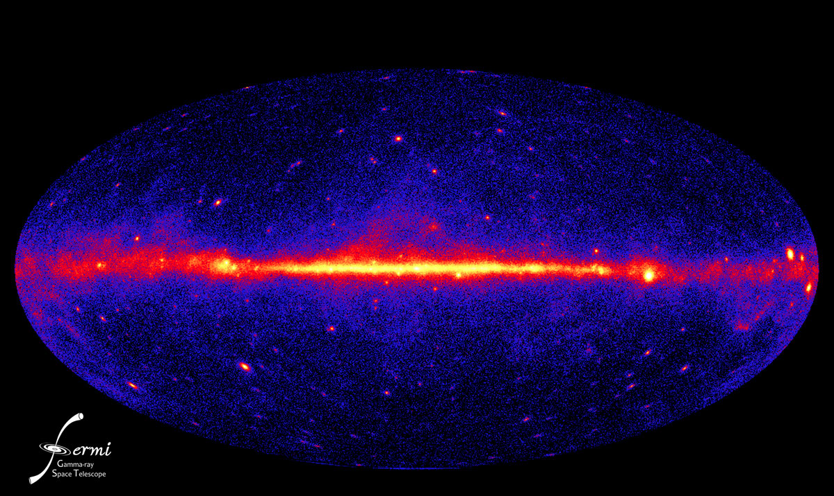
γ-ray Sky

Slide 3
γ-ray Background
Sky map - Resolved point - Galactic diffuse (π⁰,Bremss,IC)
- Solar & Local = Isotropic Extragalactic (inc. residual CR)

Slide 4
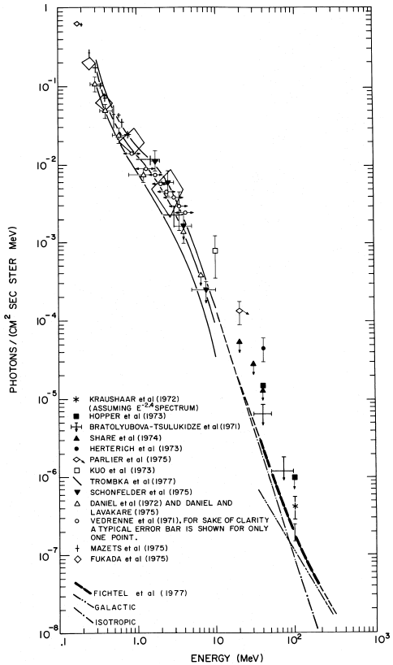
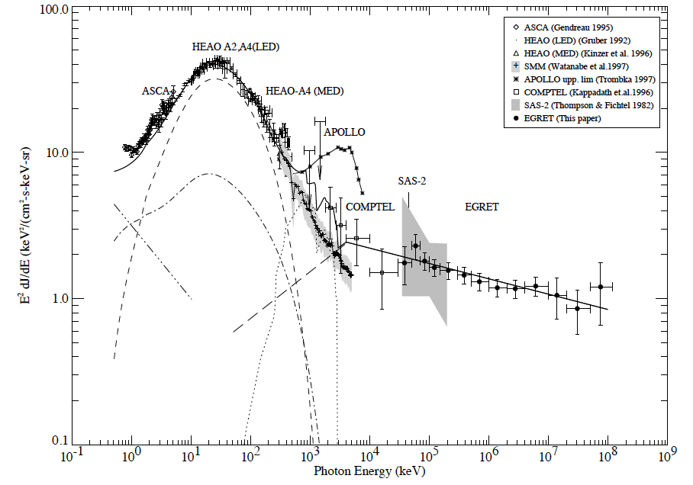
History
Fichtel+ 78
Discovered by SAS-2 satellite
EGRET on CGRO
LAT on Fermi
Streekumar+ 98

Slide 5
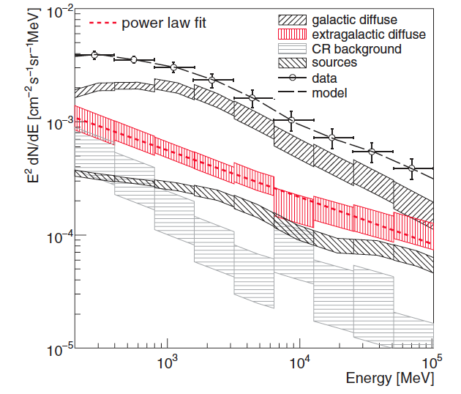
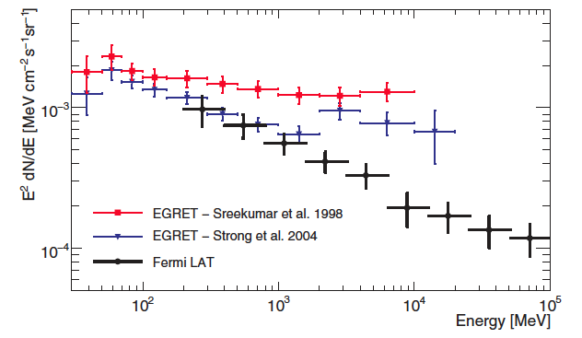
LAT EGB Spectrum 2010
Abdo+ 10
Spectrum can be fitted by power law: γ = 2.41 +/- 0.05
Flux above 100 MeV: F₁₀₀ = 1.03 +/- 0.17 x 10⁻⁵ cm⁻² s⁻¹ sr⁻¹ (extrapolated)
Foreground modeling uncertainty not included in error bands (~ 25%)
Softer than EGRET measurement (Sreekumar et al. 98)
No spectral features around a few GeV as seen in reanalysis of EGRET data (Strong+ 04)

Slide 6
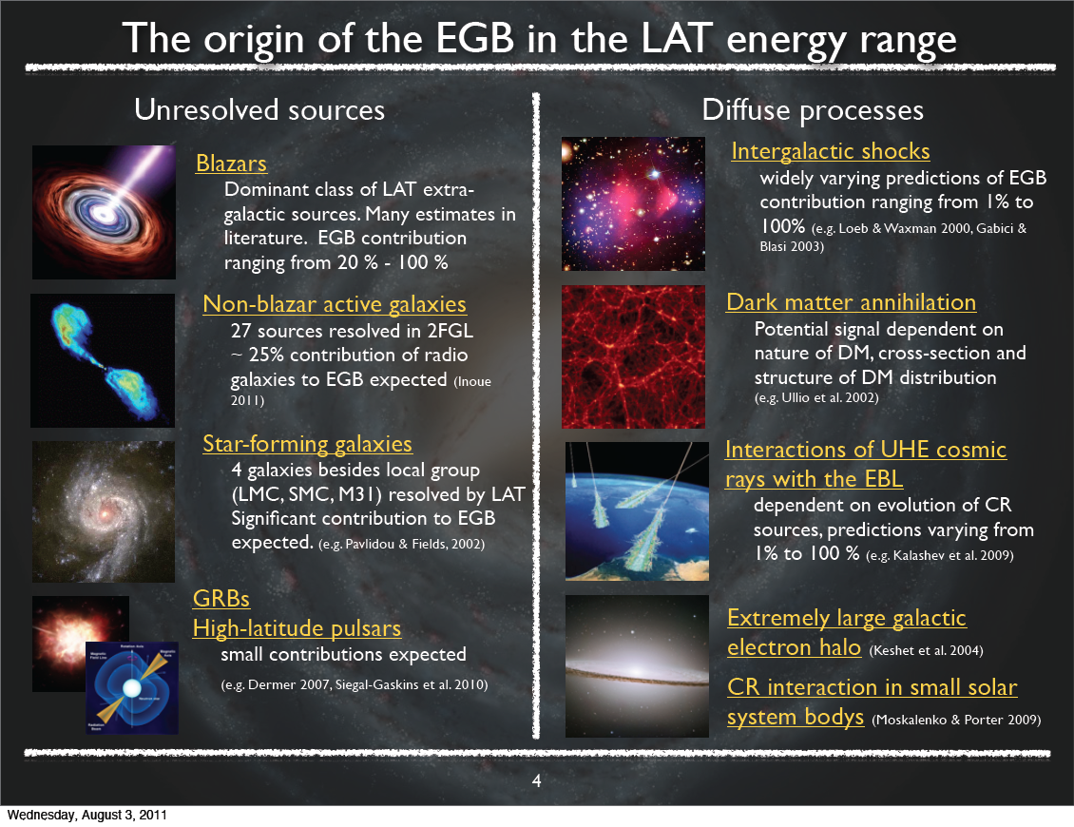
©Ackermann

Slide 7
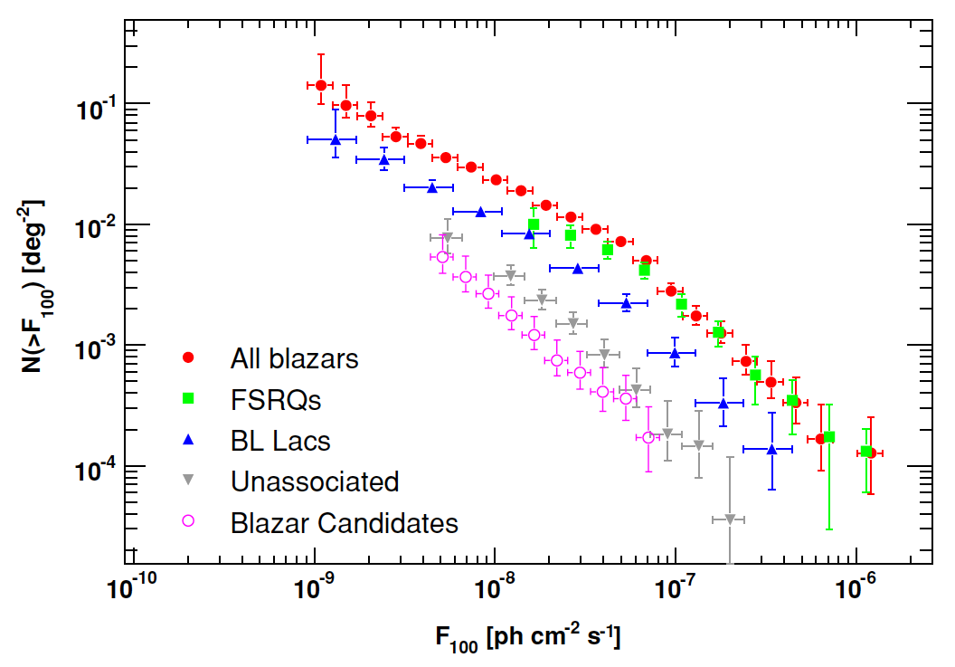
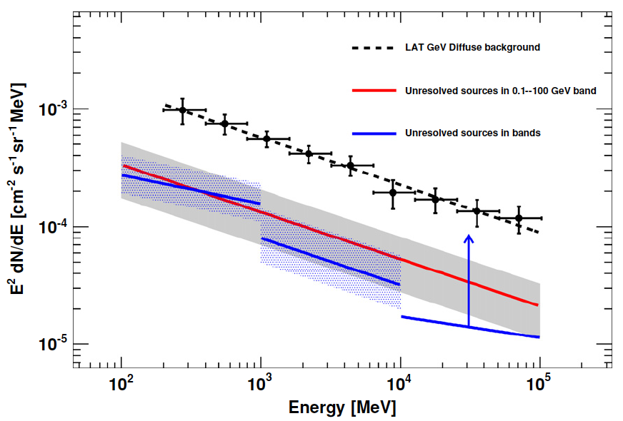
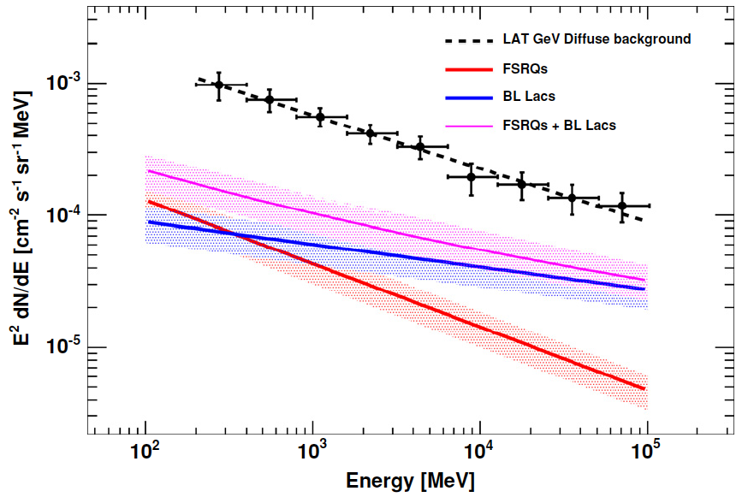
Unresolved Blazars
Abdo+ 10
Blazars dominate in LAT band
Extrapolation of source count
of resolved LAT blazars allows
estimate of their contribution
23%±5(sta)±12(sys) [100MeV-100GeV]

Slide 8
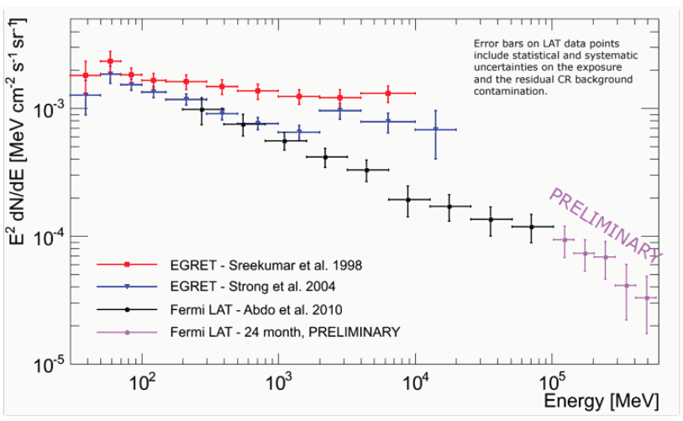
LAT EGB Spectrum 2011
Up to 580 GeV
Ackermann TeVPA11

Slide 9
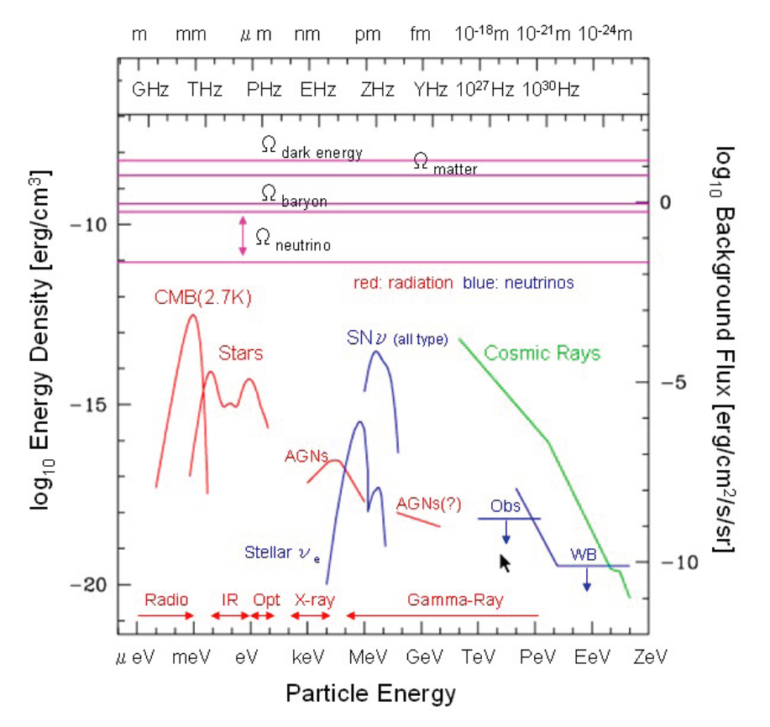
EBL
Star Light +
Dust Reemission
⇒ IR-Opt. Bkg.
γ_{eV} γ_{TeV}→e⁺e⁻
Deplete TeV γ
★IR=Infra Red~0.01eV
Opt=Optical~eV
©Totani

Slide 10
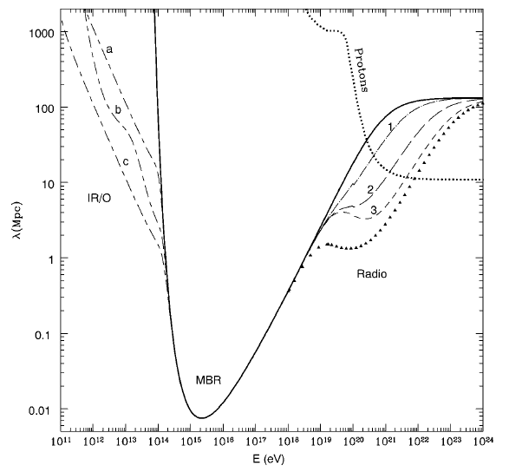
Gamma Ray Horizon
Cosmological Horizon
> TeV γ Horizon
Difficult to measure
IR background
due to zodiacal light
Coppi & Aharonian 97

Slide 11
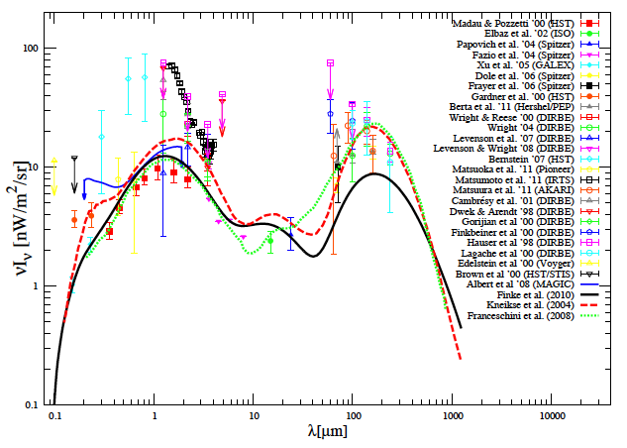
EBL Observations
Black: Our EBL model
Filled: Integrated flux of galaxies (Min EBL)
We use conservative EBL

Slide 12
Cascade Emission
Created e± scatter CMB via inverse Compton
γ_{e}~TeV/m_{e}c²~10⁶
E_{γ,c}~γ_{e}² E_{CMB}~GeV
Cooling time < Hubble time
Absorbed energy ⇒ Cascade emission

Slide 13
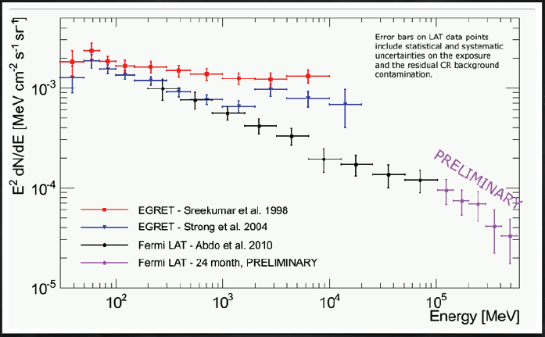
Upper Limit
If cosmological
sources produce
the background,

Slide 14
Upper Limit
The flux before
absorption should
be much higher

Slide 15
Upper Limit
The absorbed flux
cascades to low
energy horizontally
in this figure

Slide 16
Upper Limit
Then some model
violates the current
observations

Slide 17
Upper Limit
The current observations
already limit the BG
cf. Coppi & Aharonian 97

Slide 18
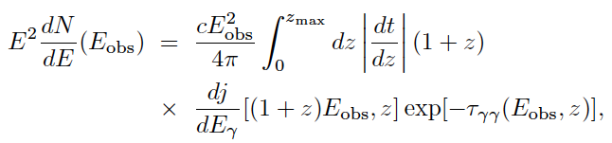


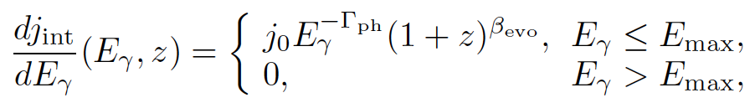
Primary Emission
Parameters: Γ_{ph}, β_{evo}, E_{obs}
Most known sources show positive evolution β_{evo}>0

Slide 19






Cascade Emission

Slide 20
Calculation
Iterative: 2nd, 3rd, … Cascades
Not affected by magnetic field
Scatter CMB dominantly
Most absorption is local
Cooling spectrum is not calculated (only affect the low energy region)

Slide 21
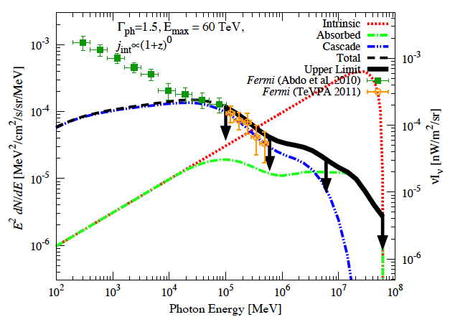

Cascade-limit Case

Slide 22
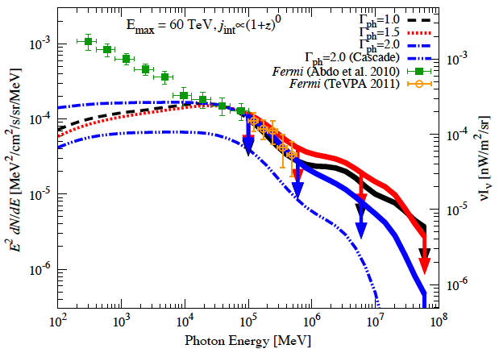
Primary-limit Case
Γ~1.5 gives
conserva.
upper limit

Slide 23
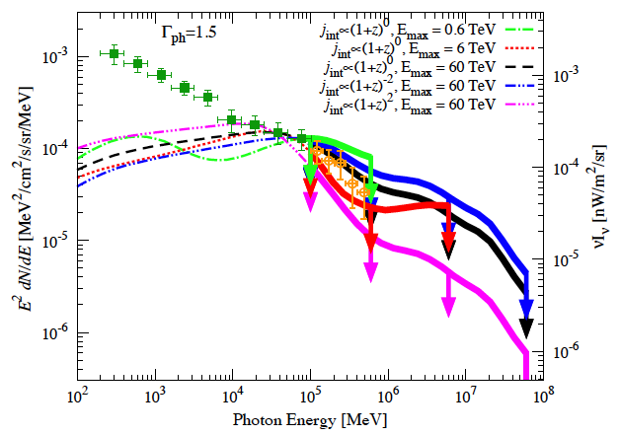
β_{evo} & E_{obs}
Negative
evolution,
Low E_{max}
ease limits
No know γ-ray
sources w/ β_{evo}<0
HBL β_{evo}=0
Elliptical -0.86
Cluster -1

Slide 24
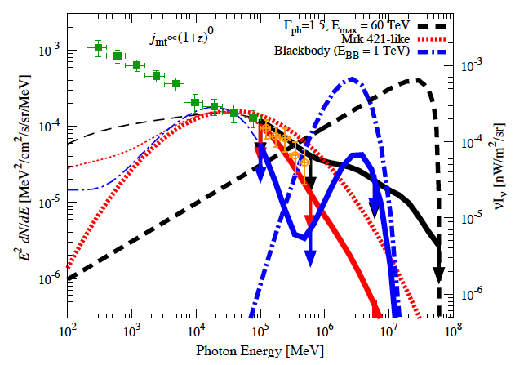
Different Spectrum

Slide 25
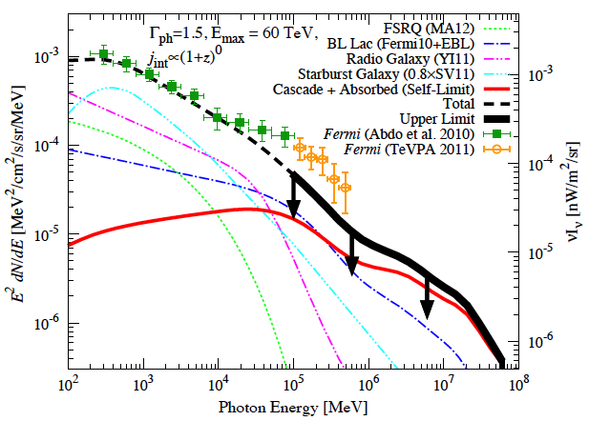

With Known Sources
Violate the
upper limit!

Slide 26
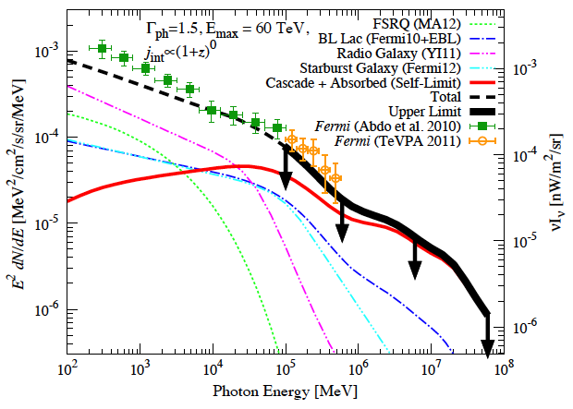
With Different Model
Starburst
model
uncertainty
Still
Inconsistent?

Slide 27
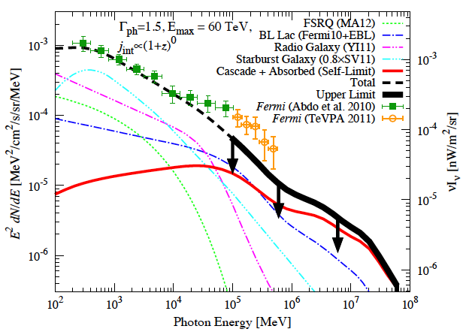
Possibilities
Hard spectrum, Sub-TeV E_{max} & β_{evo}<0
  No known γ-ray sources, TeV HBL?, LLGRB?
New physics: Axion or LIV?
Dark matter in local group?
More <10GeV Sources?
  Halo pulsars? Radio-quiet AGN?
Foreground?
  Fermi bubble?
Our upper limit is useful for
future: Fermi, CTA, CALET
See also Murase+ 12

Slide 28
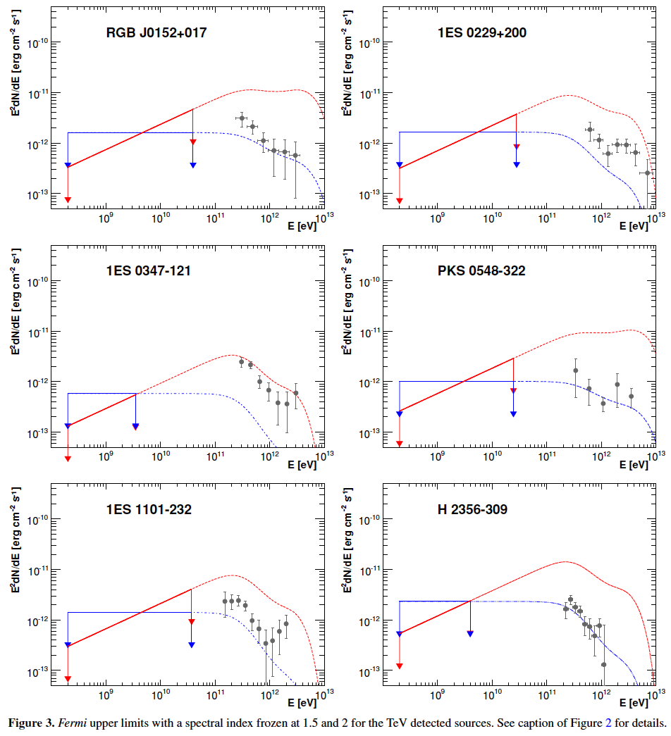
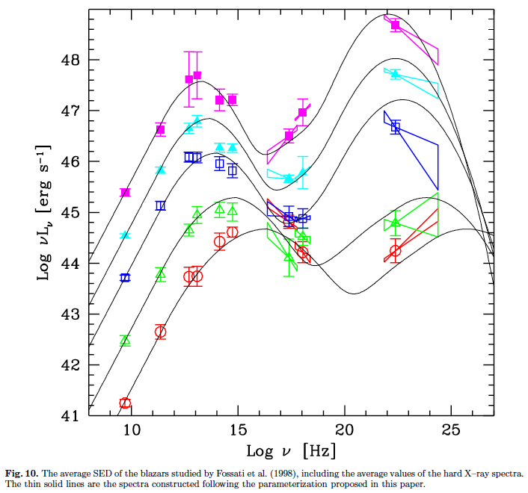
TeV HBL
TeV selected
high-frequency-peaked
BL Lac
Blazar sequence
Abdo+ 09
Fossati+ 97, 98; Kubo+ 98; Donato+ 01;
Kino & Takahara 04, Stawarz+ 07; many others

Slide 29
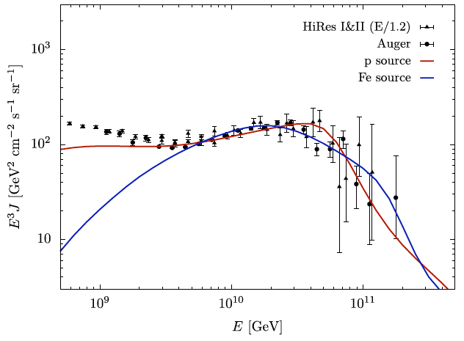
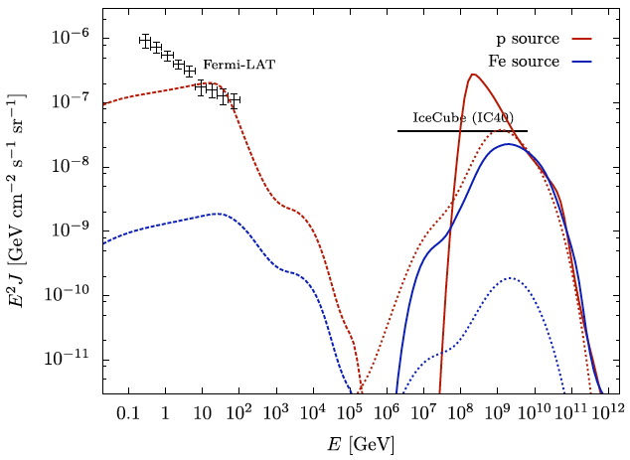
Low-Luminosity GRB?
Ahlers & Salvado 11
GRB most likely emit TeV γ
GRB energy generation rate ~ UHECR energy generation rate
~ Low luminosity GRB energy generation rate
LLGRB could negatively evolve due to metal
Murase+ 06

Slide 30
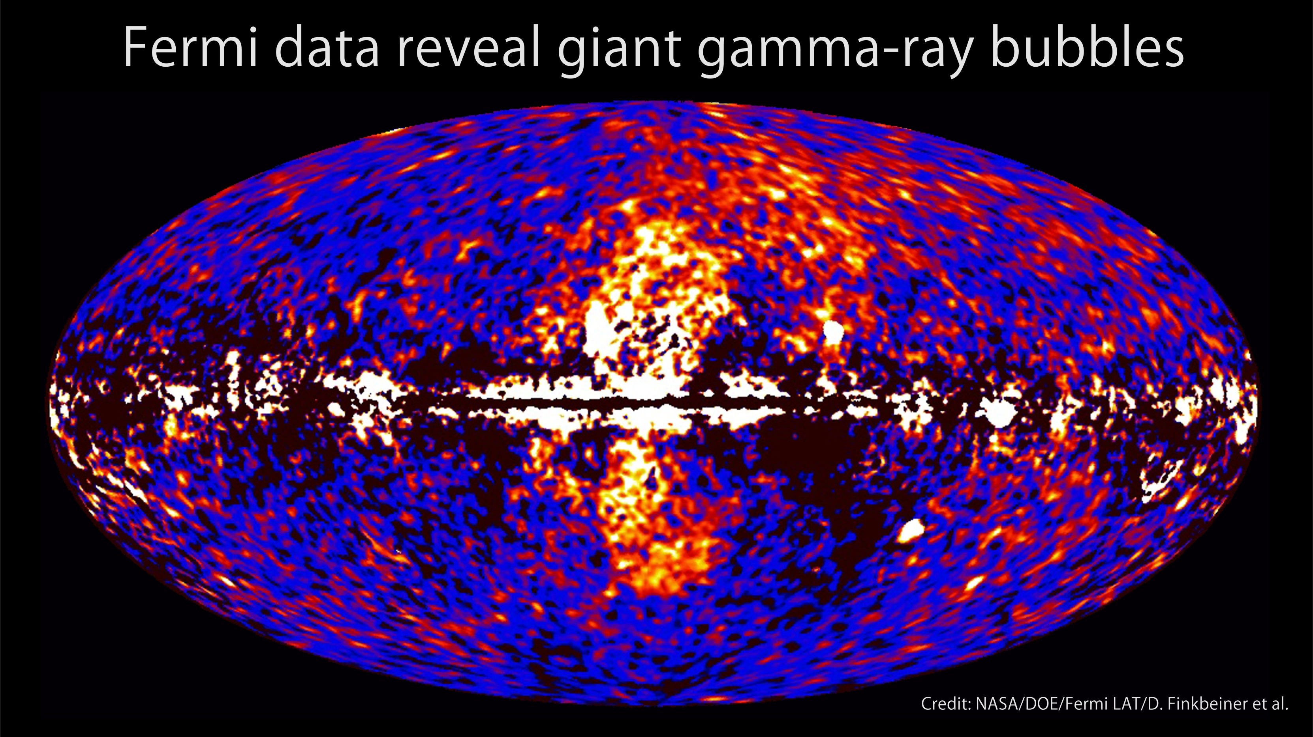
Fermi Bubble
~1.66yr
Data subtraction reveals the gamma-ray bubbles

Slide 31
Thank You

