Slide 1
量子重力効果 と ＥＢＬ （銀河系外背景放射）
ＶＨＥガンマ線観測の遠景 と 戦略
T. Kifune
1 : motivation for presenting this talk;
2 : opacity of Universe to γ-rays and EBL
QG effect on “particle reactions”
3 : Evidence?
origin of CRs …
Perspective of TeV γ astronomy ?

Slide 2
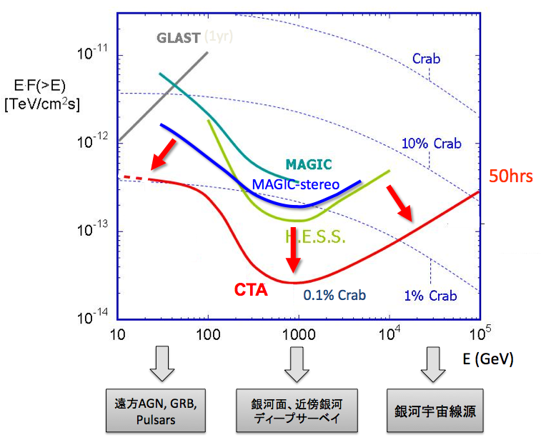
Part One: motivation of talk?
CTA は現在の超高エネルギーガンマ線天文学の成功をさらに飛躍的におしすすめる
  高感度感度 10倍(10⁻¹⁴erg/cm²/s)
  高角度分解能 2arcmin at 1TeV
  高エネルギー分解能 10% at 1TeV
  広いエネルギー領域(20GeV-100TeV)
  広い検出面積（3km²)
These performances
for the purpose of
what sort of science?
How good and necessary ?
By comparing
with what ?
Several
Town meetings
将来計画＝若手
50才より
若いこと
A view
of
ＴｅＶ γ from
a “strange” angle
北京
ICRC
[cta-japan 00944] 規約制定
パンフレット
some conversations
with old colleagues:
“Politics and Science !”
Still < 100TeV?
highest, Crab?
多様性・現象論
And /or
原理的・普遍性

Slide 3
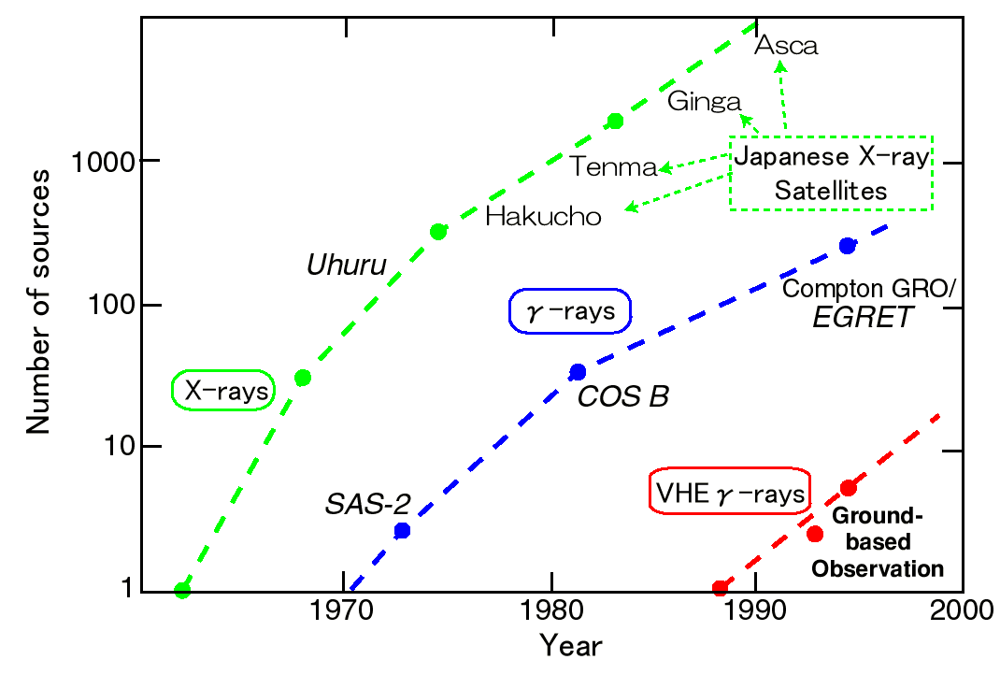
Global/international vs “日本の独自性“
γ-ray astronomy in future , 10 years from now ?
？
時間変動する天体
ΔE/E, …………などに
焦点を絞る
日本のＸ線衛星！

Slide 4
なぜ、ＴｅＶ・ガンマ？
こんなことはどうでもよい！
大切なことは science ：理解を深められるか？
ＣＴＡ? JapanCTA will be funded ?
From Teshima, Totani’s talk
In 物理・天文学会
宇宙線の起源
銀河系内、系外の
高エネルギー天体の研究
赤外・可視背景放射
（宇宙の星形成史）の研究
暗黒物質対消滅からの
ガンマ線の探索
相対論（量子重力理論）
の高精度検証
電波 パルサー・・・
中性子星
….. …….
赤外線 …….
Ｘ線 近接連星
ブラックホール
ＭｅＶ ……….
ＧｅＶ 超新星残骸？
ＴｅＶ ？？？
………………..
CRs, LHC,…..
Some new concept ?
10 –
100
TeV ?

Slide 5
Part 2: EBL, QG effect, VHE γ-rays
EBL : Extragalactic Background Light
Opacity of extragalactic space to gamma rays
γ + γ_{B} →annihilation into (e+e-)
γ_{B} ≡ EBL energy dependent cross section
K ε threshold K ε = m_{e}² phase volume
→ K ε = 4m_{e}²
K : 0.1 TeV 1 TeV 10 TeV
ε : 10eV(0.1μ) 1eV(1μ) 0.1eV(10μ)
QG effect : Quantum Gravity
reactions of γ and CRs modified by QG effects ?

Slide 6
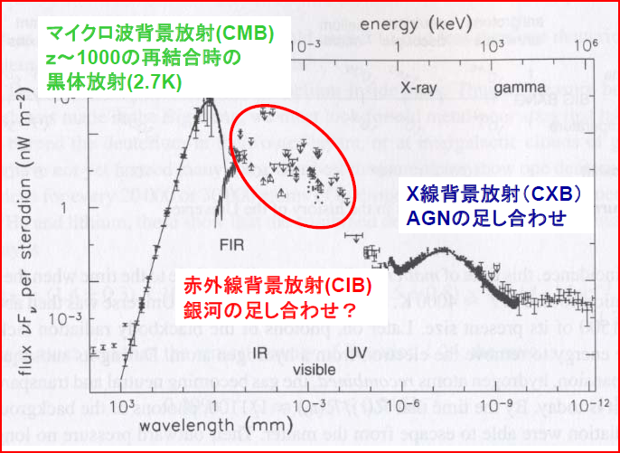
From 「赤外線背景放射のロケット観測計画CIBER」
100 10 1 0.1 TeV
-6/12=-0.5
ガンマ線の吸収
スペクトルの形状の変化： softening

Slide 7
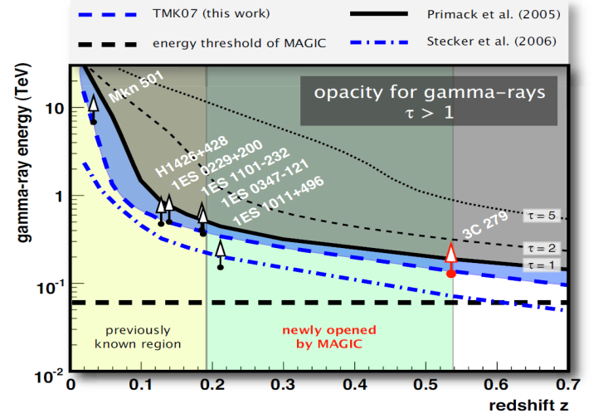
from Manel Martinez
τ_{γγ} = 3
Abdo et al. ApJ, 723, 1082 (2010)
ＥＢＬの波長 γ ray energy
Less opaque than
we have expected
from EBL known so far !
Absorption
length
EBL intensity
Distance to objects

Slide 8
How will it be finally settled?
What’s the Key ！？

Slide 9
EBL seen from TeV γ
λ (μm)
1
1.2
？
energy of EBL photons
ε K = 4m_{e}²
ε K = m_{e}²
0.1
12
ε (eV)
0.01
120
below threshold
0.001
10¹¹ 10¹² 10¹³ 10¹⁴ 10¹⁵
Density of
EBL photons
K (eV)
Gamma ray energy

Slide 10
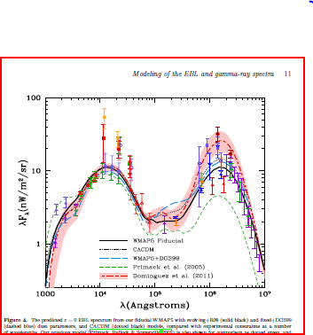
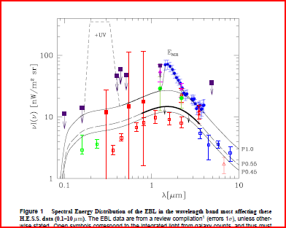
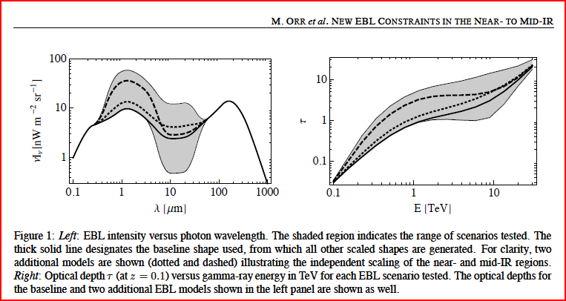
HESS Nature(2006)
Gilmore et al.(2011)
Let us Look at １－１０ＴｅＶ Region !

Slide 11
Quantum gravity ?
ξ < 0
V > c
ξ > 0
V < c
E
P
0

Slide 12
Quantum Gravity by “observing flare” event ?
OPERA Oscillation Project with Emulsion-tRacking Apparatus, CERN CNGS1
d = 7.3×10⁷cm=2.4×10⁻³ sec
Delay time = 60.7 ±6.9 ±7.4 [nsec]
(v –c)/c = (2.4 ±0.28 ±0.30) ×10⁻⁵
HESS Beijing 2011, Bolmont et al.
PKS 2155-304, z=0.116,
d = 1.4×10⁹ [ly] = 4.2×10¹⁶ [light sec]
Delay time = -5.5 ±10.9 ±10.3 [sec TeV⁻¹]
Δv/c ≈ ΔK/Mc² ≈ 10⁻¹⁶
M > 2.1×10²⁷ eV = 0.6 M_{planck}
emission time within (1-10) second ?
Emission size within 10¹⁰⁻¹¹ cm ??
emission time within (1-10) second ?
Emission size within 10¹⁰⁻¹¹ cm ??

Slide 13
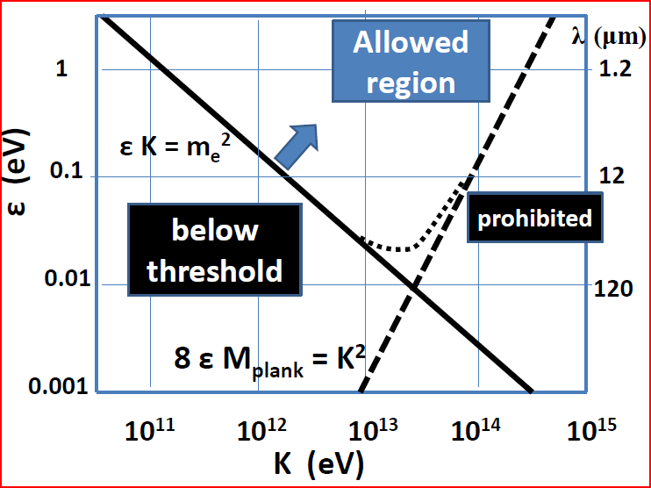
重心系のエネルギー W² =(ΣE)²-(Σpc)² ≥ (2m_{e}c²)²
4K ε ≥ 4m_{e}²c⁴ + ξ(K³/M_{pl})
Ｋｉｆｕｎｅ ＡｐＪＬ（１９９９）

Slide 14
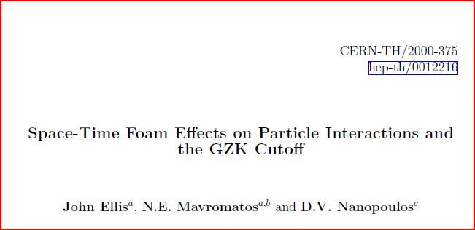
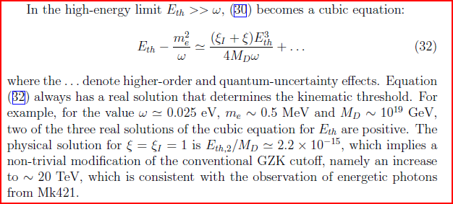

Slide 15
Reactions & Phenomena which are relevant to Gamma ray astrophysics
p(cosmic ray) + p (matter) → p+ N+ π
hadronic radiation ?
e(cosmic ray)+ γ_{b} (EBL)→ e+ γ
inverse Compton leptonic radiation ?
“cosmic cascade” ?
γ+ γ_{b} (EBL) → e⁺+e⁻ (annihilaton – e⁻e⁺)
p+ γ_{b} (EBL) → p + e⁺+e⁻
(energy loss by e⁻e⁺ of 10¹⁹eV CRs)
p+ γ_{b} (EBL) → p+ π (GZK cutoff)
γ+ A (atmosphere) → A+e⁺+e⁻ (cascade shower)
detection method OK ?

Slide 16
Kinematics: threshold energy
( γ + γ_{b} (EBL) → e⁺+e⁻ )
重心系のエネルギー W² =(ΣE)²-(Σpc)² ≥ 4m_{e}²c⁴
Energy : K + ε = E₁ + E₂
momentum : k - ε = p₁ + p₂
K²=K²(1+ξK/M),
P₁²=E₁²(1+ξkE₁/M), P₂²=E₂²(1+ξkE₂/M)
E_{i}, P_{i} proportional to mass in the final state
at threshold

Slide 17
γ + γ_{b} (EBL) → e⁺+e⁻ (absorption)
Energy : K +ε = E₁ + E₂
momentum : K(1+ξK/M)^{0.5} - ε
= p₁ + p₂ = 2p₁ = 2E₁(1+ξE₁/M)^{0.5}
Energy of final state : K + ε = 2 (p₁²c²+ m_{e}²c⁴)^{1/2}
4K ε ≥ 4m_{e}²c⁴ + ξ(K³/2M_{pl})
K > (Mε)^{0.5} ≑ 10¹³eV for ε = 10⁻³ eV
K > (Mm_{e}²)^{1/3} ≑ 10¹³eV

Slide 18
ε K = 4m_{e}²
Allowed
λ (μm)
1
1.2
energy of EBL photons
ε K = K³/2M_{pl}
ε K = m_{e}²
0.1
12
ε (eV)
prohibited
below threshold
c⁴
0.01
120
0.001
10¹¹ 10¹² 10¹³ 10¹⁴ 10¹⁵
Density of
EBL photons
K (eV)
Gamma ray energy

Slide 19
!?

Slide 20
Kinematics: above threshold
A + γ_{b} (EBL) → B + C
or target at rest
Energy : E_{A} + ε = E_{B} + E_{C}
momentum : p_{A} - ε = p_{B} + p_{C}
-1 ≤ cos θ ≤ 1
P₁²=E₁²(1+ξkE₁/M), ….
(p_{A} – ε)² + p_{B}² - (p_{A} – ε)p_{B} cos θ = p_{C}²
Ф を消去
p_{C}²
p_{B}²
θ
Ф
(p_{A} – ε)²

Slide 21
e + γ_{b} (soft photon) → e + γ (inverse Compton)
Energy : E + ε = K + E’
momentum : p – ε = k + p’
a=K/E
cos θ ≤ 1
(p_{A} – ε)² + p_{B}² - (p_{A} – ε)p_{B} cos θ = p_{C}²
4E ε ≥ a(4E ε +m₂c⁴)
+ξ(K³/M_{pl}c²) 2a(1-a)²

Slide 22
1
Effect
by QG term
ε = 100 eV
ε = 1 eV
0.1
ε = 10⁻² eV
ε = 100 eV
a = K/E
allowed
0.01
b < Mε/E²
ε = 1 eV
0.001
ε = 10⁻⁴ eV
10¹⁰ 10¹² 10¹⁴ 10¹⁶ 10¹⁸
E_{e} (eV)

Slide 23
e + γ_{b} (soft photon) → e + γ
(inverse Compton)
Energy : E1 + ε = K + E2
momentum : p₁ - ε = p₂ + K (without ξ-term)
a=K/E1= εE/(2E1²-(2E1²-m²)cosθ)
a=K/E1∝ E1,
K =a E1 ∝ E1²
cos θ ≈ 1
K²
p₂²
θ
(p₁ – ε)²

Slide 24
Inverse Compton and QG effect
“up-scattering” of “target photons”
of longer wavelength than
ε < 10⁻² eV
are suppressed for energy of incident electron
E_{e} > 10¹² eV
(for E_{e} > 10¹⁶ eV, upscattering not happens in IC scattering)
Leptonic/hadronic radiation : gamma ray source
K ～ ε (E/mc²)² might be changed ?
Argument of SSC or EC to be reconsidered ?
Life time of high energy electrons ---- prolonged ?
…….

Slide 25
p+ γ_{b} (soft photon) → p + π
(GZK cutoff)
Energy : E + ε = E_{p} + E_{π}
momentum : p - ε = p_{p} + p_{π} (ξ-term included)
4E ε ≥ m_{π}(2m_{p}+m_{π})c⁴
+ξ(E³/M_{pl}c²) m_{π}/(m_{p}+m_{π})
K²
p₂²
θ
(p₁ – ε)²

Slide 26
ε(eV)
Allowed as above
threshold
λ (μm)
40ε M_{planck} = K²
10⁸
10⁴
K=(20 m_{π}m_{p} M_{planck} )^{1/3}
= 3x10¹⁵eV
prohibited
10⁰
Below threshold
1.2
2ε K = m_{π}m_{p}
12
ξ K³/M_{planck}
= 40 ε K
120
10⁻⁴
10¹¹ 10¹³ 10¹⁵ 10¹⁷ 10¹⁹
E_{p} (eV)

Slide 27
General feature of threshold condition and QG effect
γγ_{B}→e⁺e⁻ 4Kε - 4m_{e}c² - K³/2M > 0
γp(air) →pe⁺e⁻ 4Km_{p}c² - 4m_{e} (m_{p}+m_{e}) c⁴ - K³/M > 0
4m_{e}c² = K₂³/2M
K₂
K
K₁

Slide 28
“Critical energy” of QG effect for various reactions
EBL as target
γγ_{B} → e⁺e⁻ K1 = (Mε)^{0.5} ≑ 10¹³eV
IC K1 = (Mε)^{0.5} ≑ 10¹³--10¹⁴eV
γp(air) →p e⁺e⁻ K1 = (Mm_{p})^{0.5} ≑ 10¹⁸eV
K2 ≈ (Mm_{e}m_{p})^{1/3} ≑ 10¹⁴eV
pp→ppπ⁰ E1 = (Mm_{p})^{0.5} ≑ 10¹⁸eV
E2 ≈ (Mm_{π}m_{p})^{1/3} ≑ 10¹⁵eV
pγ_{B}→ p e⁺ e⁻ E1 = (Mε)^{0.5} ≑ 10¹³eV
E2 ≈ (Mm_{e}m_{p})^{1/3} ≑ 10¹⁴eV
GZK: pγ_{B}→ pπ E1 = (4Mεm_{p}/m_{π})^{0.5} ≑ 10¹⁴ eV
E2 ≈ (Mm_{p}²)^{1/3} ≑ 10¹⁵eV
Detection OK?

Slide 29
Evidence ? and Curiosities Expand further ….
To detect > 100 TeV γ rays
From what sort of objects?
from nearby galaxies ? Or AGN ?
pp→ppπ process ensures > 100 TeV γ rays
Galactic disc emission upto …….?
origin of CRS
Halo emission accompanied ?
cosmic cascade
High energy end of EBL …….
ＧＺＫ/top-down - cascaded photons ?
Galactic objects
Nearby
galaxies
AGN

Slide 30
Nearby galaxies
By IACT
1TeV 10TeV 100TeV 1PeV

Slide 31
1. EBL
EBL ; a bridge connecting the “worlds” over 12 + 8 + 8 decades！
?
And also, or
rather more exiting

Slide 32
summary
> 10 --100TeV gamma rays :
a window to look into the Planck - scale energy region?!
Clear Evidence for QG effect ?
Galactic disk emission of Gamma rays from other galaxies ?
(Existence of γ rays > 100TeV is guaranteed by p –p interaction)
To extend the maximum energy from SNR etc., emission from Galactic disc ? --------- Origin of CRs
cosmic cascade / Halo emission ? high energy end of EBL
extragalactic diffuse VHE gamma : a whole view of EBL ?
something from top-down mechanism ?
What sort of telescope is adequate for “this science” ?
….. The case of Quadratic term …..

