Slide 1
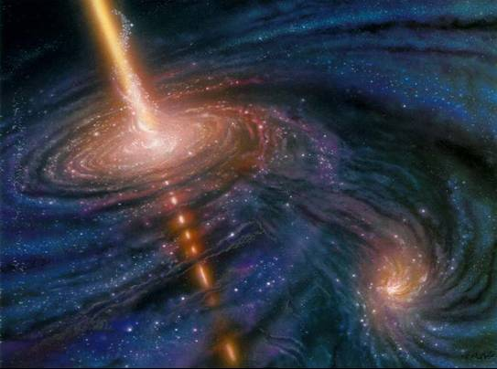
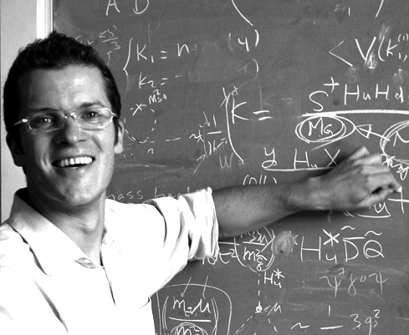
Status of VHE Gamma Ray Astronomy
ICRR, University of Tokyo
Max-Planck-Institute for Physics
Masahiro Teshima
Thanks Stefan
I will use some of your slides at ICRC11

Slide 2
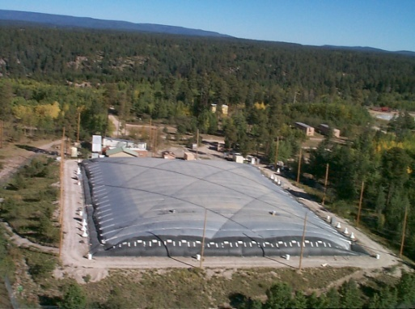
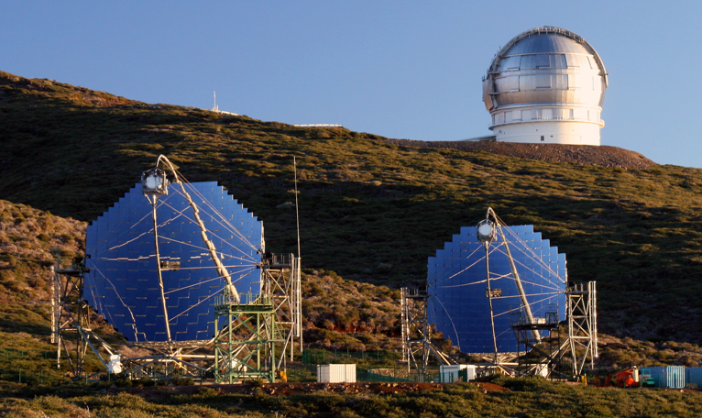
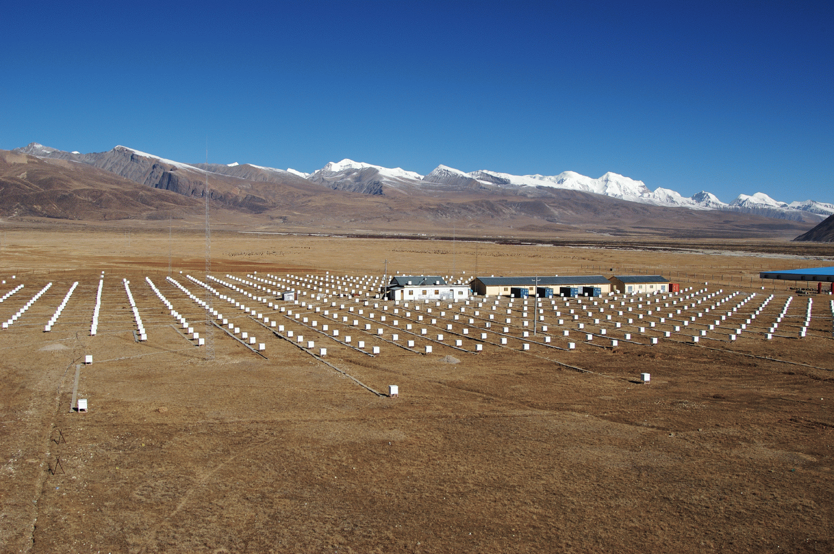
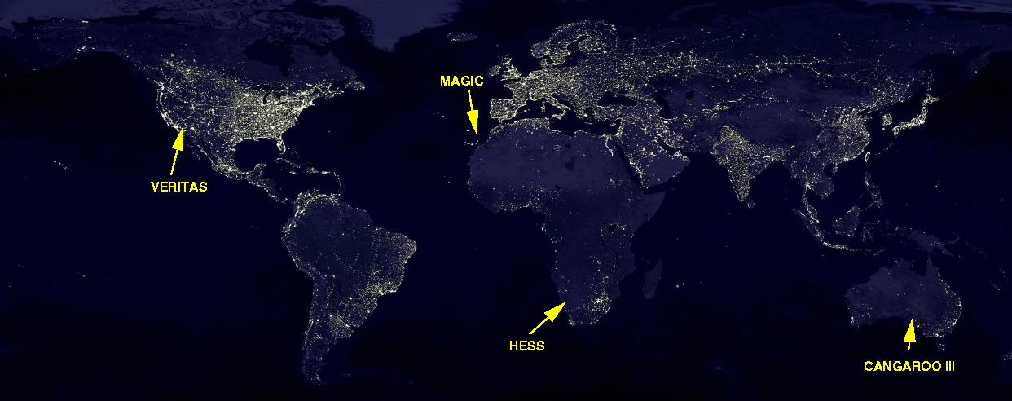
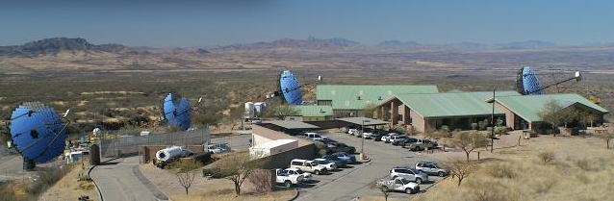
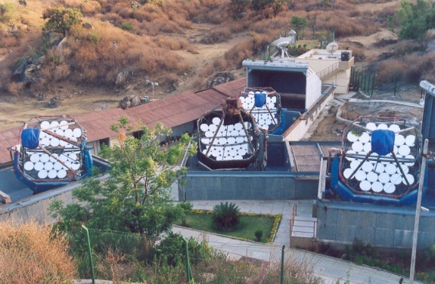
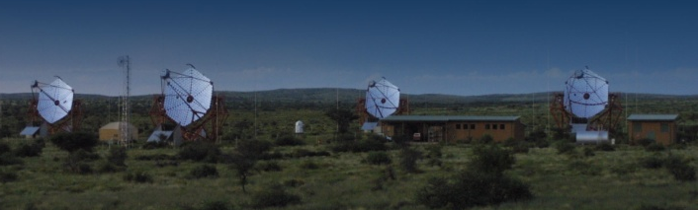
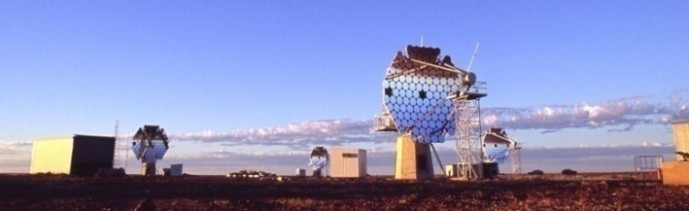
VHE Instruments
MILAGRO
MAGIC
TIBET
TIBET
ARGO-YBJ
MILAGRO
STACEE
TACTIC
VERTAS
PACT
GRAPES
TACTIC
HESS
CANGAROO
Notes:
2

Slide 3
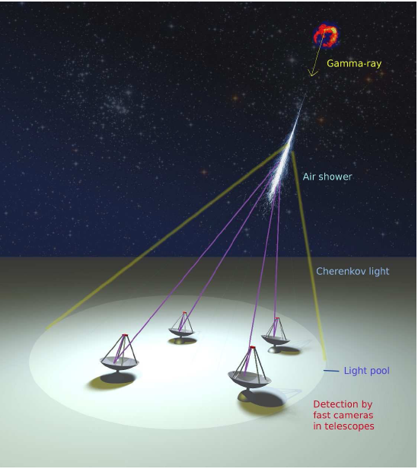
Imaging Air Cherenkov Telescope
Cherenkov Light
50photons/m² (5 pe/m²) at 1TeV
➔ MAGIC 2 x240 m², HESS 4 x106 m²
T1
T２
T３
T４
Typical parameters
Energy range 50GeV ~ 10TeV
Angular resolution ~0.1 degrees
Energy resolution ~20%
Detection area ~10⁵m²
Sensitivity ~1% Crab Flux (10⁻¹³ erg/cm²s)

Slide 4
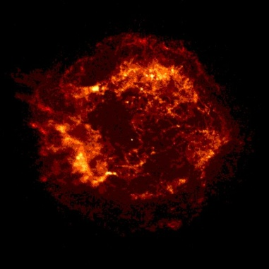
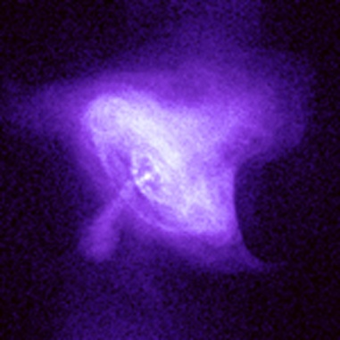
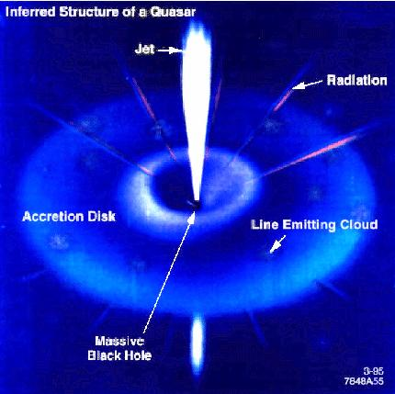
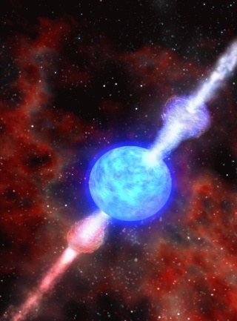
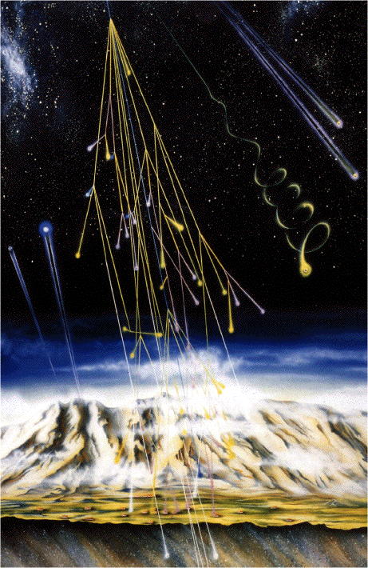
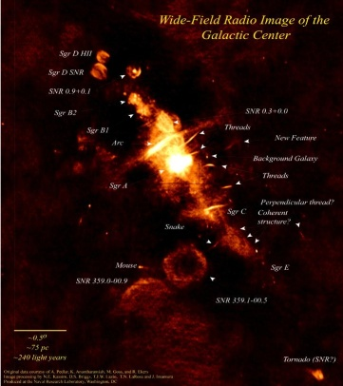
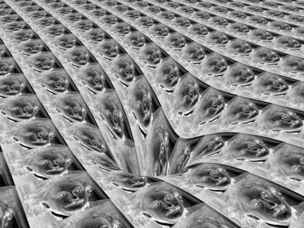
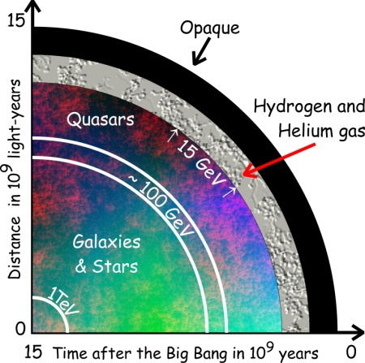
Physics objectives
SNRs
Pulsars
and PWNe
Micro quasars
X-ray binaries
AGNs
GRBs
Origin of
cosmic rays
Space-time
& relativity
Dark matter
Cosmology

Slide 5
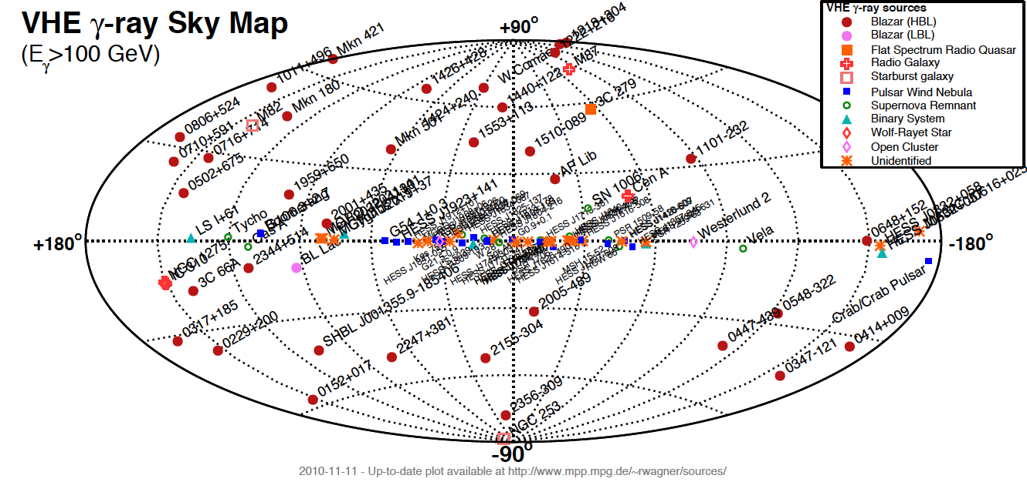
VHE Skymap
106 sources (45 Extragalactics + 61 Galactics) in Nov 2010
Blazars, FSRQs, FR-I, Starburst galaxies SNRs, PWNe, Pulsar, Binaries, un-IDs

Slide 6
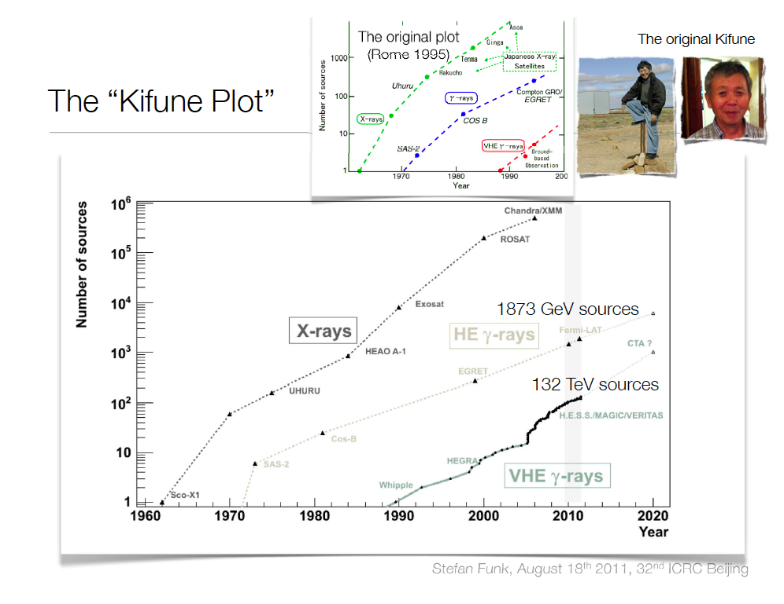

Slide 7
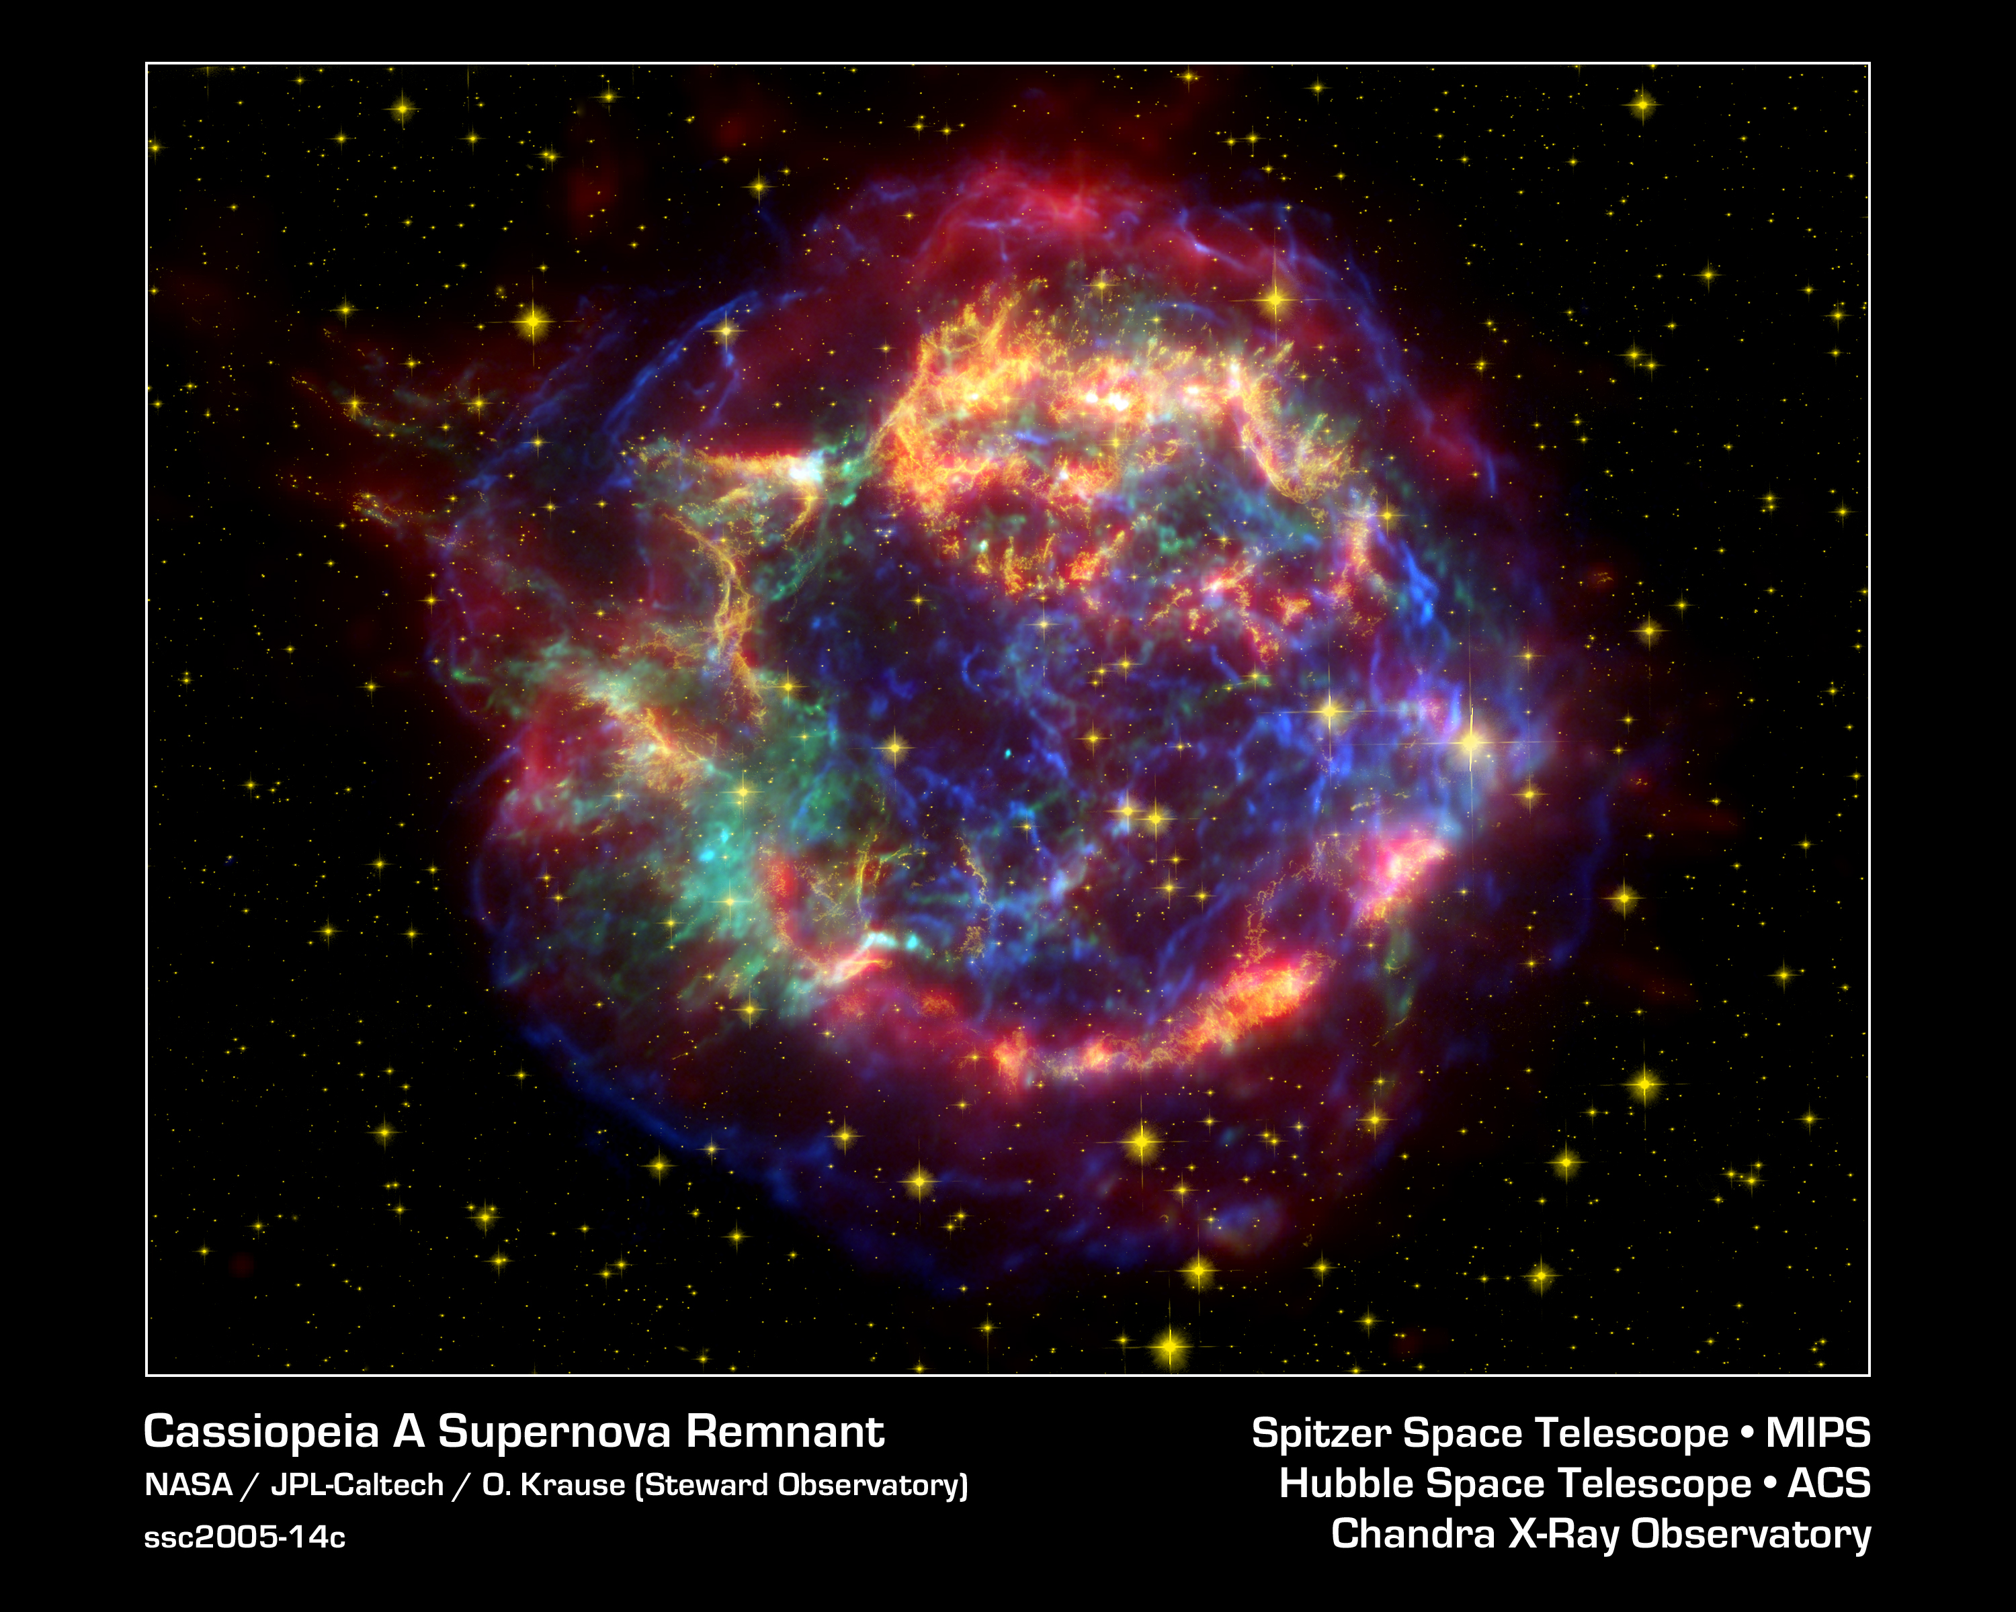
Galactic Sources
SNRs, PWNe

Slide 8
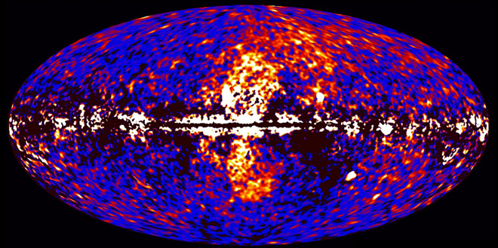
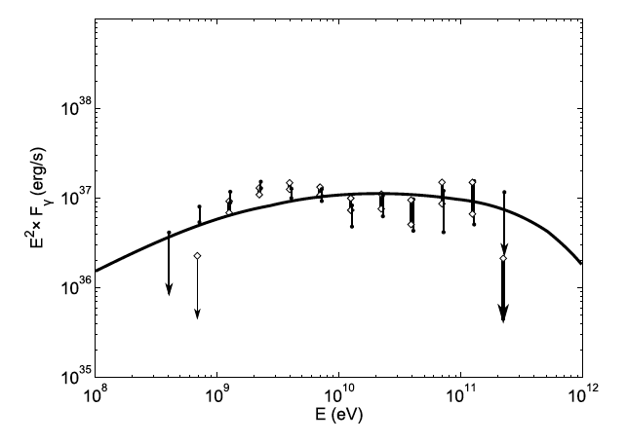
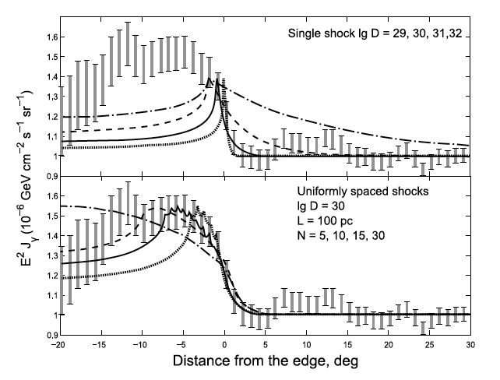
Fermi Bubbles
Symmetry suggests relation to Galactic Center
Hard Energy Spectrum (dN/dE ~ E⁻²)
Extends up to 10kpc above the disk (cooling time problem)
Edges are not clear

Slide 9
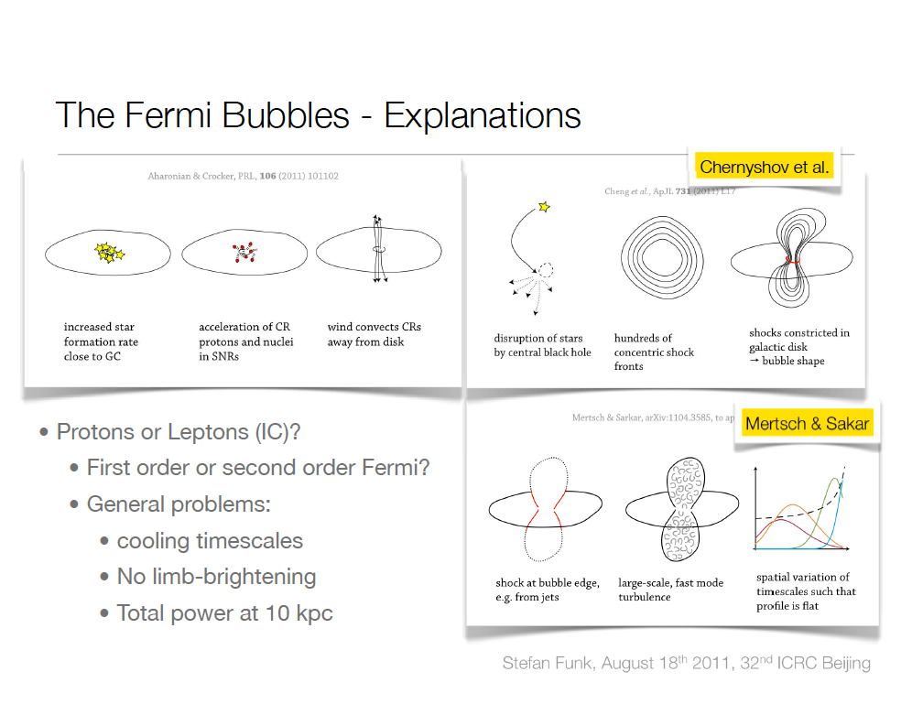

Slide 10
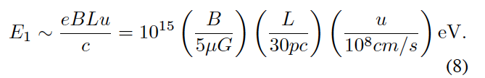
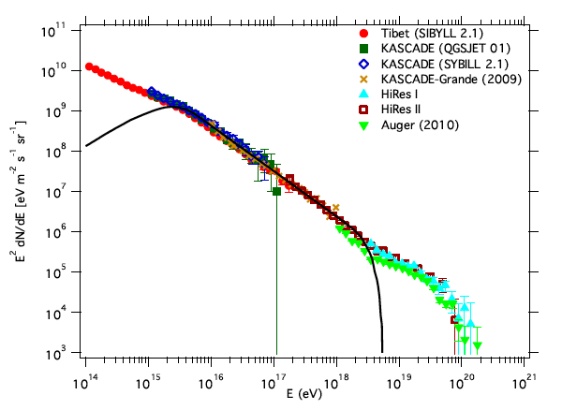
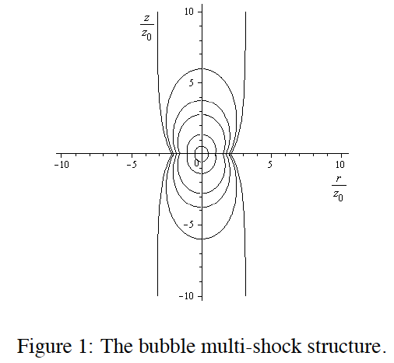
Cosmic rays above knee?
P, e acceleration by multiple shocks,
Chernyshov et al. at ICRC2011

Slide 11
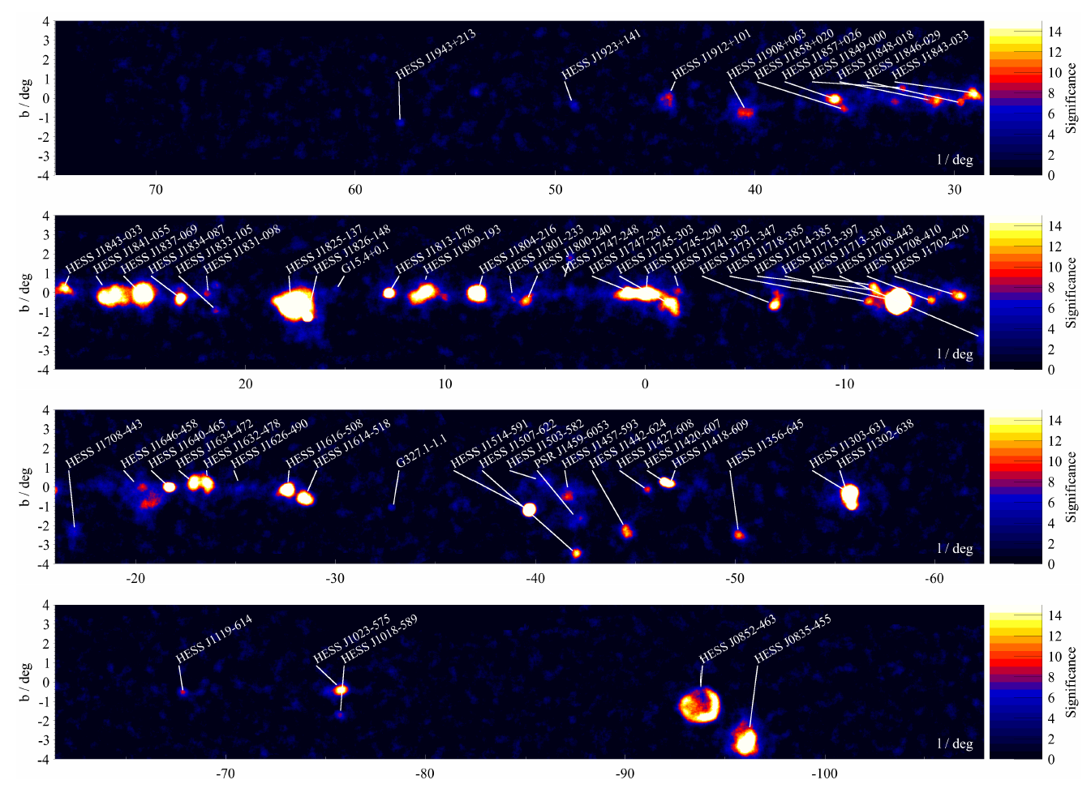
HESS galactic plane survey update (H.Gast et al. ICRC11) 63 sources are identified (observation of >2300hrs)

Slide 12
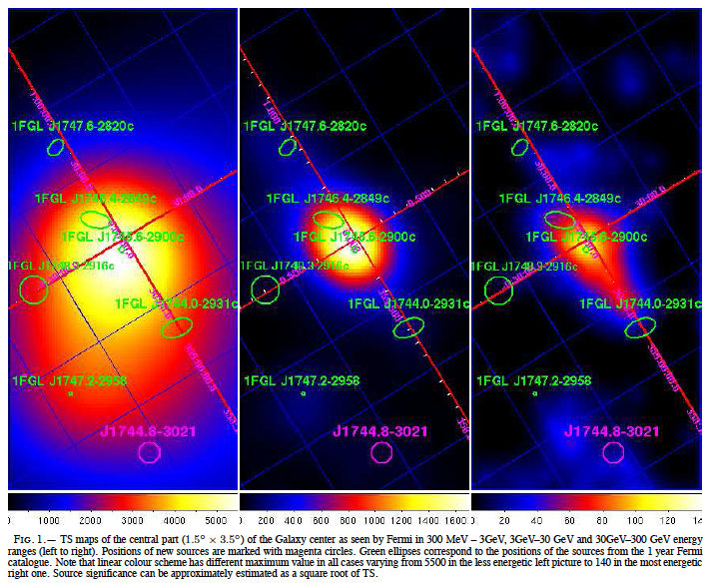
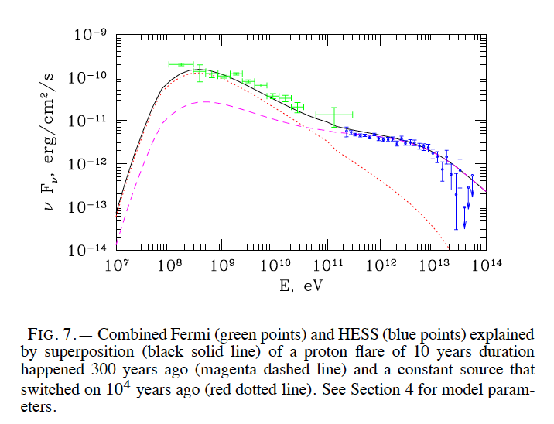
Galactic Center
0.3-3 GeV
3-30 GeV
30-300 GeV
Constant L ~1.9 x 10³⁹erg/sec
Flare L ~ 1.9 x 10⁴² erg/sec
(10yr flare 300yrs ago)
Chernychov et al. 2011

Slide 13
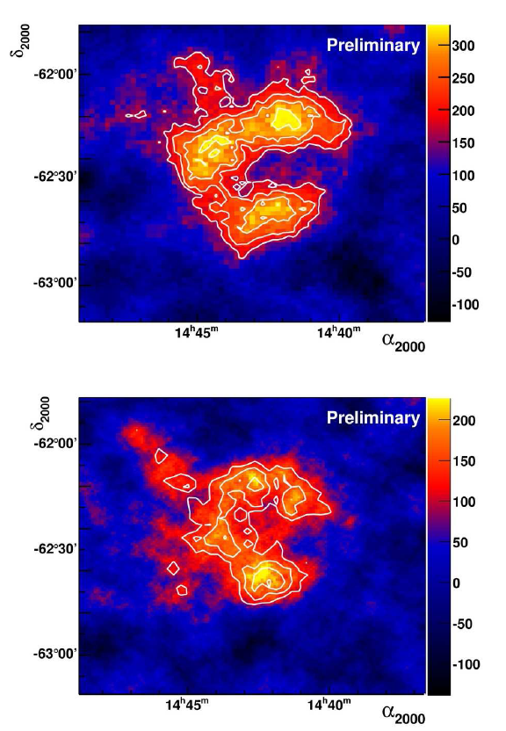
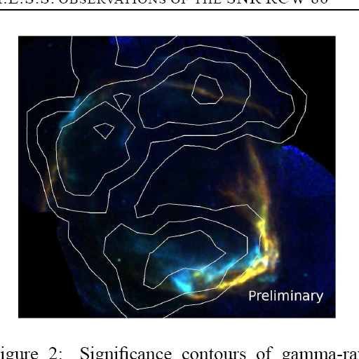
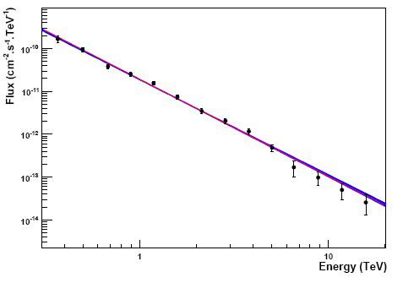
HESS: Shell type SNRs
RX J1713, RX J0852, RCW86
HESS
HESS
HESS RCW86
Index ~2.0
Break ~20TeV
Index ~2.2
XMM-Newton, HESS

Slide 14
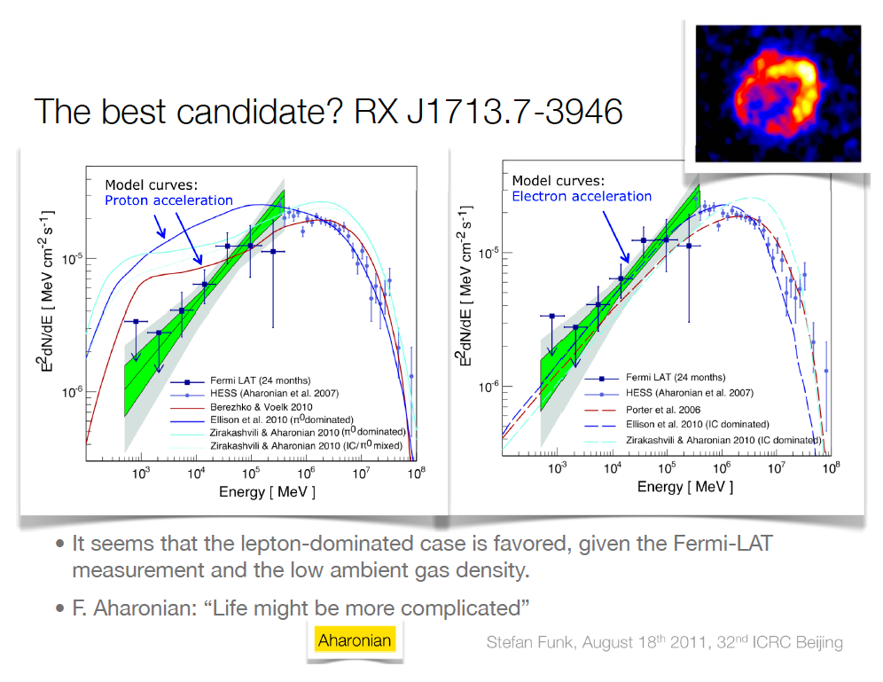

Slide 15
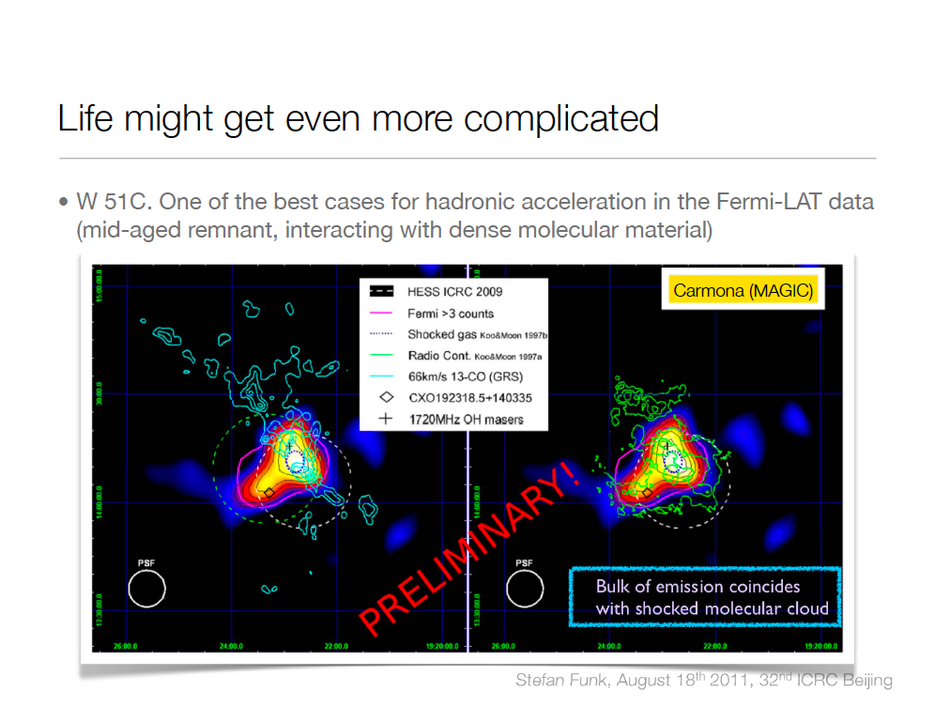

Slide 16
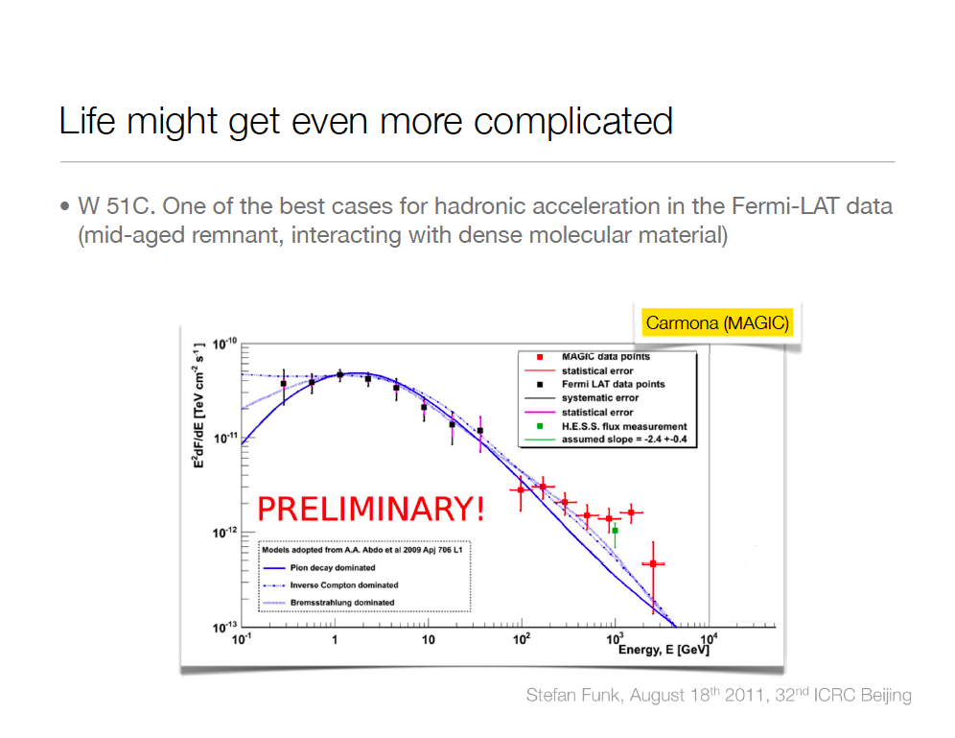

Slide 17
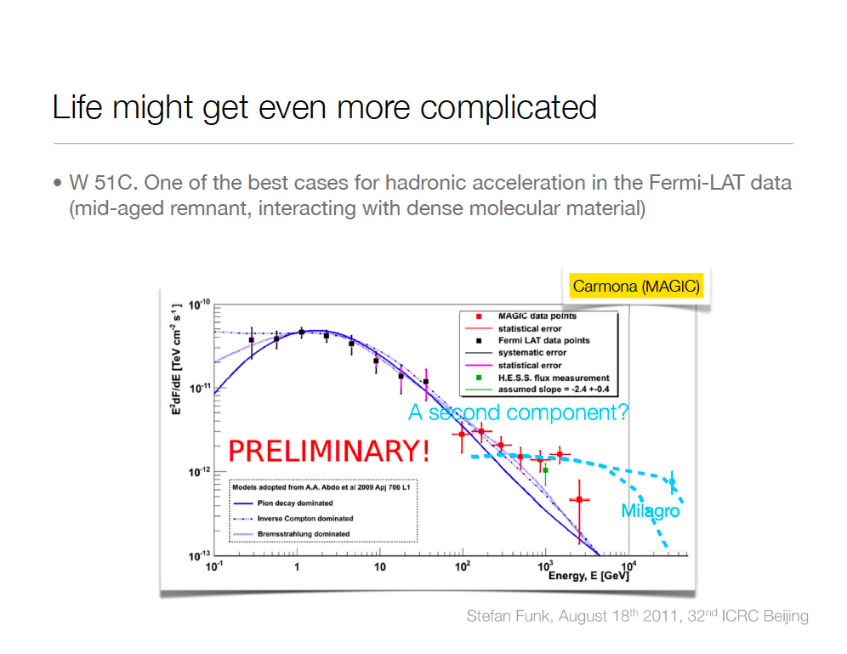

Slide 18
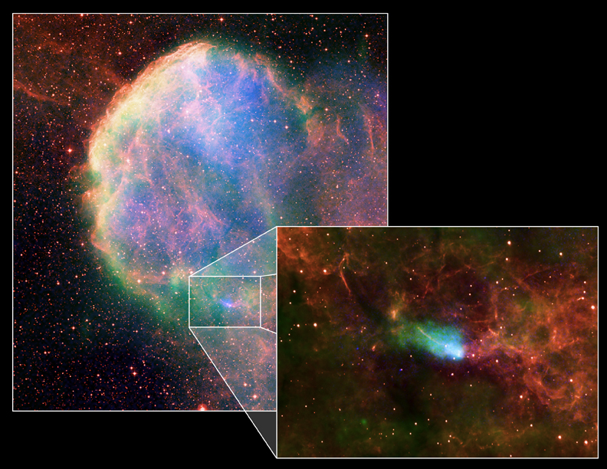
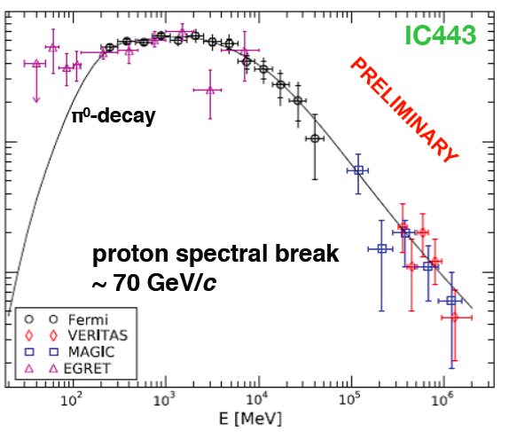
MAGIC: Shell type SNRs
IC443(MAGIC J0616)
Composite image
With X(Chandra),
Radio(VLA),
Optical (DSS)
MAGIC J0616
CXOU J061705.3+222127
index~3.1
Molecular Cloud
Radio
X-ray
EGRET 3EG J0617+2238
Pulsar CXOU J061705.3+222127

Slide 19
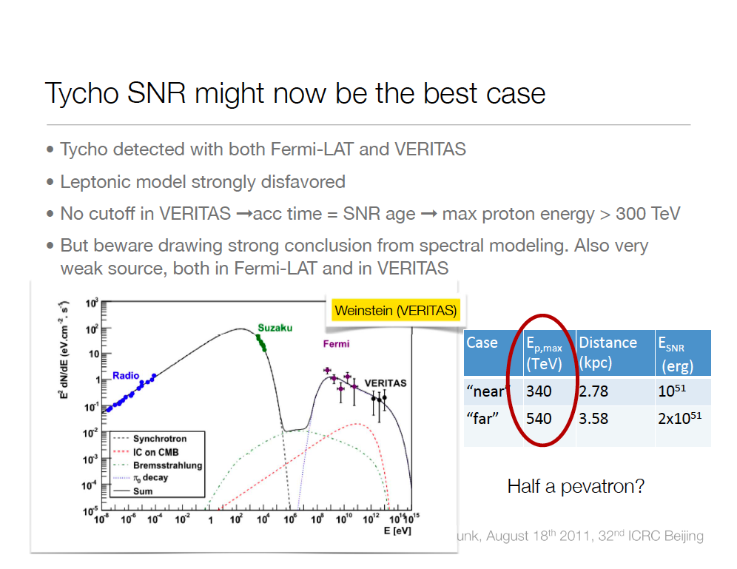

Slide 20
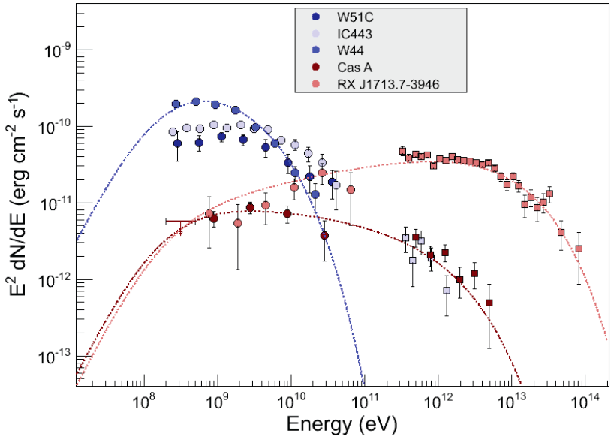
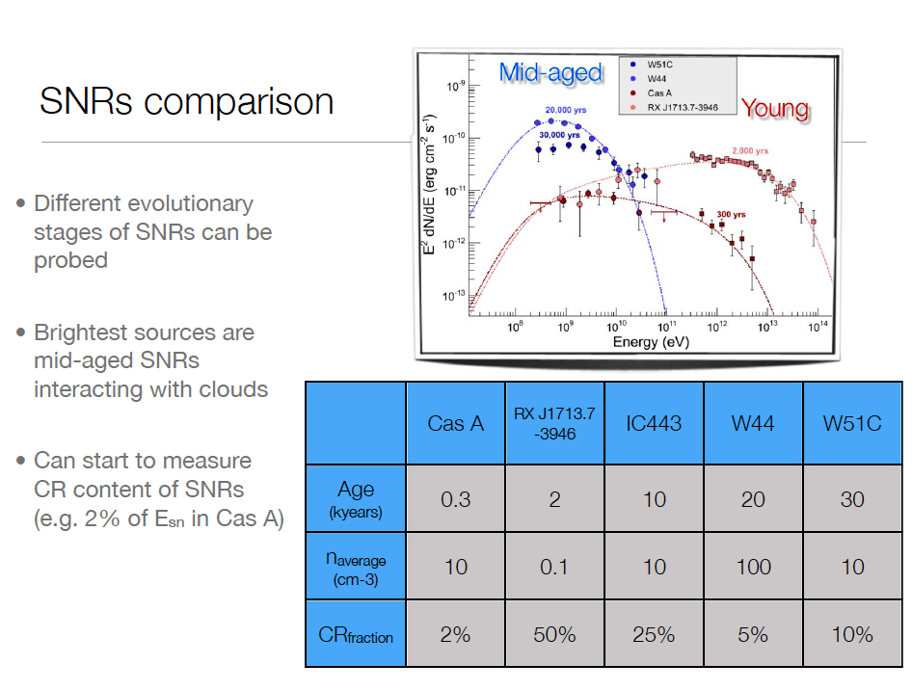
SNRs in different evolutionary stages
10-30kyr
We can study SNRs in different
evolutionary stages
2kyr
0.3kyr
Courtesy of S.Funk

Slide 21
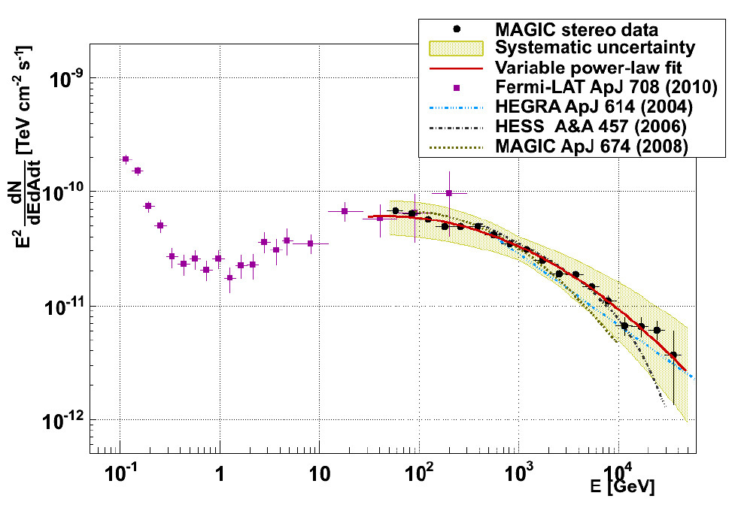
Crab Nebular energy spectrum
Fermi + MAGIC Stereo
IC peak
61 ± 6 GeV

Slide 22
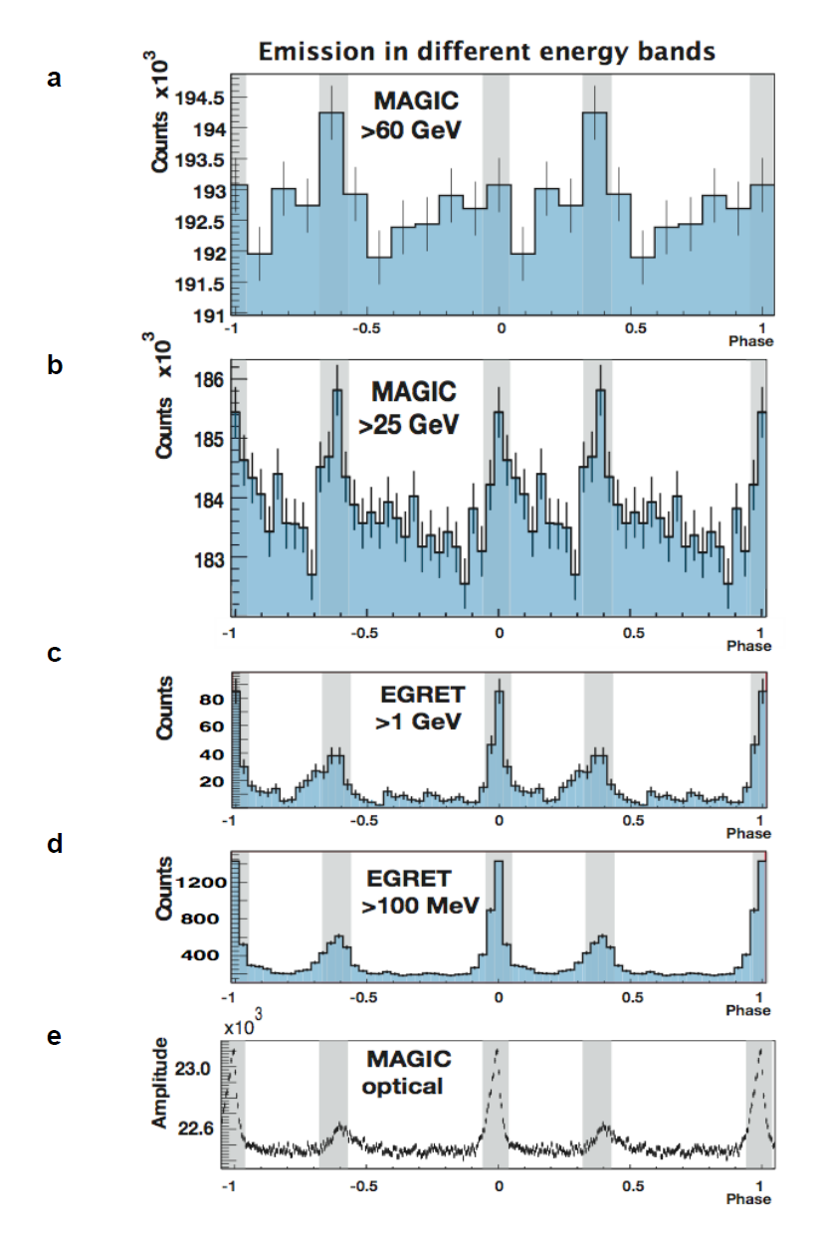
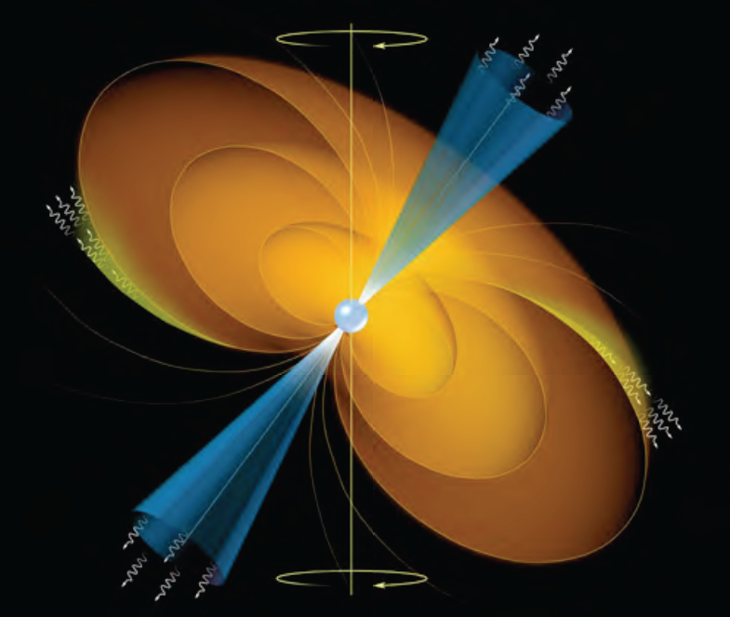
Crab Pulsar with MAGIC Mono
MAGIC result: Published in Science in 2008
By measuring the spectrum around cutoff
or at high energies is important to distinguish
the emission model
Polar cap: double exponent
Outer gap: simple exponent

Slide 23
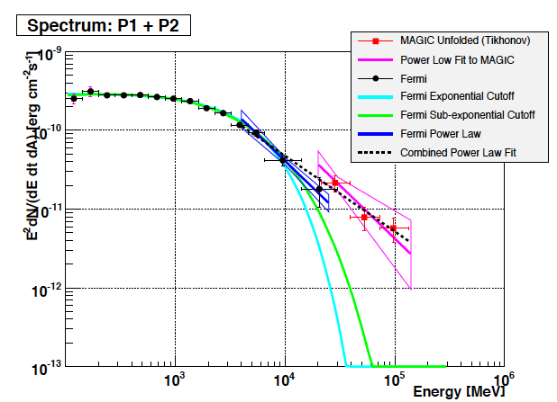
Crab Pulsar with MAGIC mono
Fermi
Cut off feature of Spectrum: Exponent or Power-Law
Fermi
EGRET
MAGIC
PhD Thesis of Takayuki Saito 2010

Slide 24
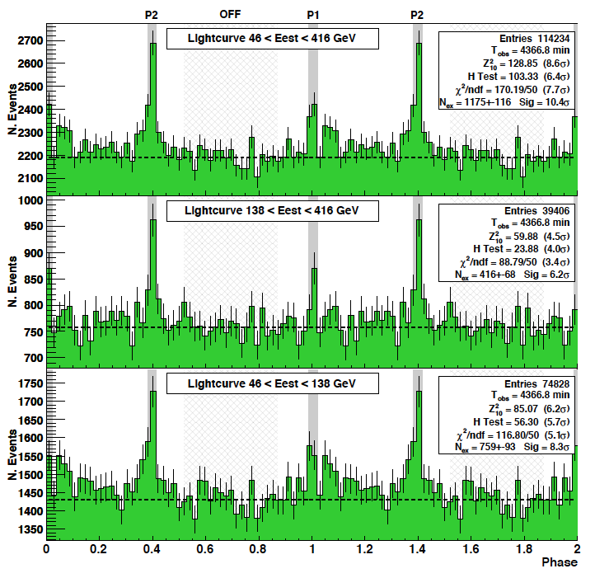
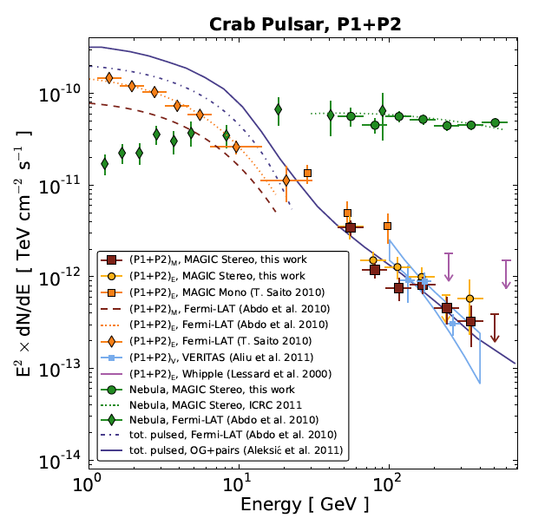

Crab Pulsar with MAGIC Stereo

Slide 25
Extragalactic sources

Slide 26


Cosmic Ray accelerator
Active Galactic Nuclei
FRI, FRII
Blazars
Gamma factor ~10
SMBH 10⁷-10¹⁰ M◎
M87 (HST)

Slide 27


Number of extragalactic VHE Sources (46)
HESS
MAGIC
VERITAS
MAGIC
Whipple
HEGRA
HESS
FERMI
VERITAS
1ES1959
PKS2155
M87
Mrk 421
Mrk 501
1H1426
1ES2344
Fermi

Slide 28


Slide 29

Mrk421 MWL SED
Synchrotron
Inverse Compton

Slide 30






EBL (Extragalactic Background Light)
Extragalactic Background Light
blazar
IACT
γ_{VHE}
γ_{EBL}
e⁺
e⁻

Slide 31

EBL upper limit by MAGIC and HESS observations

Slide 32



Second most distant 100GeV source
FSRQ PKS1222 (4C +21.53) (z=0.432)
>10 sigma
in 30min
~8 mins doubling time will require
new modeling in the framework of EC
EBL correction Dominguez et al. 2010

Slide 33


Slide 34
Summary of VHE gamma ray astronomy
The VHE gamma ray astronomy started with the discovery of VHE emission from Crab by Whipple observatory in 1989
The number of VHE sources increases rapidly due to the third generation telescopes, HESS, MAGIC and VERITAS (1~2 sources/months)
More than 130 of VHE gamma ray sources
  SNRs, Pulsar, PWNe, Binaries / BL Lacs, FSRQs, FR-I, Starburst Galaxies
Fermi bubbles ➔ CR above knee?, PeVatron? TeV observation is highly important
Big surprise: Crab Pulsar ➔ up to 400GeV!!
Multiwavelength observation with Swift, Suzaku, Fermi, HESS/MAGIC/VERITAS
  Very strong tool to study Nature of sources
Distant sources:3c279(z = 0.536), PKS1222 (z = 0.432)
  The room for the extra component (Pop-III) in EBL is not so large

Slide 35

Thanks

Slide 37

Pulsar Wind Nebulae observation by HESS
Major galactic TeV source population
  Associated with relatively young (<10⁵ year old) and energetic pulsars
Generally believed that we see inverse Compton emission of 1-100 TeV electrons
1% of Spin-down energy goes to VHE gamma rays
Funk 2006
Notes:
37

Slide 38

Pulsar Wind Nebula HESS J1825-137
Energy Dependent Morphology
Major galactic TeV source population
  Associated with relatively young (<10⁵ year old) and energetic pulsars
Generally believed that we see inverse Compton emission of 1-100 TeV electrons
1% of Spin-down energy goes to VHE gamma rays
Clear evidence for cooling of electrons in the Nebula
Notes:
38

Slide 39






FSRQ 3C279 (z=0.536) MAGIC
Most distant 100GeV AGN
January 16, 2007

Slide 40

Source modeling by M. Boettcher, A.Reimer, A. Marscher
Leptonic EC
B is too weak
Leptonic SSC
B is too weak
SPB +Sync Pγ
Jet energy 10⁴⁹erg/s
SPB + Sync, BLR Pγ

Slide 41

PKS 2155−304 (HESS Observation)
Spectral Energy Distribution
Time-averaged SED is well described by a single zone SSC model:
Fermi
ATOM
RXTE
FERMI
Swift
HESS

Slide 42




IC310 (FR-I Radio galaxy) is discovered, when observing Perseus cluster / NGC1275 : MAGIC
Fermi
Too bright as an off-axis blazar

Slide 43

Interpretation

Slide 44

Crab Nebular Spectrum
MAGIC Stereo

Slide 45



Gamma-Ray Emission Processes(1)
Astrophysical process

Slide 46



M87 flare in 2008:
MAGIC, VERITAS, HESS, VLBA
Model of 43GHz Radio flux
using the measured VHE gamma flux

Slide 47


M87 flare in 2008:
MAGIC, VERITA, HESS, and VLBA
2.5mas (0.25pc)
20” (2kpc)
30mas (3pc)

Slide 48


Morphological studies of UHECR potential sources
Cen A (3.4Mpc) & Cen B (56Mpc)
Moskalenko et al. 0805.1260v1

Slide 49


Cen A: HESS detection
Distance: 3.8Mpc
Flux: 0.8% in Crab Unit
Spectral Index: -2.7
Cross: the best location (COG)
Circle: 95% C.L. VHE extension limit
L_{VHE} ~ 2.6 x 10³⁹ erg s-1
L_{UHECR} ~ 10⁴⁰ erg s-1

Slide 50

Extra-galactic sources
45 sources ( 3 x FR-I, 2 x Starburst galaxies, 4 x FSRQs, 36 BL Lacs )

Slide 51


SNR Study
RX J1713 HESS + Fermi
Color HESS observation
Contour Suzaku X-Ray
Fermi

Slide 52

MAGIC Crab Nebula (PWN)
Gamma Ray Signals from Crab ~ 0.4Hz
>500GeV Circle
~ 250GeV
MAGIC
IC
Sync.
Position of Pulsar
IC peak is estimated to be
IC_peak = 77 ± 35 GeV

Slide 53


Crab Nebula spectrum
Fermi and MAGIC-Stereo
Smaller error bars
in only 3.5 hours

Slide 54

SNR W51
One of the most luminous star forming region (distance ~ 6kpc)
W51C is a medium age (~30kyr) Super Nova Remnant
Shell of the remnant is interacting with surrounding molecular cloud
Discovery by Fermi/LAT (GeV) and HESS (4.4 σ at 1TeV)
Promising candidate SNR to test and study cosmic ray acceleration

Slide 55


Slide 56

Great success!! HESS galactic plane survey
PWNe, SNRs, Binaries, un-IDs

Slide 57




Gamma ray emission process from DM Annihilation
Dark Matter Annihilations
Bergstrom et al.

Slide 58




MAGIC Telescopes
New technologies
to lower the threshold energy
17m diameter world largest Cherenkov tel.
0.1°High resolution camera
Hemispherical High QE PMT
Optical fibre analogue signal transmission
2GS/sec Ultra Fast FADCs
Fast rotation for GRB ~20secs/180deg.
Trigger threshold ~50GeV ➔ ~25GeV
Upgrade from MAGIC to MAGIC Stereo
Regular operation since September 2009
Sensitivity 1.6% Crab ➔ ~0.7% Crab (50hrs)
Angular resolution 0.1 deg ➔ 0.06 deg
Energy resolution 25% ➔ 15%
85m

Slide 59



Angular Resolution in MAGIC Stereo
Data and MC agrees very well !!
~ 0.1 degrees at 100GeV
~ 0.05 degrees at 1000GeV

Slide 60


Slide 61

Sensitivity of MAGIC Stereo achieved (~0.6% Crab), factor 3 better than mono
1.6%Crab MAGIC Mono
0.6%Crab MAGIC Stereo

Slide 62

Sensitivity of MAGIC Stereo achieved
(1yr)
1.6%Crab
50hrs
MAGIC-stereo
AGNs, Pulsars
GRBs
0.6%Crab
Cosmic ray sources
Knee in gamma
Background Limited
Deep TeV Survey
~1 mCrab
Signal Limited

Slide 63
Bench Mark: Crab Nebula 3.5hr observation with MAGIC-Stereo
Smaller error bars
in only 3.5 hours

