Slide 1
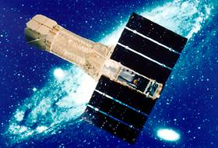
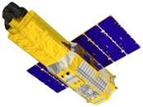
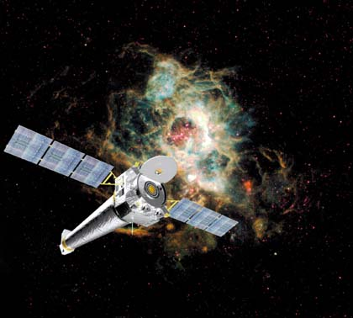
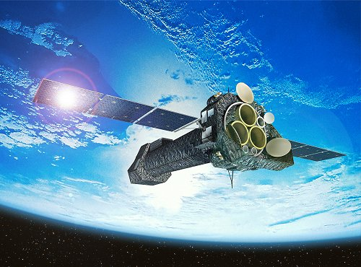
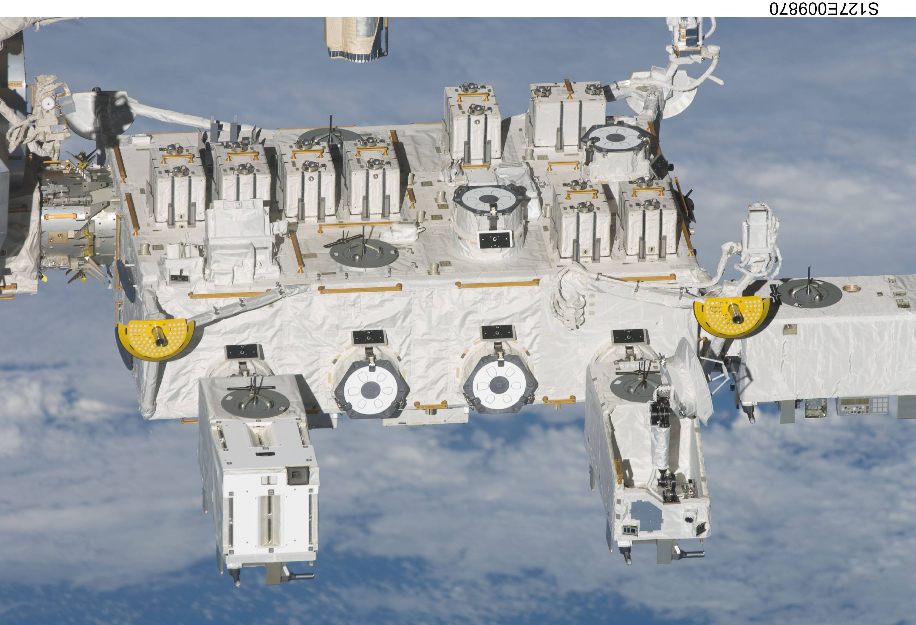
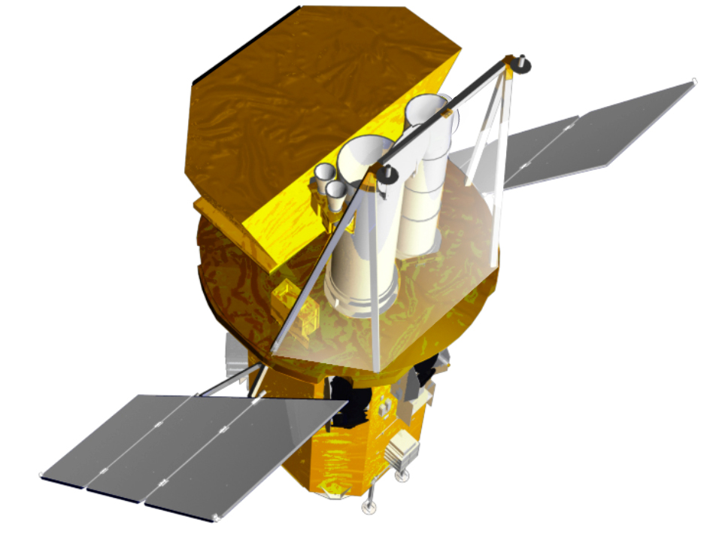
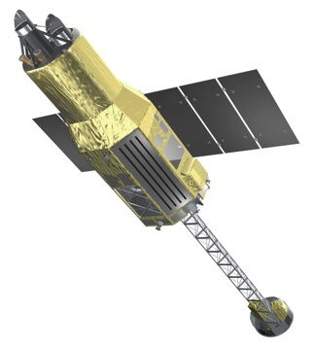
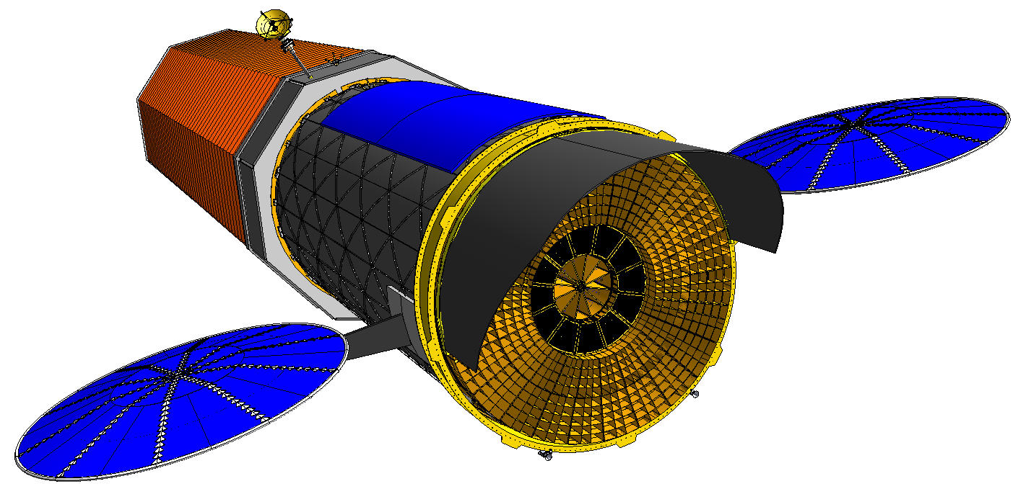
X線天文学の課題と戦略
東工大 河合誠之

Slide 2
X線天文学は終わったか
新天体・新現象の発見がない
画期的な観測技術革新がない
宇宙の果てに届かない
テーマがX線に閉じている
金と時間がかかりすぎ
ある
ある
届く (GRB, QSO)
閉じない
なのはX線だけじゃない

Slide 3
X線天文学による新発見
新帯域
Accreting X-ray source: Sco X-1 (1962)
Pulsar wind nebula: Crab (1964)
Cosmic X-ray background (1966)
X rays from AGN (1970)
Accreting X-ray pulsar: Cen X-3 (1971)
Black hole: Cyg X-1 (1973)
Stellar corona (1975)
Hot gas in galaxy clusters (1976)
X-ray bursts (1976)
Local Hot Bubble (1977)
月掩蔽
新帯域
感度
Timing
多波長
感度
感度
全天監視
軟X線

Slide 4
X線天文学による新発見
多波長
即応
GRB X-ray afterglow (1997)
“Magnetar” = AXP+SGR (1998)
AGN jet imaging (2000)
Supergiant Fast X-ray Transient (2004)
Bubbles in galaxy clusters (2006)
Supernova shock breakout (2008)
X-ray echo of Galactic Center flare (1996–2009)
BH binaries + radio jets, γ-ray flare (1996-2009)
Crab Nebular variation (2010)
帯域
稀
解像度
長期
監視
解像度
監視
多波長
稀
長期
分光撮像
監視
多波長
長期

Slide 5
Swift Instruments
Burst Alert Telescope (BAT)
  15-150 keV
  2 sr field of view
  CdZnTe detectors
  Most sensitive gamma-ray imager ever
  Detect ~100 GRBs per year
X-Ray Telescope (XRT)
  0.2-10 keV
  Few arcsecond positions
  CCD spectroscopy
UV/Optical Telescope (UVOT)
  170 – 650 nm
  Sub-arcsec positions
  Grism spectroscopy
  6 UV/optical broad-band filters
  22nd mag sensitivity (filtered)
Spacecraft
  Autonomous re-pointing, 20 - 75 sec
  Onboard and ground triggers
UVOT
BAT
BAT
XRT
UVOT
XRT
Spacecraft

Slide 6
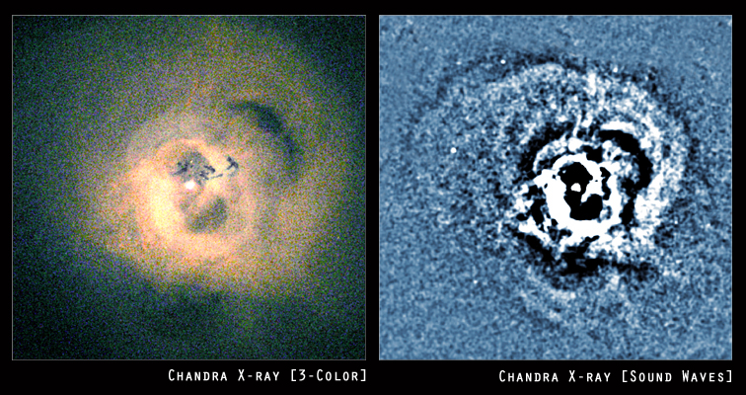
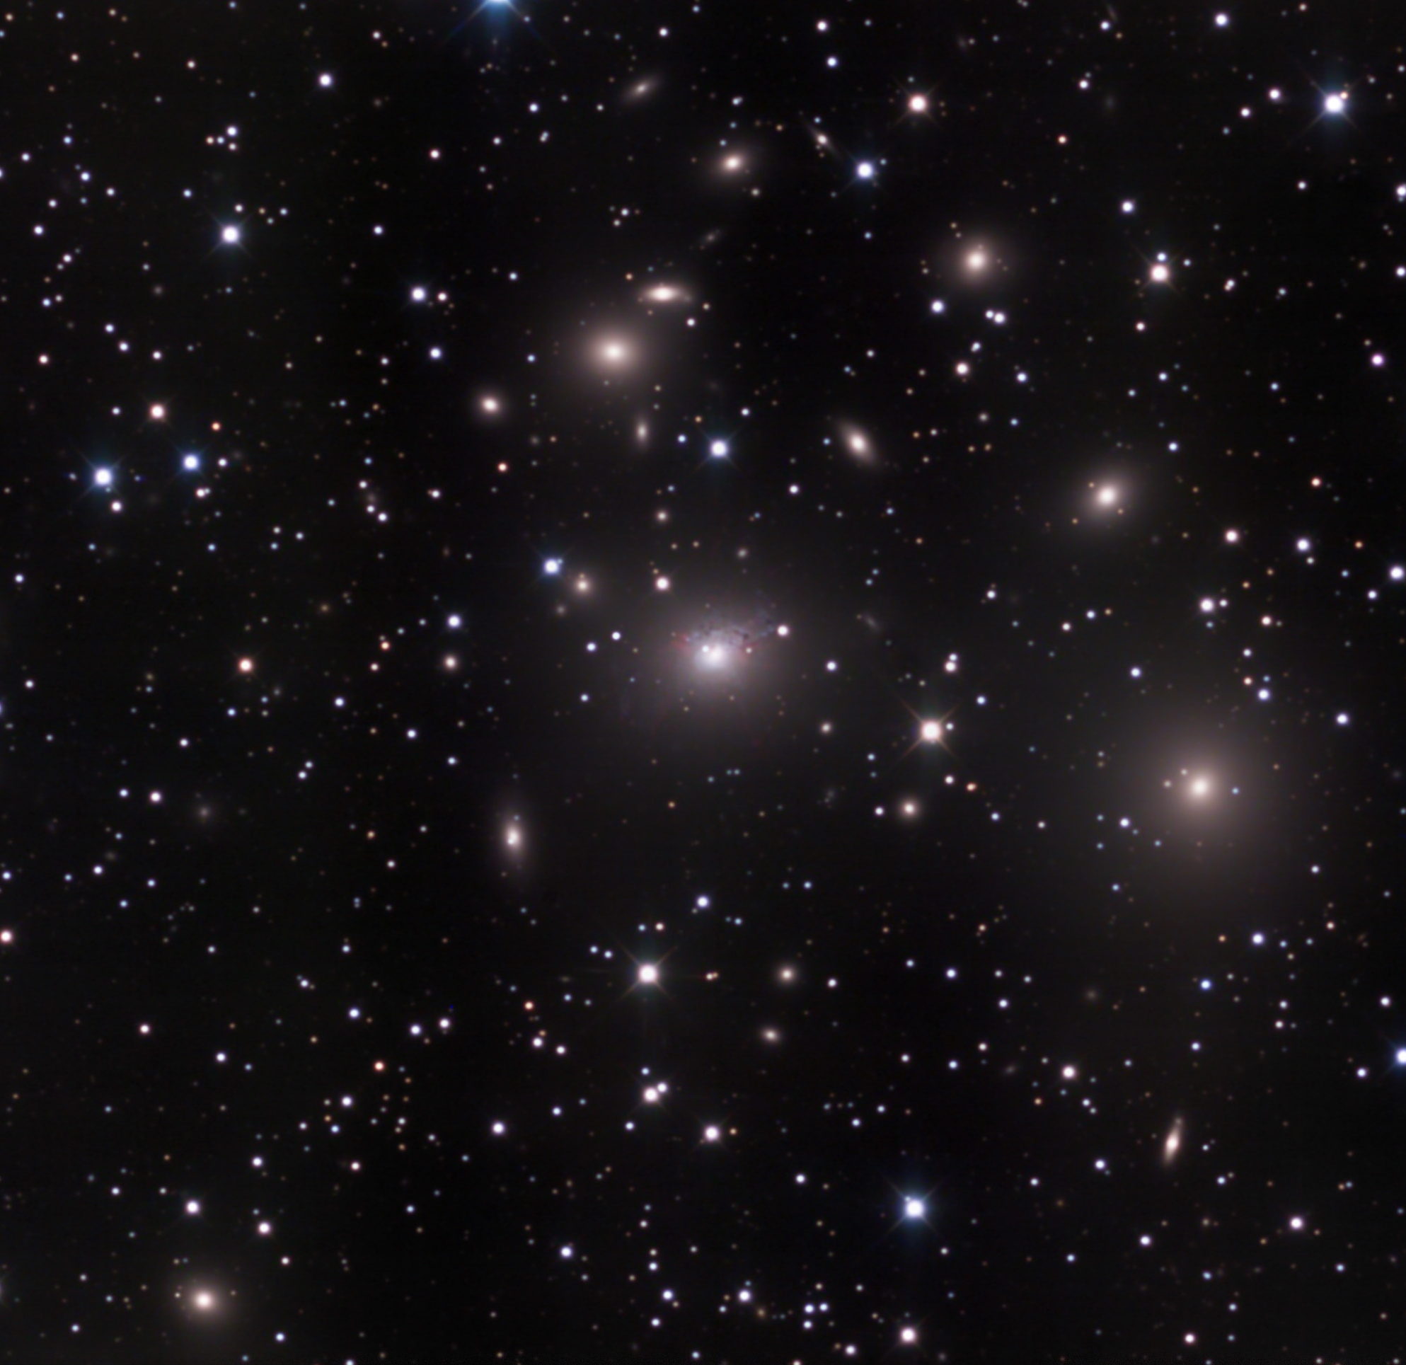
Perseus Cluster of galaxies

Slide 7
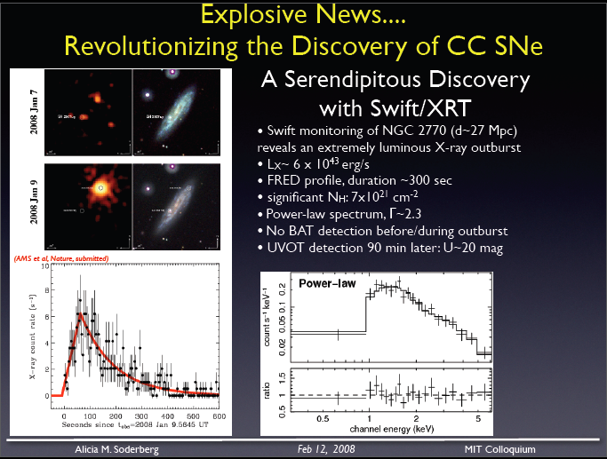
SN 2008D Shock Breakout
SN 2007uy
- XRT monitoring of NGC 2770 (27 Mpc)
revealed extremely luminous X-ray outburst
- E_{X} ~ 2x10⁴⁶ ergs
- No BAT, no radio late >> probably no jets
- UVOT detection of SN rising 90 min later
- SN Ib/c
- Shock breakout. May occur for all SN
9 Jan 2008
Soderberg et al. 2008

Slide 8
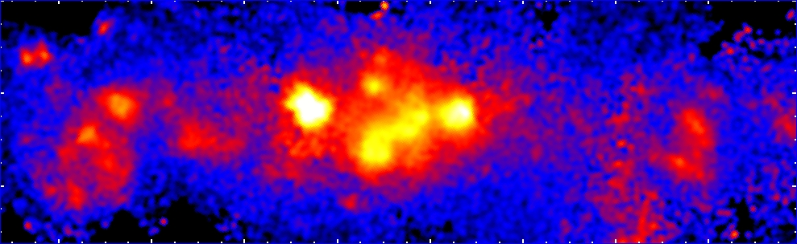

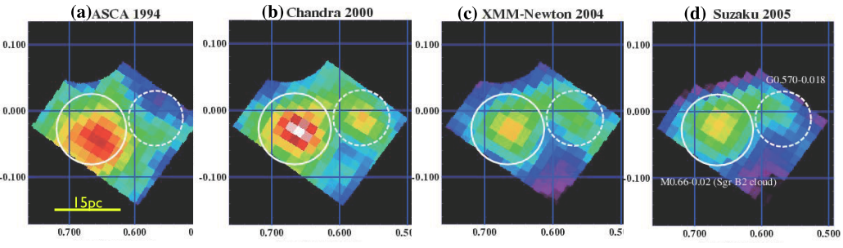
Fe line in the Sgr B2 region decayed in 10 years
➔ Sgr B2 is an X-ray reflection nebula
Suzaku 6.4keV image
Sgr B2 region : size ~10 light years
6.4 keV line: photoionized Fe
Inui et al. 2009

Slide 9
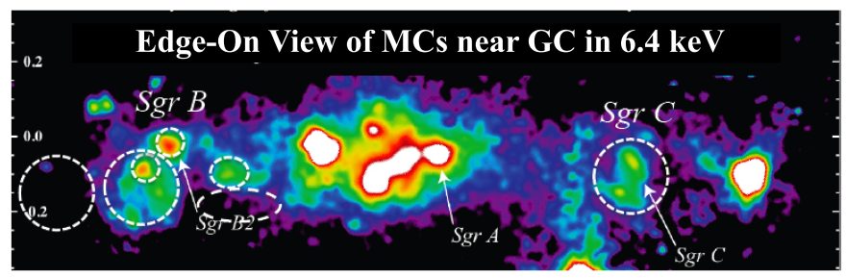
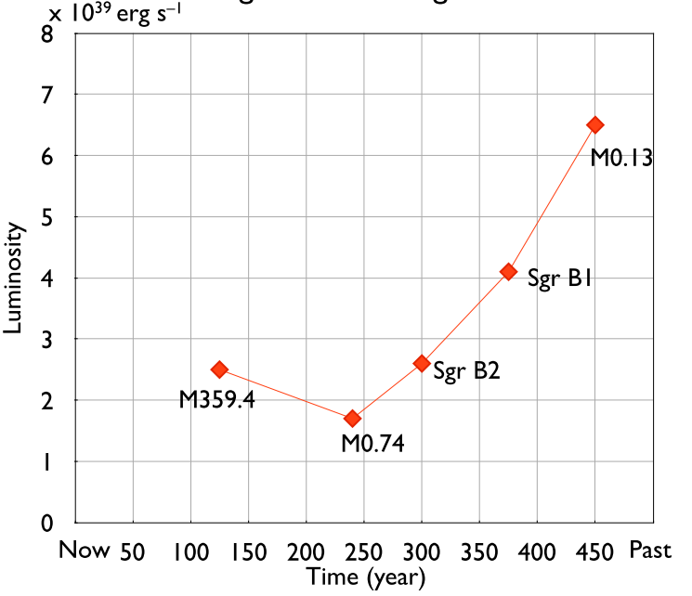
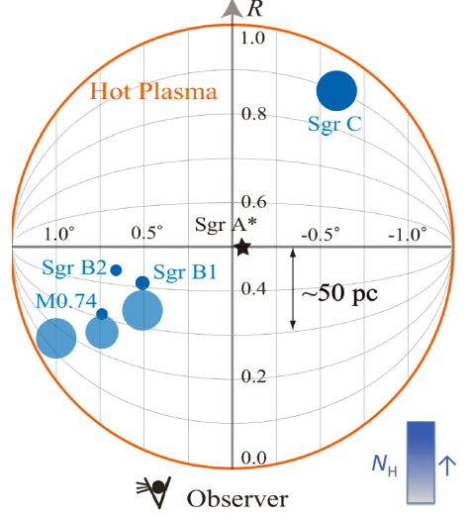
X-ray tomography of molecular clouds
Sgr A* light curve
Current Lx~10³³ erg/s
Ryu et al. 2009, PASJ, 61, 751

Slide 10
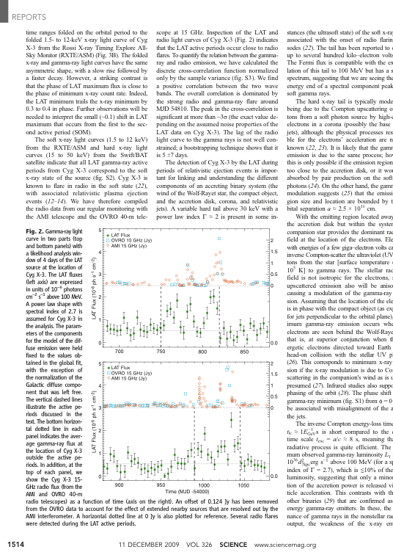
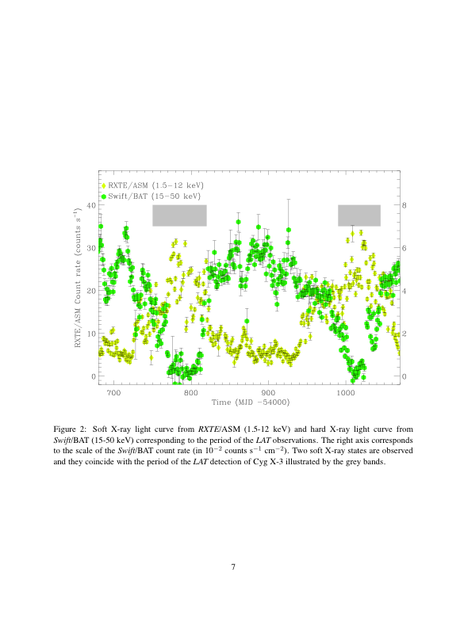
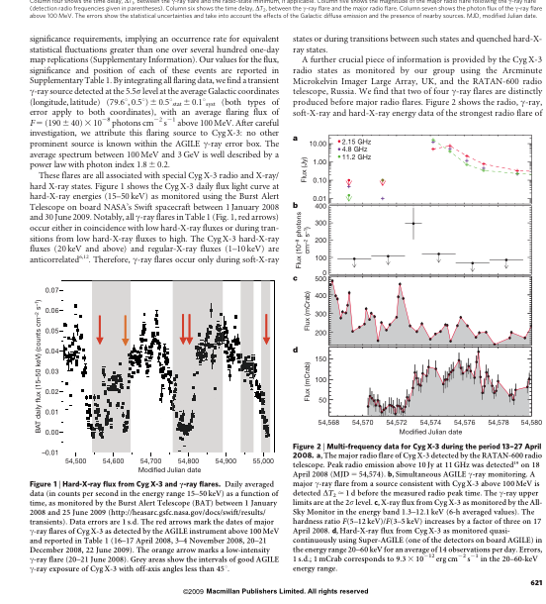
Cyg X-3
Tavani al. 2009, Nature
Abdo et al. 2009, Science
BAT (15-50 keV)
AGILE Flares (>100 MeV)
BAT (15-50 keV)
ASM (2-12 keV)
Radio 15 GHz
LAT Flux

Slide 11
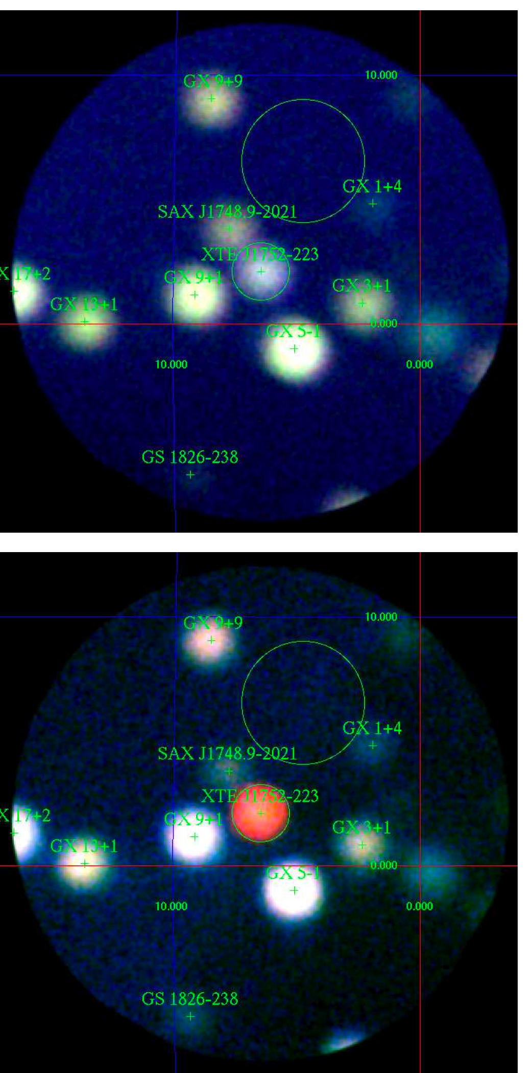
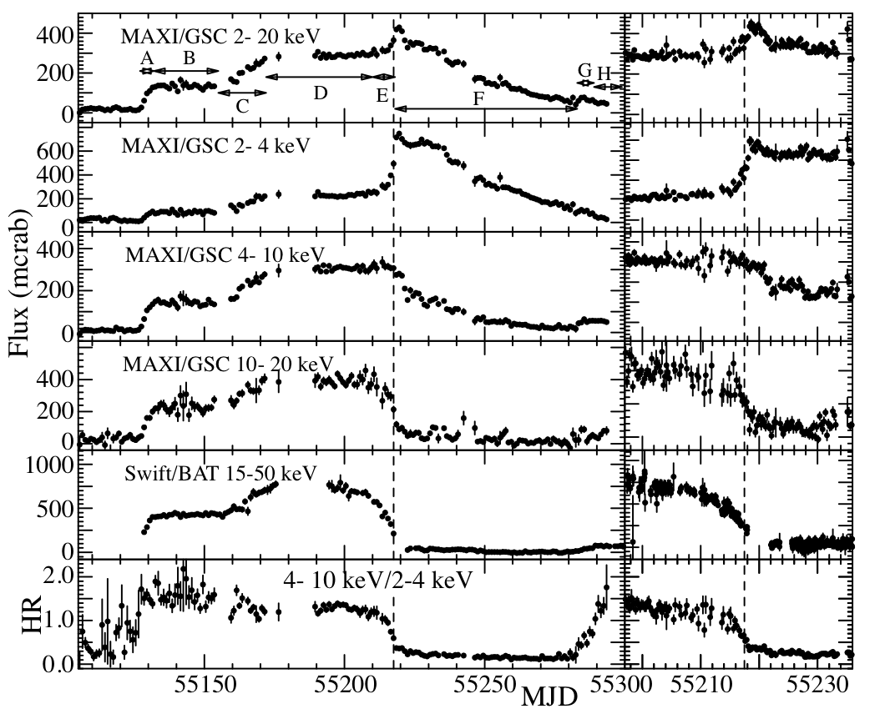
MAXI light curve of a new BH candidate XTE J1752-223
Radio Detection
MAXI

Slide 12
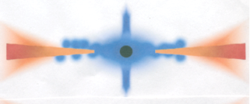
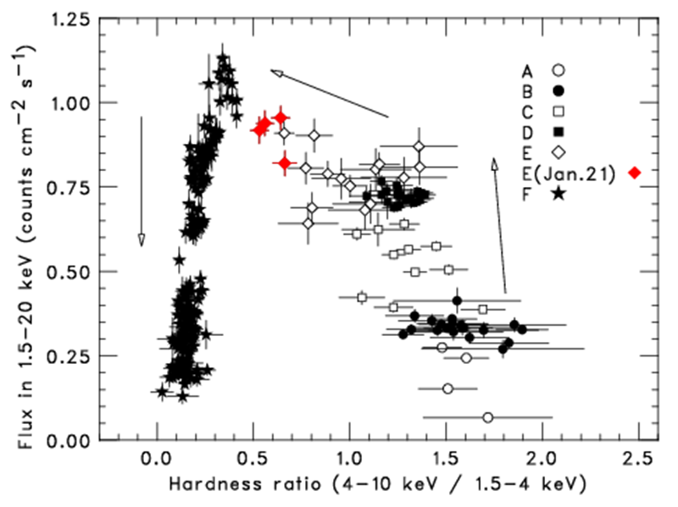




XTE J1752-223 observed by MAXI
High energy emmission
Disc
Jet
A model by Done et al (2007)
Jet Jan 21 2010
The present 6-month observation has revealed an evolution of the accretion disc of BH X-ray nova!
Apr 10 2010
Oct 23 2009
Nakahira et al 2010 PASJ

Slide 13
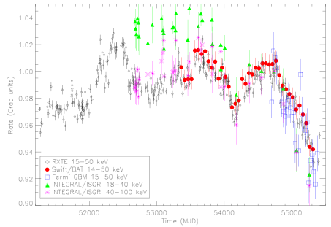
Crab Nebula X-ray variation
–7% in 2 years
Wilson-Hodge 2010

Slide 14
現在運用中の衛星／実験
mission | band |  |  | 撮像 | 分光 | 面積 | 計時 | 監視 | 探査調査 | 緊急対応 | 偏光 | 光学
RXTE |  | M | H | ▲ | △ | ◎ | ◎ | ○ | △ | ◎ | × | ×
XMM | S | M |  | ○ | ◎ | ◎ | ○ | × | △ | △ | × | ○
Chandra | S | M |  | ◎ | ◎ | ○ | △ | × | △ | △ | × | ×
INTEGRAL |  |  | H | △ | △ | ○ | ○ | △ | △ | △ | ▲ | ×
Swift | S | M | H | ○ | ○ | ○ | ○ | ◎ | ○ | ◎ | × | ○
Suzaku | S | M | H | ○ | ○ | ◎ | △ | × | × | △ | × | ×
Fermi |  |  | H | × | △ | ◎ | △ | ○ | × | × | × | ×
MAXI | S | M |  | △ | △ | ○ | △ | ◎ | ○ | × | × | ×

Slide 15
X線天文学の利点
高エネルギー現象を既知の天体へ結びつける最も確実な観測手段
宇宙物理学的理由
  熱的・非熱的両過程の放射
  透過力が強い
  光子数が多い
技術的理由
  斜入射反射鏡により結像
    空間構造、高感度、放射源の分解、位置決定
  高分散分光（回折格子、マイクロカロリメータ）
    運動学
    温度、組成、密度

Slide 16
今後の衛星計画
NuSTAR (米) 硬X線撮像
ASTROSAT (印＋) 高計数計時、多波長
ASTRO-H (日米)
GEMS (米)
SRG (露独）
HXMT（中）
SVOM（中仏）
…
IXO

Slide 17
将来の衛星／実験
mission | band |  |  | 撮像 | 分光 | 面積 | 計時 | 監視 | 探査調査 | 緊急対応 | 偏光 | 光学
NuSATR |  | M | H | ○ | ○ | ○ | ◎ | × | × | ○ | × | ×
ASTROSAT | S | M | H | ○ | ○ | ◎ | ◎ | ○ | × | ○ | × | ○
ASTRO-H | S | M | H | ○ | ◎ | ○ | △ | × | × | △ | × | ×
GEMS |  | M |  | × | △ | ○ | ○ | × | × | ? | ◎ | ×
SRG | S | M |  | ○ | ○ | ○ | △ | × | ◎ | ? | × | ×
HXMT |  |  | H | △ | △ | ◎ | ○ | × | ◎ | ? | × | ×
SVOM | S | M | H | ○ | ○ | ○ | △ | ◎ | ○ | ◎? | × | ○
JANUS |  | M |  | △ | × | × | × | ◎ | × | (×) | × | IR
MAXI-2 | S |  |  | ○ | ○ | △ | × | ◎ | ○ | × | × | ×
DIOS | S |  |  | △ | ◎ | ○ | ○ | × | ◎ | ○ | × | ×
Origin | S | M | H | ○ | ◎ | ○ | ○ | ◎ | × | ◎ | × | IR
IXO | S | M | H | ○ | ◎ | ◎ | ◎ | × | × | △ | ? | ×

Slide 18
US Decadal Survey Report Recommendation
Large Scale Space Program - Prioritized
Wide Field InfraRed Survey Telescope (WFIRST)
Explorer Program Augmentation Laser
Interferometer Space Antenna (LISA)
International X-ray Observatory (IXO)
Science Themes
  Cosmic Dawn (Reionization, First galaxies/stars)
  New World (Nearby habitable planets)
  Physics of the Universe (DE, DM, Inflation, GR)

Slide 19
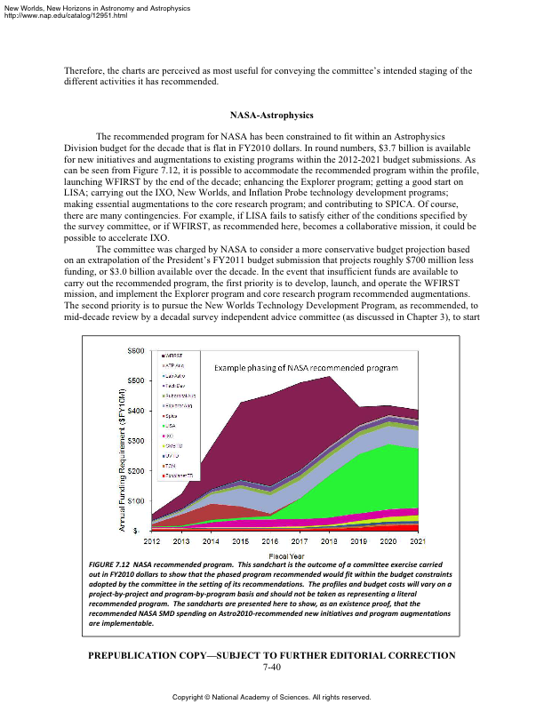
WFIRST
LISA
Explorer
SPICA
IXO

Slide 20
What does Astro2010 mean for X-ray Astronomy?
IXO recommended, but number four
  probably not earlier than 2025
  fewer jobs in X-ray astronomy
  lack of Big Theme (i.e. First BH) in immediate future
Explorer program recommended as number 2
  Med/Small explorer for focused science goals
ESA Cosmic Vision selection in parallel

Slide 21
個人的展望
たぶん日本にはチャンス
X線の強みを活かせる次のステップは、高いエネルギー分解能と解像力の両立
→ASTRO-H マイクロカロリメータを発展させた中核ミッション
  反射鏡：XMMのような大面積、~10秒角の分解能
  検出器：多画素化 >30x30
個別テーマで小規模国際協力
  硬X線、γ線
  突発天体に対応できるSwift後継ミッション
  サーベイ

Slide 22
X線天文学の今後の方向
Big Themeの追求
  First Black Hole
    銀河形成／共進化、宇宙再電離
  Cosmology
    銀河団サーベイ、SZ効果
さまざまな課題の追究
  Cosmic Chemical Evolution (SNR, 銀河団, …)
  Accretion and Jets (X線連星, AGN, …)
  Neutron Star Equation of State
  Particle acceleration
新現象・新天体の探索
  Rare events (突発現象の長期・大天域監視)
  External trigger （γ、光、電波、GW, ν）

Slide 23
X線とCTAとの連携
Non-thermal source
  硬X線撮像、X線偏光
多波長連携
  突発現象、時間変動
  対応天体 （広帯域放射過程、分子雲、伴星、母銀河）
長期+広天域モニター
  長期的相関
  稀な天体現象の追跡観測

Slide 24

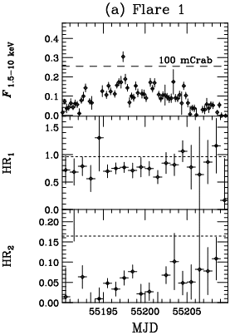
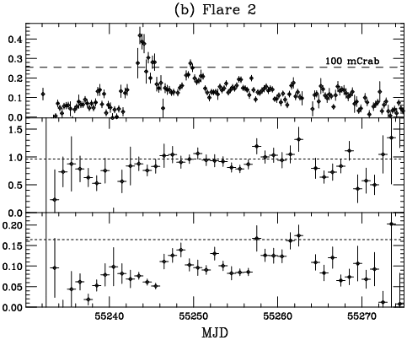
MAXI detections of two intense flares from Mrk421
Jan. 1, 2010
~120 mCrab.
Feb. 16, 2010
~164 mCrab.
MAGIC flare
VERITAS ATel #2443
MAXI
2 – 4 keV
(6 hour)
F_{4-10 keV}
F_{2-4 keV}
F_{15-50 keV}
F_{2-4 keV}
Isobe et al. 2010 PASJ

Slide 25

２. ASTRO-H X-ray Astronomy Satellite
Launch in 2014
Launch site:
Tanegashima Space Center, Japan
Launch vehicle: JAXA H-IIA rocket
Orbit Altitude: 550km
Orbit Type: Approximate circular orbit
Orbit Inclination: ~31 degrees
Orbit Period: 96 minutes
ASTRO-H
Total Length: 14m
Mass: <2.6 metric ton
Power: <3500 W
Telemetry Rate: > 8 Mbps (X-band)
Recording Capacity: > 12 Gbits
Mission life : > 3 years
Suzaku (6m, 1.7t)
2010/04/15 SRON

Slide 26
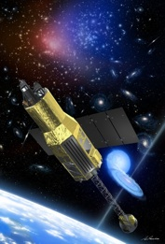
２. ASTRO-H Mission Objectives
Observing the Dynamic Universe and Studying its History with the Ultimate Goal of Understanding the Structure and Evolution of the Universe
Scientific objectives :
Revealing the large-scale structure and its evolution of the Universe
Understanding the extreme conditions in the Universe
Exploring the diverse phenomena of non-thermal Universe
Elucidating dark matter and dark energy
Key features :
High resolution spectroscopy with Soft X-ray Spectrometer
Hard X-ray focusing imaging
High sensitive wide-band spectroscopy (0.5-600 keV)
2010/04/15 SRON

Slide 27
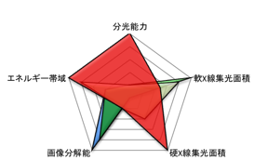
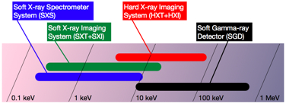
2. ASTRO-H Instruments
Spectroscopy (for diffuse source)
ASTRO-H
Energy Coverage
Area for
SoftX-rays
Energy Coverage
Chandra
Suzaku
SXT-S
(telescope)
SXS
Angular Resolution
XMM
Area for
Hard X-rays
Soft X-ray Spectrometer System
HXT
(telescope)
- 0.3-12 keV
- Large Area Soft X-ray Telescope
- X-ray micro calorimeter
- super resolution (<7eV at 6 keV)
HXI
Hard X-ray Imaging System
- Hard X-ray Telescope (5-80 keV)
- Focal Length 12 m
- New CdTe Imager (Fine Pitch Strip)
SXT-I
(telescope)
SXI
Soft X-ray Imaging System
SGD
Soft Gamma-ray Detector
- 0.4-12 keV
- Large Area Soft X-ray Telescope
- Large FOV 38x38 arcmin²
- CCD spectroscopy
- 10-600 keV non-imaging
- Si/CdTe Compton Camera with Narrow FOV
Active Shield
- most sensitive gamma-ray detector ever
2010/04/15 SRON

Slide 28
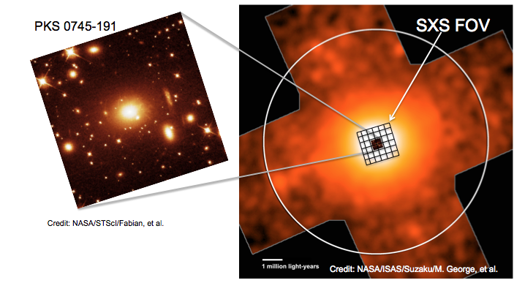
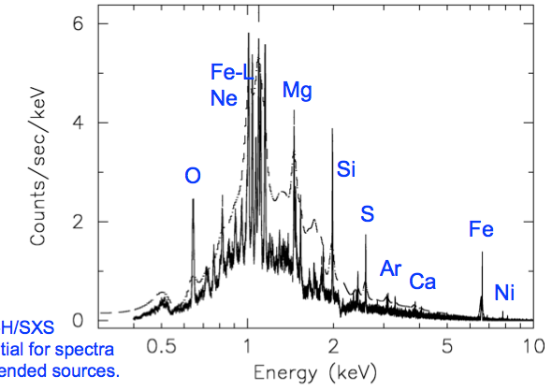
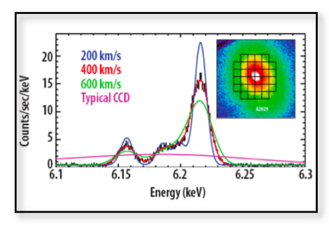
5. ASTRO-H Science
Cluster of Galaxies
Dynamics
（Turbulance, Collisions)
Non-thermal Emission
Cluster Outskirt
（Site of Sturcture Formation）
Temperature Map
Heavy Metal Distribution
低バックグランド広視野
X線CCD観測
Simulation of Centaurus Cluster
To the virial radius, and beyond
M.R. George et al. 2009
SXI FOV
Astro-H will detect bulk velocity flow as small as 300 km/s in
the brightest 30 clusters with T > 60 x 106 K (kT > 5 keV.)
2010/04/15 SRON

Slide 29
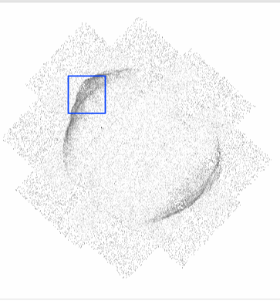
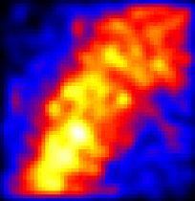
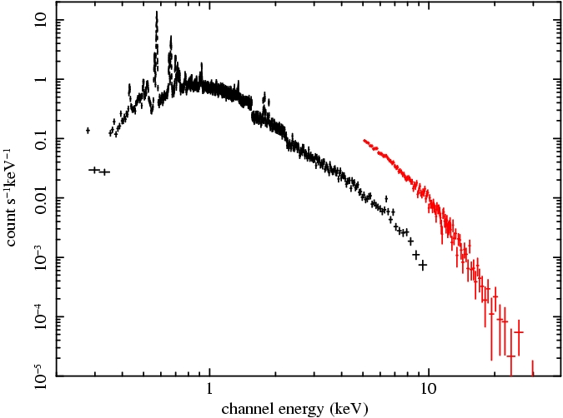
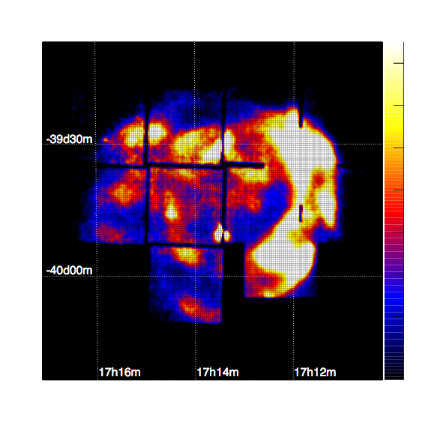
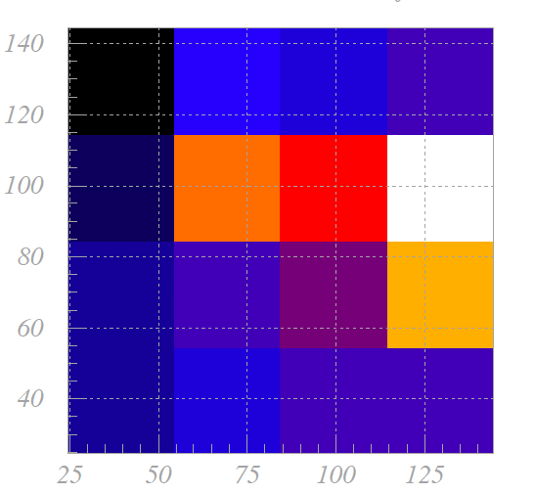
5. ASTRO-H -Performance -
Supernova Remnants
ASTRO-H 10-40 keV (100ks)
SN1006 2-10 keV (Suzaku)
Site of Particle Acceleration
to map electon distribution with E=Emax
RXJ1713
SN1006
by ASTRO-H
Suzaku at 40 keV
ASTRO-H at 40 keV
by A.Bamba
2010/04/15 SRON

Slide 30
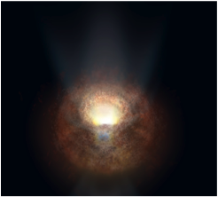
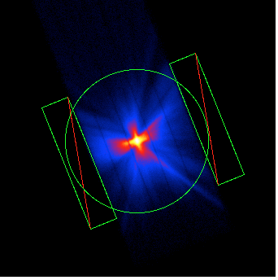
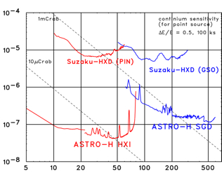
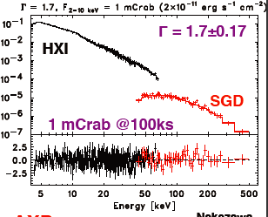
5. ASTRO-H -Performance -
X. Sensitivity
Imaging with hard X-ray optics will enable us to observe at x100 times higher sensitivity than Suzaku. 40-50% of the cosmic X-ray background will be resolved into hidden super-massive black holes.
Obscured SMBH
Bright
Soft Gamma-ray Spectrum up to several hundred keV by SGD for bright AGN
Faint
2010/04/15 SRON

Slide 31
6. ASTRO-H Mission Status
The ASTRO-H Project has been authorized to proceed into Phase C/D by the Japanese government (SAC : Space Activity Commission). SAC has confirmed that the ASTRO-H project is ready to proceed to the development phase.
2009/Jan-Feb : Science Working Group members (science advisors) selected
        by NASA(8), ESA(3) and JAXA(2)
2009/Feb. 25-27 : 1st Collaboration Meeting (Science Meeting/3rd Design Meeting)
2009/June 16: NASA entered Phase B
2010/Jan 5 : PASSed the SAC (Space Activity Commission) final-review
2010/Feb. 23-25: 2nd Collaboration Meeting
1. 2009 Sep- 2010 Jan: Sub System Level Review
2. 2010 Feb-Mar/April: System Level PDR
3. 2010 Nov-2011 April : MTM - TTM
4. 2011 Feb-Mar: CDR
5. 2013 Feb-Oct: Integration Test
6. 2014 Jan-Feb.: Launch (Planned)
as of March/2010
2010/04/15 SRON

